Slide 1
Individual Survey

Slide 7
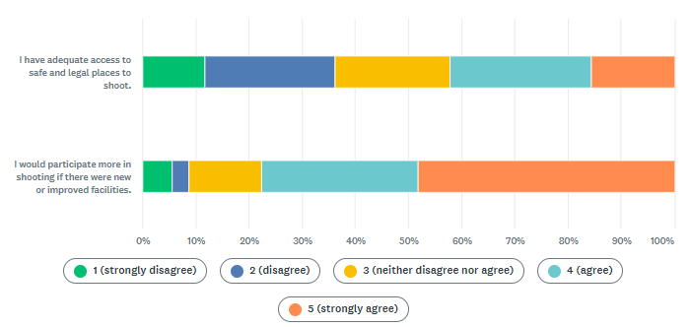
Q6. To what extent do you disagree or agree with the following statements:
11.84%
149
24.40%
307
21.54%
271
26.55%
334
15.66%
197
5.48%
69
13.74%
173
29.55%
372
48.05%
605
3.18%
40

Slide 13
