Slide 1
Club Survey

Slide 2
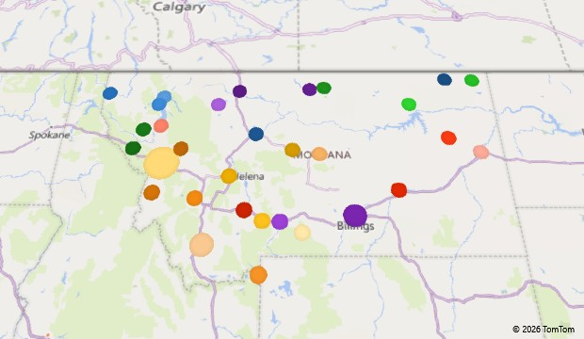
Q3. Location of Club Responses (closest City, County)

Slide 3
[Great Falls Shooting Sports Complex, Shelby Trap Range]
[Whitefish Rifle and Pistol Club]

Slide 5
Other (please specify) responses:
One range owned and operated by club. Second range land owned by FWP but facilities owned and operated by club
Owned by Montana FWP
Member owned (501-c7) and operated
Leased forest service land by public association
Owned by the members, run by a board of directors
DNRC Land Lease and Operated by a nonprofit club
Lease from USFS and operated by a club
Leased land from the city

Slide 6
Other (please specify) responses:
No limit to public citizens purchasing an annual membership
Guest at the camp get to use the range.

Slide 9
[Anaconda Trap Club]

Slide 10
Other (please specify) responses:
Any shooting discipline can be done here. Does not have areas for specific shooting disciplines. Restrictions on ammo and target type.
5-stand
We are looking to convert to a sporting complex and integrate Archery in 2027
ARA (Amarican Rimfire Association) Events
Indoor & Outdoor Smallbore position shooting, Black Powder rifle silhouette, Scoped rifle silhouette, Lever action silhouette, Schuetzen rifle, Muzzle Loader, Indoor postal matches, Target Pistol competition, Service Rifle, 1000 yard benchrest, Women only pistol training
Ladies Shooting Group
Indoor 22/air rifle range
USPSA, IDPA, IPSC, PCSL, Steel Challenge

Slide 11
Other (please specify) responses:
Indoor Pistol Range
Increase length of facility
None
A safety berm between the rifle bench line and the pistol bays and, steel target stands with safety berms behind them
None
Shotgun 5 stand

Slide 12
Other (please specify) responses:
No amenities other than 2 information kiosks. There are a few roads and parking areas at shooting spots
Campsites dry, no power
Restroom vault
Porta potty 4 covered shooting benches
Limited event camping
14 concrete and steel rifle benches
ADA access to most firing lines & restrooms
Our restroom is an outhouse. We also have an enclosed storage trailer

Slide 13
*See Other (please specify) responses on next slide

Slide 14
Q14. Which additional amenities would you most like to add?
Other (please specify) responses:
Would like to construct shooting lanes, backstops, firing line, shooting benches, roads, parking spots
Indoor toilet
Better power supply
Indoor range
replace current water system with well
Site perimeter sound buffering
Sound abatement
None
A key card swipe electric gate access/exit system for the main entrance. Security cameras and a recording system
General building improvements
Sign for advertisement of Shooting days and league times and day that can be seen from fairgrounds and softball fields
Move dirt to improve shooting lanes from a wedding cake to a rectangle
Safety Berms

