Slide 1
FWP Shooting Range Programs
Shooting Range Facilities Task Force
December 18, 2025

Slide 2
FWP Shooting Ranges
Purpose: To acquire, develop, and maintain public shooting ranges.
Funding:
  Federal Pittman-Robertson
  State match from general license dollars
Photo credit: Kristi Powell

Slide 3
FWP Shooting Ranges - Existing
Range Name | Location | Operations/Maintenance | Range Types
Deep Creek Shooting Range | Missoula | Hellgate Civilian Shooters Assoc. | Rifle, pistol
GF Shooting Sports Complex | Great Falls | GFSSC | Rifle, pistol, shotgun
Havre Rifle & Pistol Range | Havre | Havre Rifle & Pistol Club | Rifle, pistol
Whittecar Rifle & Pistol Range | Hamilton | Whittecar Rifle & Pistol Club | Rifle, pistol
Big Arm Archery Range | Kalispell | FWP | Archery
Cabbage Gulch | Anaconda | FWP | Rifle, pistol
Glendive Shooting Range | Glendive | FWP | Rifle
Lone Pine Archery Range | Kalispell | FWP | Archery
Makoshika Archery Range | Glendive | FWP | Archery
Montana WILD Archery Range | Helena | FWP | Archery
Photo credit: Kristi Powell

Slide 4
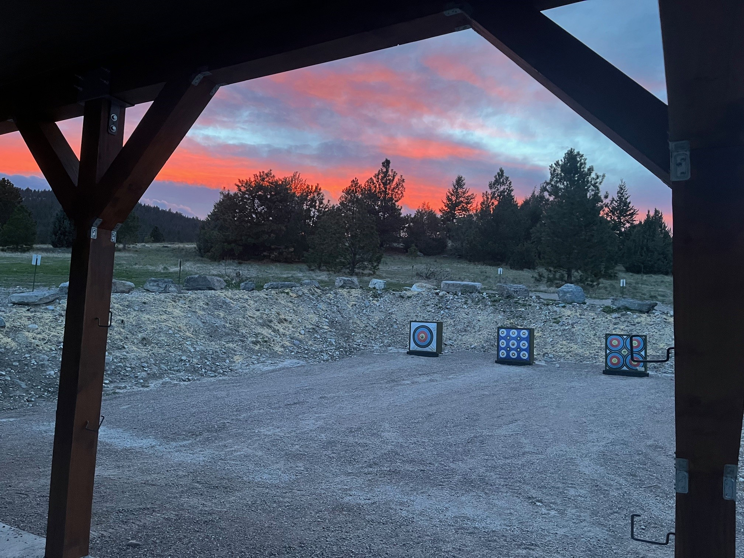
FWP Shooting Ranges – Completed Projects
Lone Pine Archery Range
Big Arm Archery Range
Big Arm Archery Range
Photo credit: Kristi Powell

Slide 5
FWP Shooting Ranges – Planned Projects
Project | Project Description
Logan Public Shooting Range | Acquire easement and develop rifle range, pistol bays, and shotgun area.
Whittecar Rifle & Pistol Range | Demolish and rebuild existing firing line shelter.
Makoshika Archery Range | Replace targets and improve infrastructure.
Glendive Shooting Range | Reconfigure 100-yard rifle range, add long-distance rifle range, and add pistol range with shelter.
Glasgow Shooting Range | Acquire lease and develop 100-yard rifle range, pistol range, and archery range.
Tally Lake Shooting Range | Acquire lease and develop 200-yard rifle range, pistol bay, parking area, and latrine.
Photo credit: Kristi Powell

Slide 6
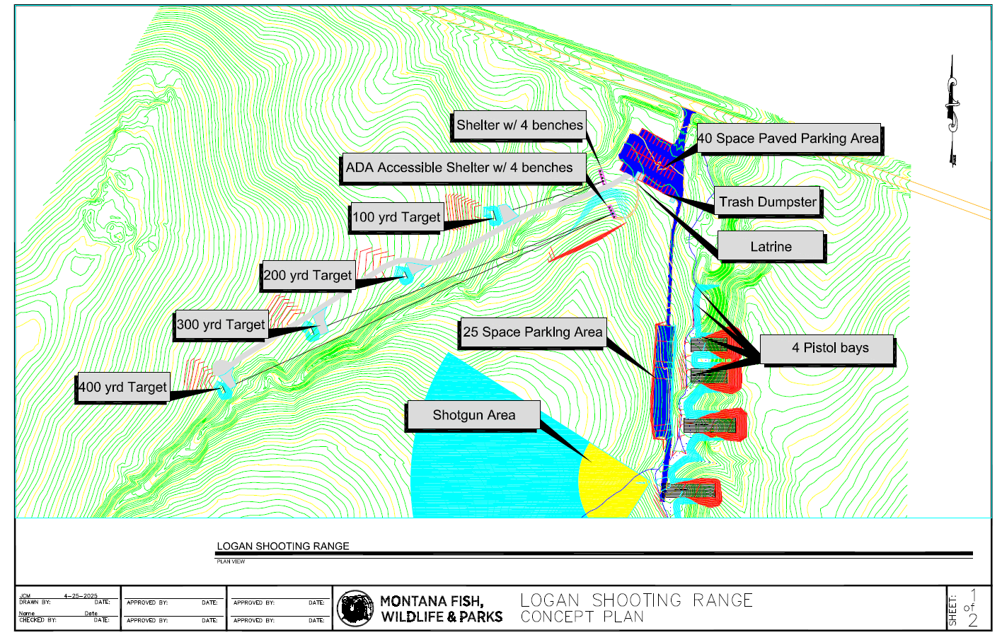
Logan Public Shooting Range Project

Slide 7
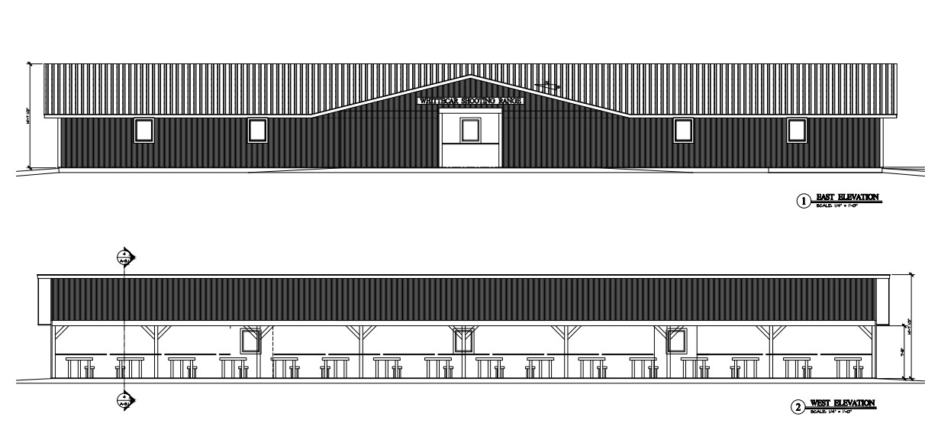
Whittecar Rifle & Pistol Range Project
Photo credit: Kristi Powell
Whittecar Rifle & Pistol Range – Building Concept

Slide 8
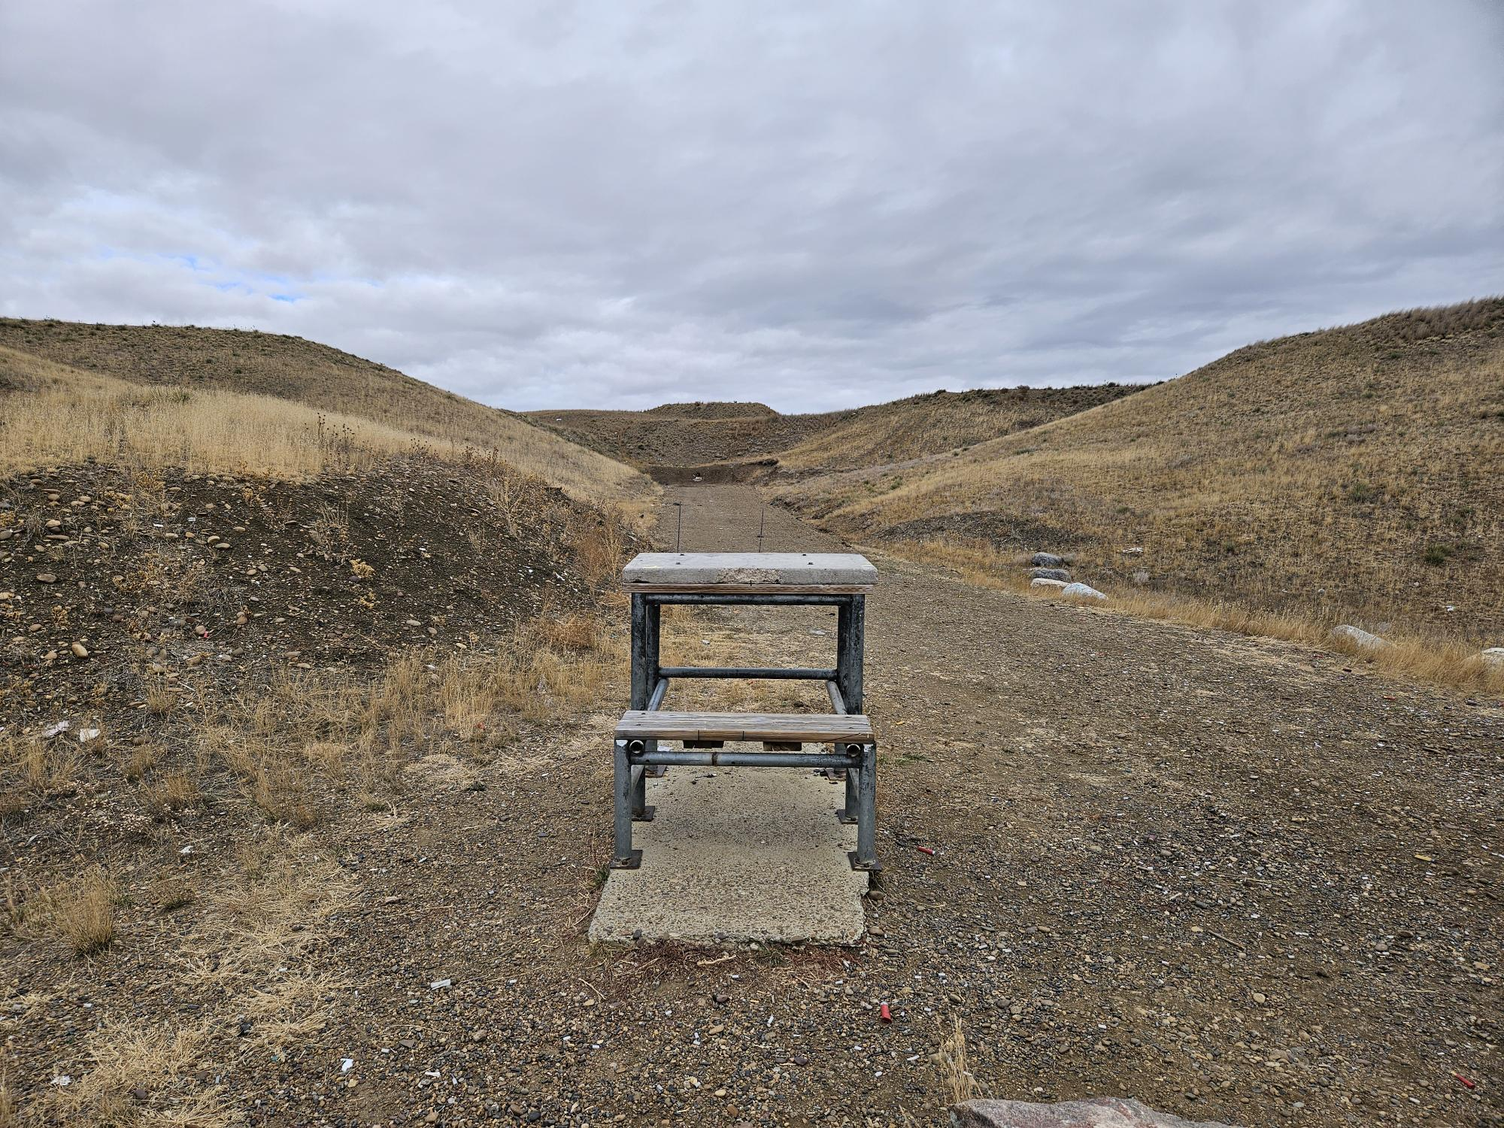
Glasgow Shooting Range Project
Photo credit: Kristi Powell

Slide 9
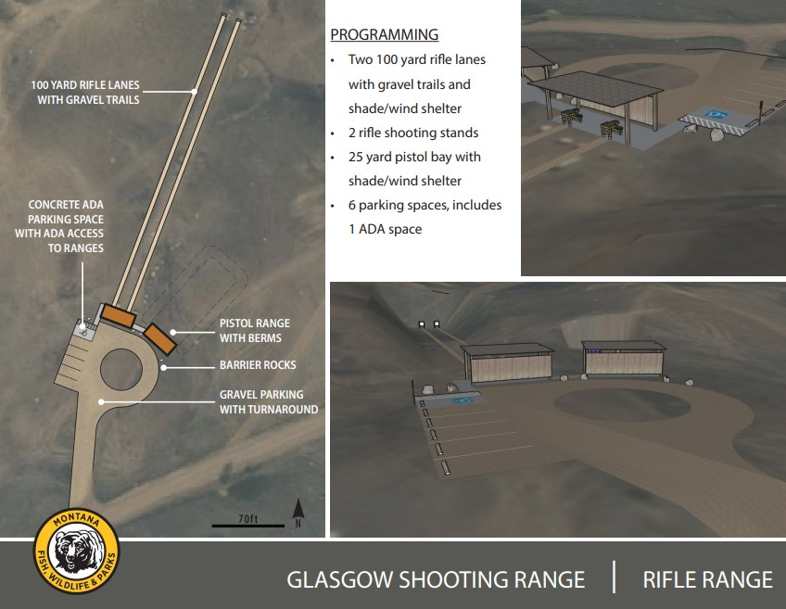

Slide 10
FWP Shooting Ranges – Key Takeaways
More steps to projects that require acquisition.
Need to plan for long-term maintenance and operations.
Photo credit: Kristi Powell

Slide 11
Montana Shooting Range Grant Program
Purpose: “…for the establishment and improvement of a system of shooting ranges throughout Montana” (87-1-276, MCA)
Statute: 87-1-276 through 87-1-279
ARM: 12.10.103 through 12.10.112
Program Guidelines
Photo credit: Kristi Powell

Slide 12
Montana Shooting Range Grant Program
Eligible Applicants:
  Private shooting club
  Private organization
  Unit of local government
  School district
Eligible Projects:
  Purchase of real property
  Earthwork
  Fixed improvements
  Reasonable grant application expenses
Photo credit: Kristi Powell

Slide 13
Montana Shooting Range Grant Program
Funding:
  State hunting license dollars
  $800,000 appropriated for 2027 biennium
  Applicants must provide 1:1 match
Photo credit: Kristi Powell

Slide 14
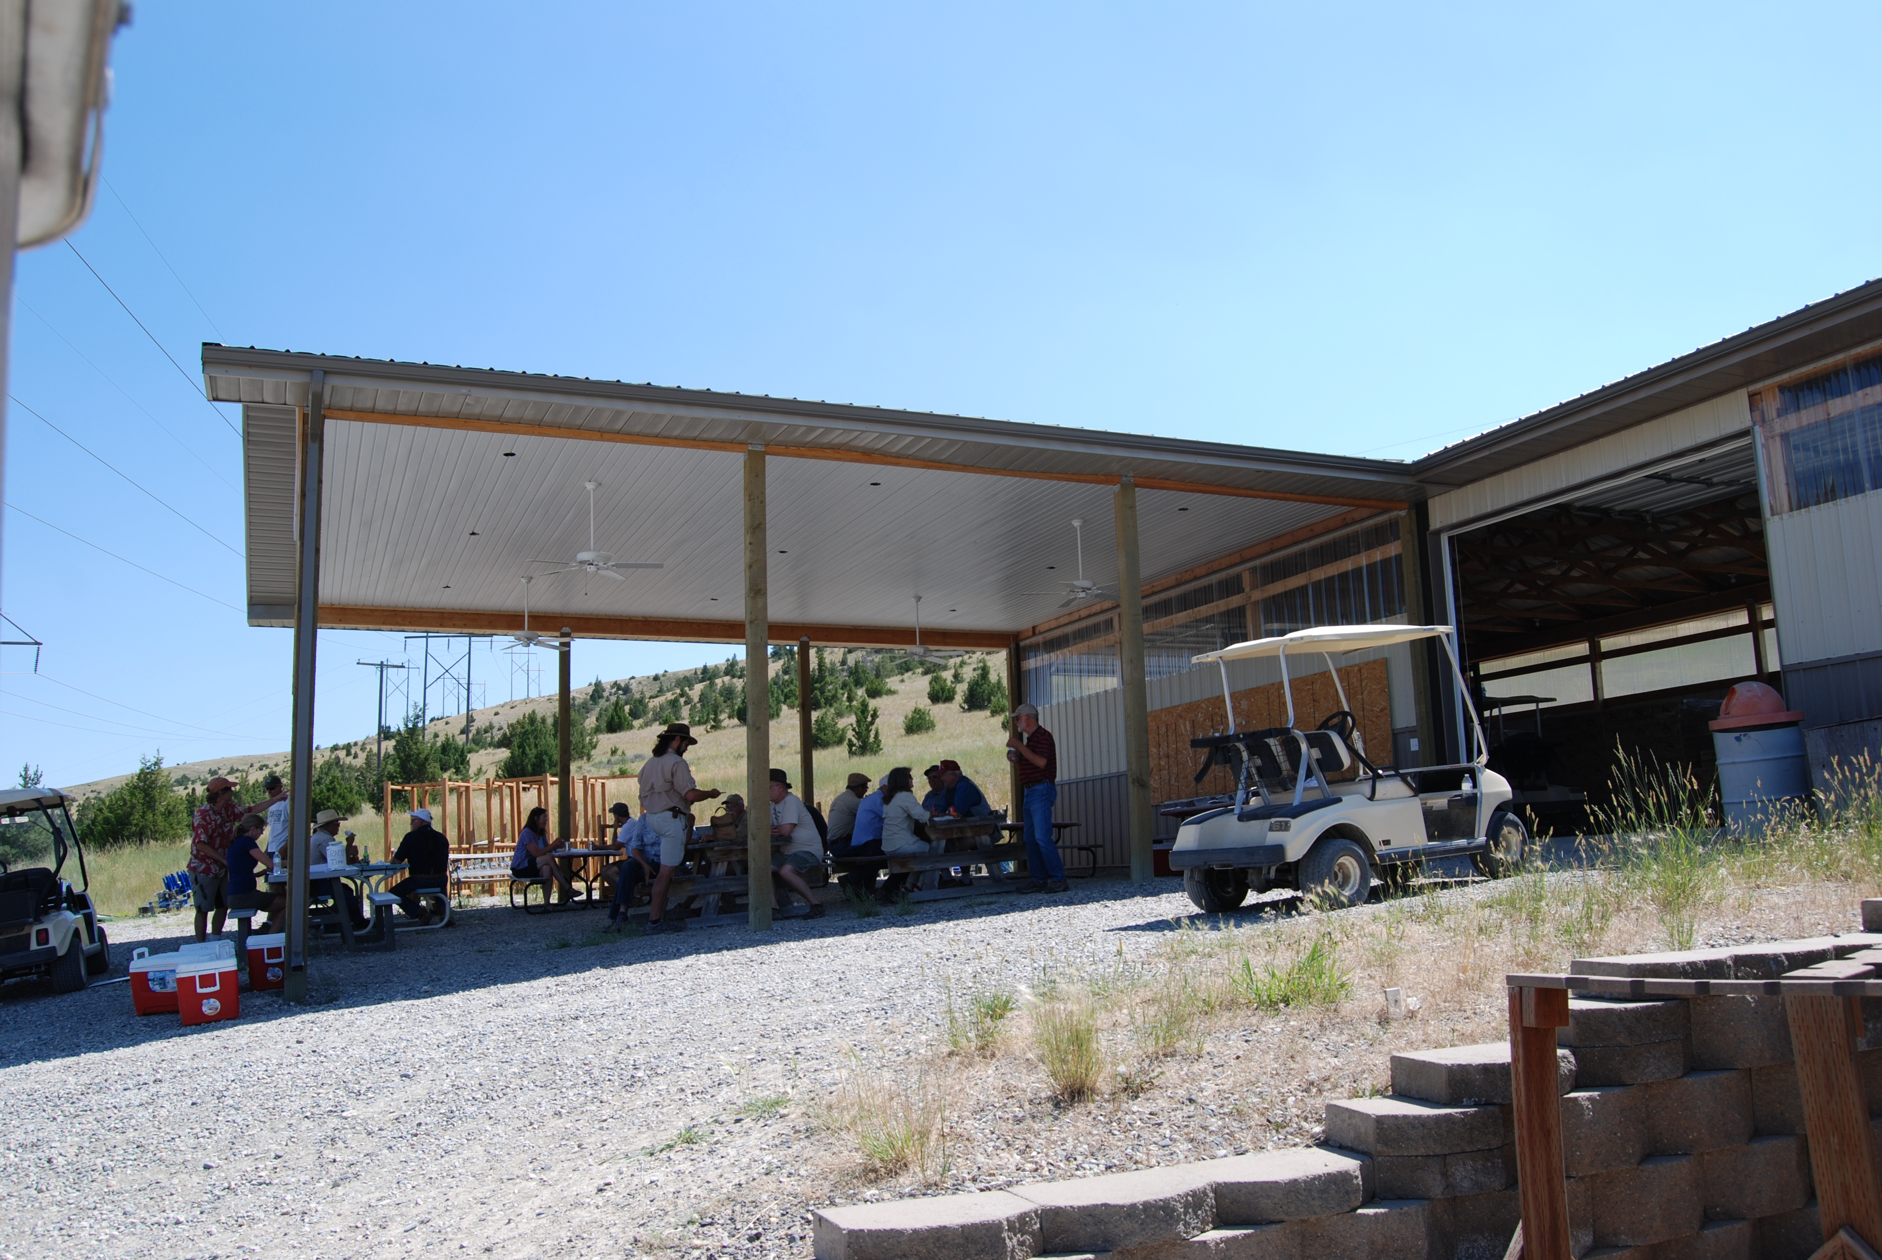
Montana Shooting Range Grant Program
FY2026 Projects:
  $400K awarded
  15 projects
  $27K average award
Photo credit: Kristi Powell
Gallatin Sporting Clays

Slide 15
Montana Shooting Range Grant Program
FY2026 Example Projects
Grantee | Project Description | Grant Award
Bigfork Gun Club | Improve 300-yard range road, parking, and landscaping. | $23,956.50
Billings Rod & Gun Club | Construct archery range shelter and improve walking path. | $50,406.60
Great Falls Trap and Skeet Club | Three new trap machines | $13,747.50
Hi-Line Events Center Inc. | Improve trap field range. | $39,456.99
Prickly Pear Sportsmen’s Assoc. | Install lighting, security cameras, and wastewater collection. | $22,504.00
West Yellowstone Shooting Sports Assoc. | Improve range pathway and handgun range. | $1,950.00
Photo credit: Kristi Powell

