Slide 1
Montana Fish, Wildlife and Parks
Eligible Shooting Range Funding Sources

Slide 2
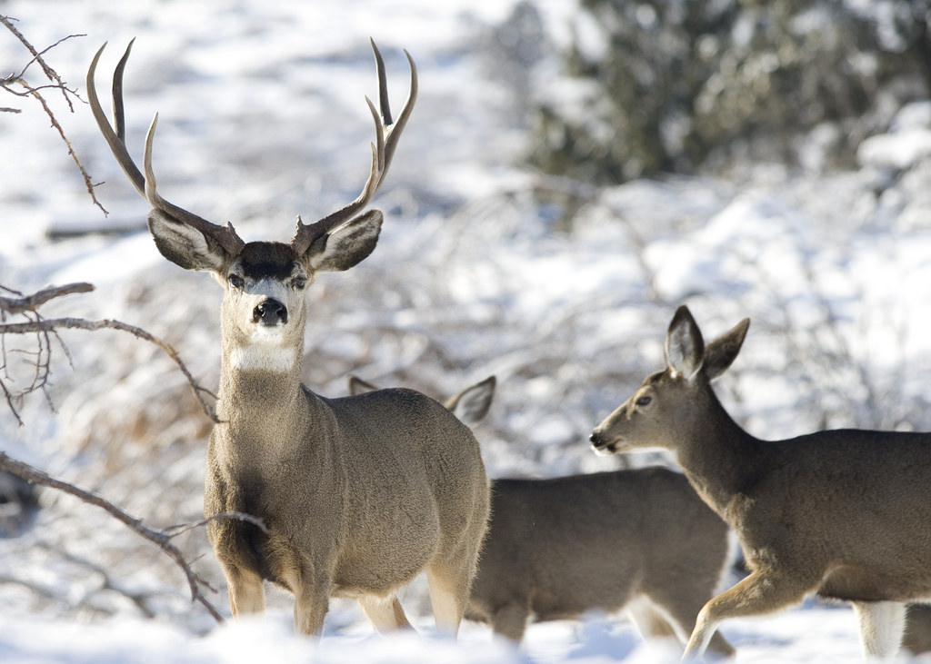
General License Fund - 02409

Slide 3
ASSOCIATED MCAS
Assent To Pittman-Robertson Act -- Authority Of Department
87-1-708. Assent to Pittman-Robertson Act -- authority of department. (1) The congress of the United States having passed an act which was approved on September 2, 1937, and which is known as 50 Federal Statutes 917 of the acts of congress, wherein it is, among other things, provided that "no money apportioned under this chapter to any state shall be expended therein until its legislature or other state agency authorized by the state constitution to make laws governing the conservation of wildlife shall have assented to the provisions of this chapter and shall have passed laws for the conservation of wildlife, which shall include a prohibition against the diversion of license fees paid by hunters for any other purpose than the administration of said department", and since the moneys referred to in the act of congress are collected in part from the hunters of this state and will not be returned to the state of Montana except the state of Montana does assent to the act, now, therefore, the state of Montana does assent to the provisions of said act of congress which is commonly known as the Pittman-Robertson bill, but such assent is with the express reservations enumerated in this section, 87-1-709, and 87-1-710. The state of Montana does not by the passage of these sections or by the consent herein given surrender to the congress of the United States or any department of the government of the United States any of those rights which are retained by the people of the state of Montana or the state of Montana and which are guaranteed to them by the 9th and 10th amendments to the constitution of the United States, nor shall this section, 87-1-709, and 87-1-710 in any manner or at all be construed or held to be the state of Montana's consent to amending the constitution of the United States in any manner or at all relative to its rights. Provided, however, that nothing herein shall be construed as giving consent to the purchase or acquisition of lands by the United States or by any of its departments or officers for establishing migratory bird sanctuaries under the Migratory Bird Conservation Act of the United States or otherwise and that the title to all lands acquired under the provisions of this section, 87-1-709, and 87-1-710 for wildlife projects and projects constructed thereon shall be and remain in the state of Montana.
(2) The department is hereby authorized to perform such acts as may be necessary to the establishment and conduct of wildlife projects as defined and authorized by said act of congress, provided every project initiated under the provisions of this section, 87-1-709, and 87-1-710 shall be under the supervision of the department, and no laws or rules or regulations shall be passed, made, or established governing the game or fur-bearing animals or the taking or capturing of the same in any such projects except they be in conformity with the laws of the state of Montana or rules promulgated by the department. The title to all lands acquired or projects created from lands purchased or acquired by deed or gift shall vest in, be, and remain in the state of Montana and shall be operated and maintained by it in accordance with the laws of the state of Montana. The department shall have no power to accept benefits unless the projects created or established shall wholly and permanently belong to the state of Montana, except as provided in 87-1-709. Nothing contained herein shall prevent the department from entering into cooperative agreements on federally owned lands as provided for herein.
History: (1)En. Sec. 1, Ch. 167, L. 1941; Sec. 26-1122, R.C.M. 1947; (2)En. Sec. 2, Ch. 167, L. 1941; amd. Sec. 1, Ch. 80, L. 1951; amd. Sec. 13, Ch. 417, L. 1977; Sec. 26-1123, R.C.M. 1947; R.C.M. 1947, 26-1122, 26-1123.

Slide 4
ASSOCIATED MCAS
Cooperation With United States For Wildlife Restoration
87-1-709. Cooperation with United States for wildlife restoration. The department, in the name of the state and with the approval of the governor, shall have the power to enter into the cooperative agreements on federally owned lands with the government of the United States or some department or bureau thereof or with an individual or individuals, private corporations, or partnerships for the purpose of carrying on any wildlife restoration project and established under the provisions of said Pittman-Robertson Act of the congress of the United States and shall have the power to acquire by purchase, either for cash or upon installments, or lease or by gift or devise, either individually or in conjunction with the government of the United States or some department or bureau thereof, such lands or other property or interests therein as may be necessary for the purpose of carrying on any wildlife restoration project created and established under the provisions of said Pittman-Robertson Act of the congress of the United States. The state of Montana does reserve to itself, acting through its legislature, the right to direct the department to abandon any wildlife restoration projects created and established as the state of Montana may in its judgment think proper, provided the department shall have no power to exercise the right of eminent domain to condemn or acquire property under 87-1-708 through 87-1-710.
History: En. Sec. 3, Ch. 167, L. 1941; amd. Sec. 2, Ch. 80, L. 1951; amd. Sec. 13, Ch. 417, L. 1977; R.C.M. 1947, 26-1124.

Slide 5
ASSOCIATED MCAS
Use Of Hunters' License Fees For Department Purposes Only
87-1-710. Use of hunters' license fees for department purposes only. In accordance with the other requirement of said act of congress, it shall be the law of this state, so long as this assent shall be unrepealed, that no license fees paid by hunters in the state of Montana shall be used or taken for any other purpose than the administration and use of the department.

Slide 6
Budget Planning Matrix –
What it is and what it is used for?

Slide 7
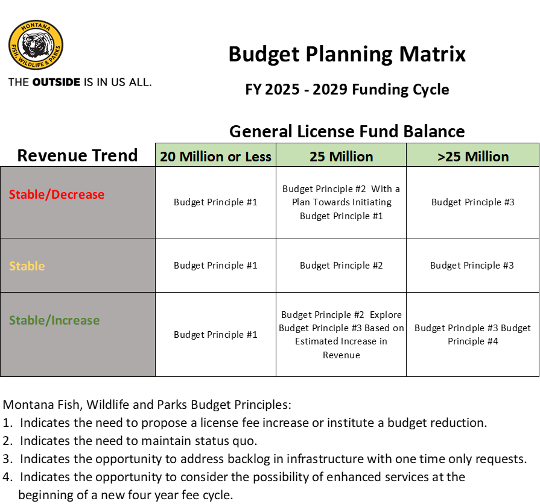
Used to make EPP decisions for base budget expansion
Used to identify a need for programmatic cuts
Used to identify opportunity to request OTO or address deferred maintenance
Need for fee license increase

Slide 8
FY25 General License Revenue

Slide 9
Known Changes to FY27 Revenue

Slide 10
Community Shooting Range Grant Program – Funded with General License Dollars

Slide 11
Program moved from Base HB 2 to Long Term HB 5 and increased to $400,000 per year

Slide 12

Federal Pittman-Robertson (PR) Fund - 03097

Slide 13
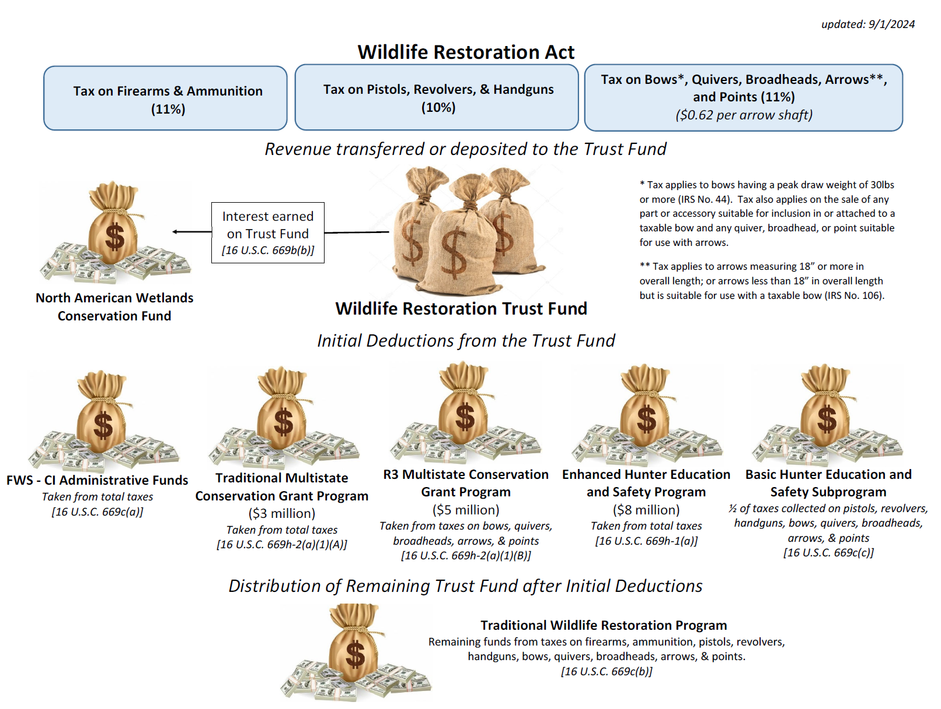

Slide 14
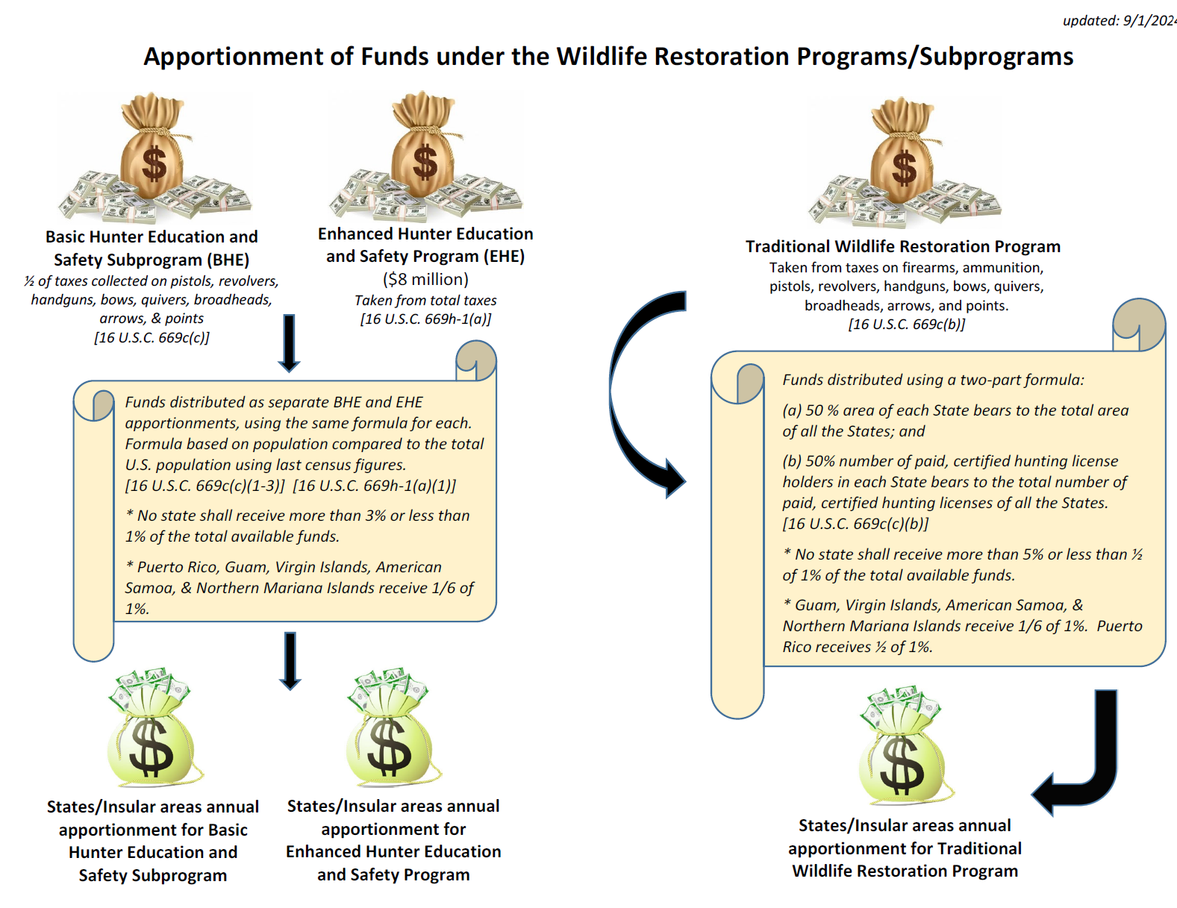

Slide 15
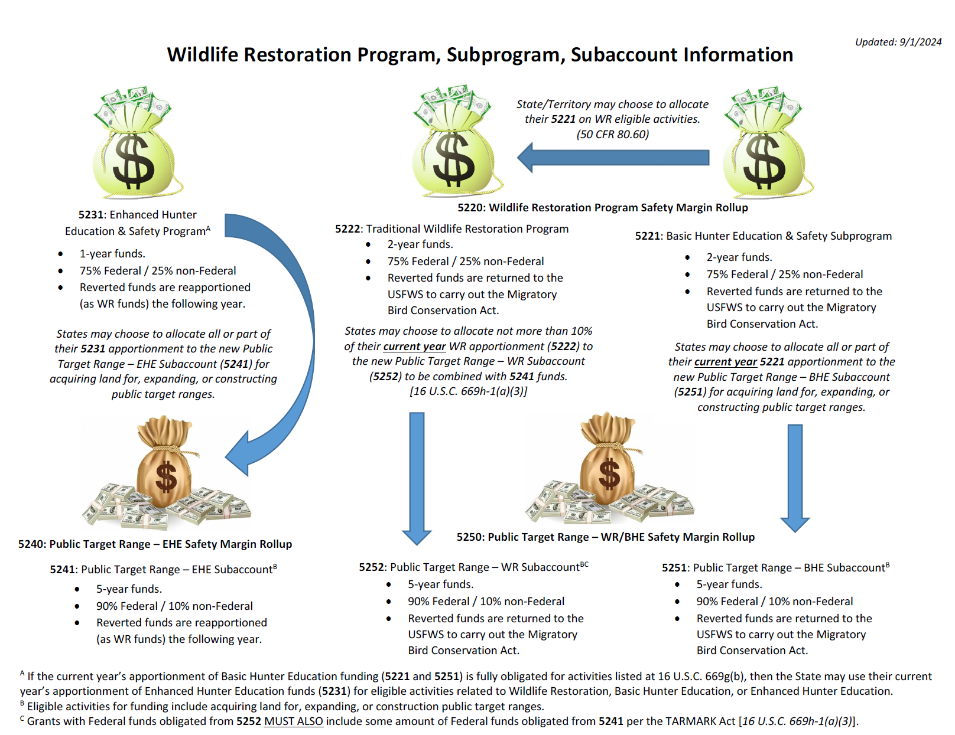

Slide 16
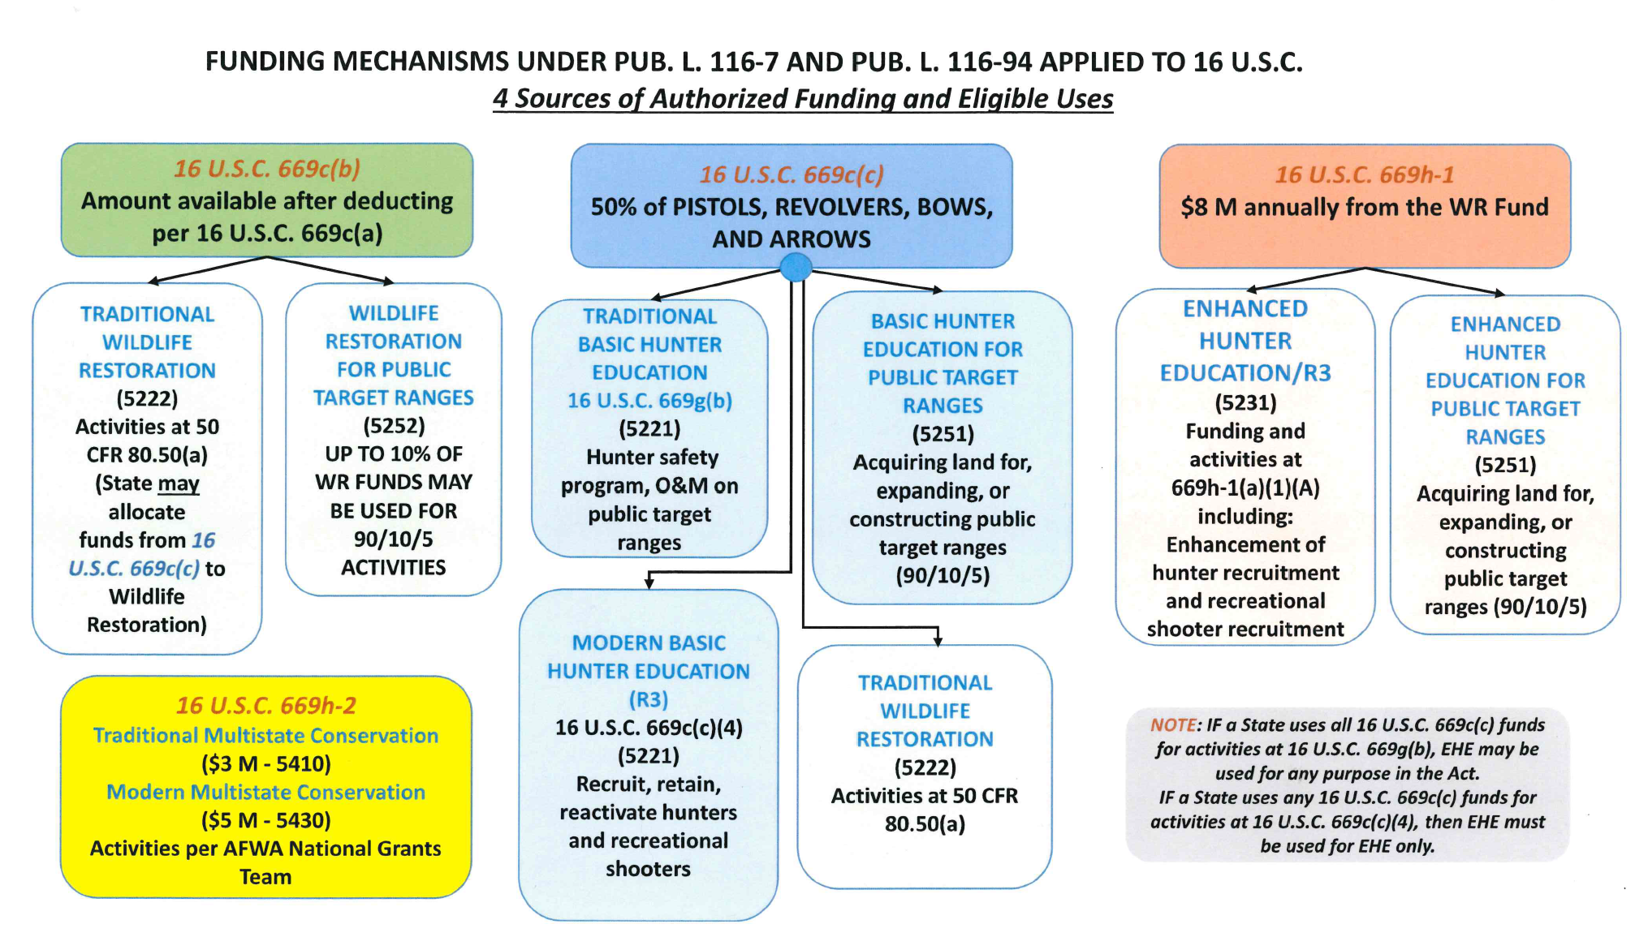

Slide 17
FWP Traditional Wildlife Restoration Information

Slide 18
FWP Basic Hunter Education Information

Slide 19
FWP Enhanced Hunter Education Information

Slide 20
FWP Public Target Range Information

Slide 21
FWP SHOOTING RANGE PROGRAM
Current HB 5 Authority

Slide 22
FWP SHOOTING RANGE PROGRAM
Budgeted Project List

Slide 23

QUESTIONS

