Slide 1
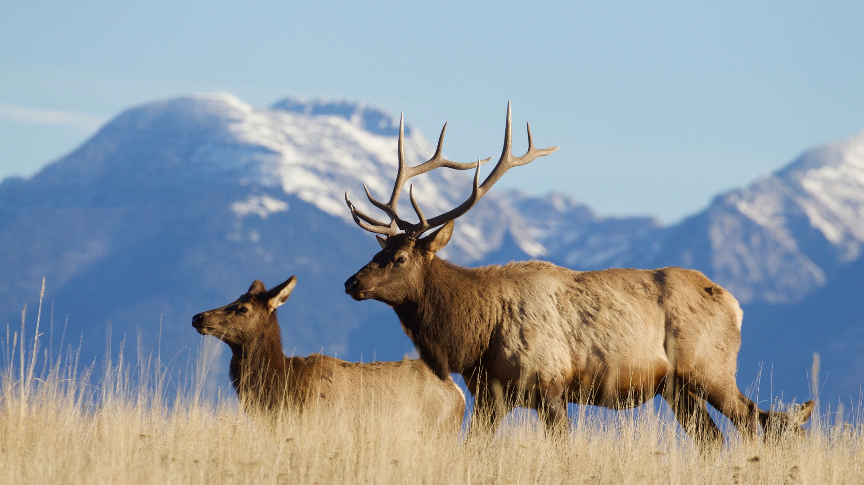
Landowner Preference –
An Overview
Montana Fish, Wildlife & Parks
1

Slide 2
What is Landowner Preference?
Landowner Preference (LOP) creates a separate pool of licenses or permits that are drawn first, before the general drawing occurs.
  15% of an opportunity’s quota.
  Leftover licenses are added to the general drawing’s quota.
  Only applies to first-choice opportunities.
LOP does not guarantee a successful draw but does typically increase the odds.
The 15% pool is shared between resident and nonresident applicants, but nonresident applicants are capped at 10% for the entire drawing. (Landowner & General drawing)
2

Slide 3
Types & Requirements
Landowner Preference – Deer & Antelope (MCA 87-2-735)
  Applies to Deer B, Deer Permit, Antelope, Antelope 900-20, & Antelope B drawings.
  Requires 160 acres or more of real property that is primarily used for agricultural purposes within the applied for hunting district.
Landowner Preference – Elk B (MCA 87-2-516)
  Requires 640 acres or more of contiguous land, at least some of which is used by elk, within the applied for hunting district.
  160 acres or more of contiguous land in agricultural production on which the department has documented game damage within the last two years also qualifies.
Landowner Preference – Elk Permit (MCA 87-2-705)
  Requires 640 acres or more of contiguous land, at least some of which is used by elk, within the applied for hunting district.
3

Slide 4
Types & Requirements (Cont’d)
Nonresident Priority Pool (MCA 87-2-714)
  Applies only to nonresident Big Game & Elk Combination (Class B-10) license drawings (17,000 * .15 = 2,550 licenses available).
  Valid only on the landowner’s property
  Requires a minimum of 2,500 contiguous acres owned in fee title.
  For each additional 2,500 contiguous acres owned, the landowner may designate priority to an immediate family member (up to 5 per landowner).
  Landowners who qualify for this program and were enrolled in an FWP administered hunting access program in the previous license year are eligible to purchase an additional elk or deer bonus point.
4

Slide 5

Who can receive priority?
Landowner Preference – Deer, Elk, and Antelope
  A landowner themselves
  An immediate family member of a landowner
  An employee of the landowner
Nonresident Priority Pool
  A landowner themselves
  An immediate family member of a landowner
5

Slide 6
Who can receive priority? (Cont’d)
Landowner Preference – Deer, Elk, and Antelope
  One person per claimed property/license type/year.
  For example, each year, one person may claim the elk permit, and another may claim the antelope, but two people cannot both claim the elk permit.
Nonresident Priority Pool
  Up to five per claimed property (dependent upon acreage). One additional person for every 2,500 contiguous acres.
2,500-4,999 acres | 5,000-7,499 acres | 7,500-9,999 acres | 10,000-12,499 acres | 12,500+ acres
1 person | Up to 2 people | Up to 3 people | Up to 4 people | Up to 5 people
6

Slide 7
Application Process
Applicant applies for desired license or permit through FWP’s Online Licensing Service.
Applicant mails/emails completed form and required supplemental documentation to FWP Licensing.
FWP Licensing reviews and confirms the following:
  A license or permit application has been submitted online.
  Property being claimed meets or exceeds the applicable acreage requirements.
  Property being claimed is within the hunting district(s) where the applicant’s first-choice opportunity is valid.
  Ownership of the property being claimed can be verified using a combination of MT Cadastral Survey, a copy of the property deed or a tax bill (and signatory authority documentation when necessary).
  Property being claimed is historically used by elk (when applicable).
FWP Licensing either approves the application or sends a denial letter to the applicant describing the reason for rejection.
7

Slide 8
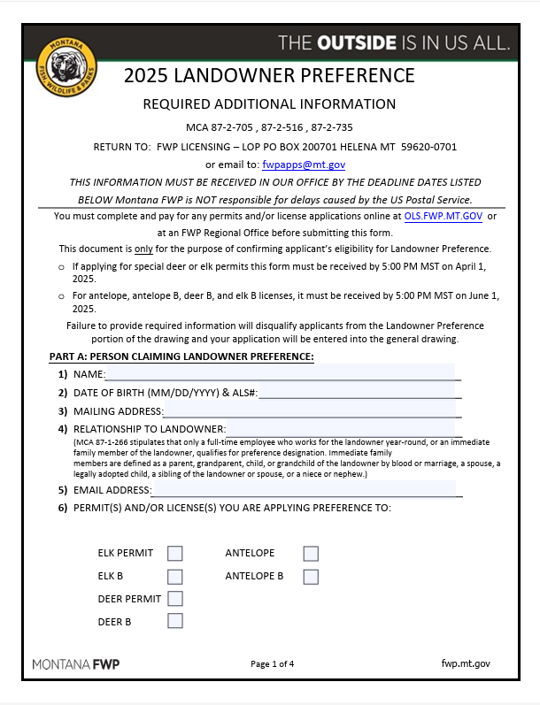
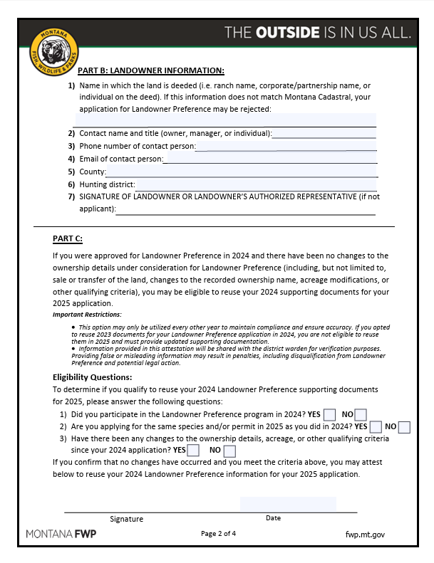
Application Processes
8

Slide 9
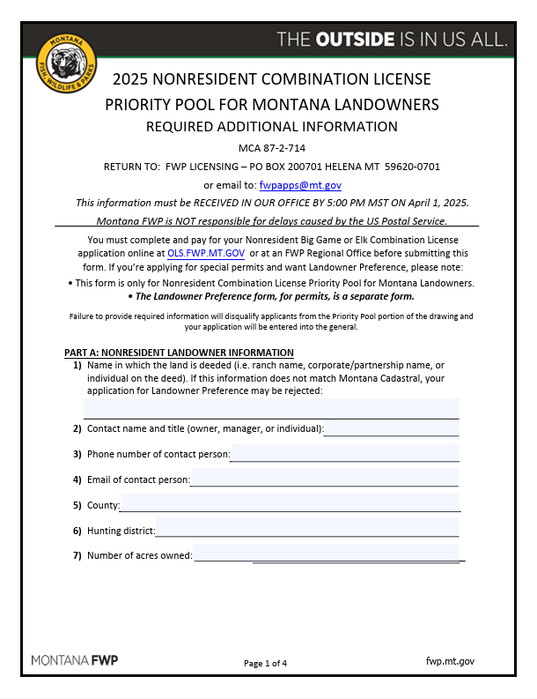
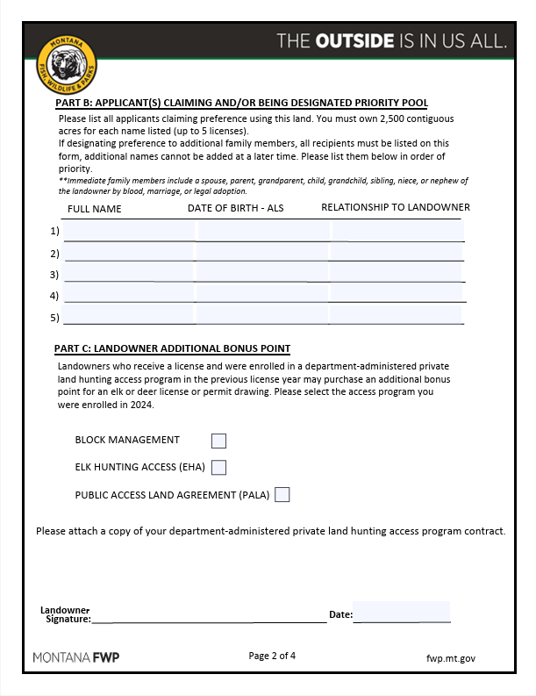
Application Processes (cont'd)
9

Slide 10
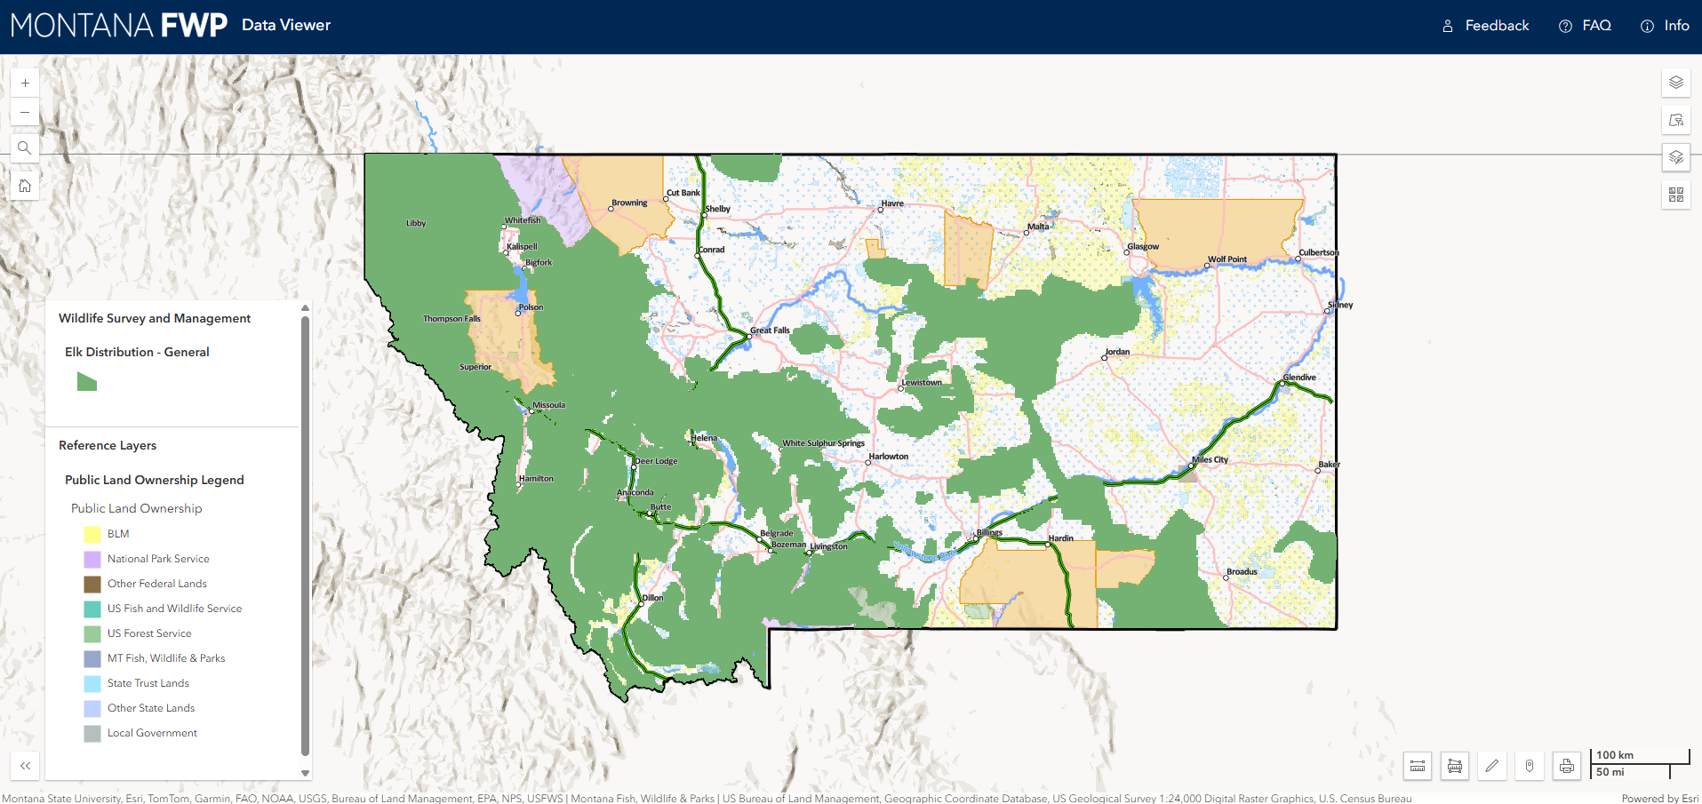
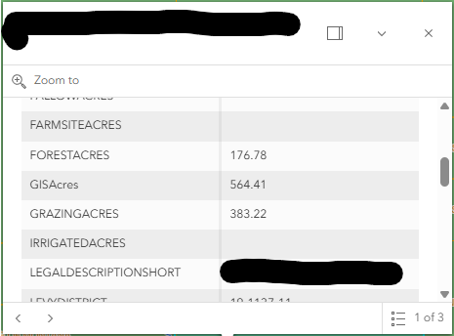
Application Processes (Cont’d)
FWP Elk Layer (Green) – General Elk Distribution.
MT Cadastral Data – Used to verify acreage, hunting district, and land ownership.
10

Slide 11
Recent Legislative Action
House Bill 146 (2023 – Passed):
  Established statutory authority and eligibility requirements for landowner preference on deer and antelope licenses (MCA 87-2-735).
House Bill 635 (2023 – Passed):
  Established statutory authority and eligibility requirements for the Nonresident Priority Pool program (MCA 87-2-714).
House Bill 519 (2025 – Tabled):
  Would have repealed the Nonresident Priority Pool program in its entirety (MCA 87-2-714).
11

Slide 12
Recent Legislative Action (cont'd)
Senate Bill 235 (2025 - Passed):
  Affects requirements for Elk B Licenses and Elk Permits.
  Removes language which previously allowed property under a contract to purchase to qualify for Landowner Preference.
  Adds language which clarifies that land usage by elk must be documented by FWP to qualify for Landowner Preference (elk layer).
  Adds definitions of "employee" for the purposes of designating preference.
    Elk B: "employee" means a person who is paid by a landowner to do work and who has state or federal taxes withheld from the payment for the work provided.
    Elk Permit: an employee of the landowner who works full time and year-round as part of the active farm or ranch operation.
12

Slide 13
Current Challenges
Dividing property into multiple parcels/entities can allow multiple individuals to legally claim landowner preference.
Permits or licenses obtained using landowner preference are valid throughout the hunting district not required to be used only on the landowner’s property.
Difficulty identifying and preventing multiple applicants from claiming landowner preference on the same property.
Multiple guiding statutes, definitions, and requirements across programs can cause confusion.
Landowners and their designees are not guaranteed a license or permit, especially in areas with higher concentrations of private land.
13

Slide 14
Drawing Example – Landowner Preference
General Information
Opportunity | Overall Quota | Landowner Quota (15%) | Max Nonresident Quota (10%)
799-20 Elk Permit | 280 | 42 | 28
Landowner Portion
Res. Applicants | Res. Successful | NR Applicants | NR Successful | Total Successful | Remaining Total Quota | Remaining (Max) NR Quota
122 | 36 | 20 | 6 | 42 | 238 | 22
General Portion
Res. Applicants | Res. Successful | NR Applicants | NR Successful | Total Successful | Remaining Total Quota | Remaining (Max) NR Quota
3,139 | 216 | 513 | 22 | 238 | 0 | 0
14

Slide 15
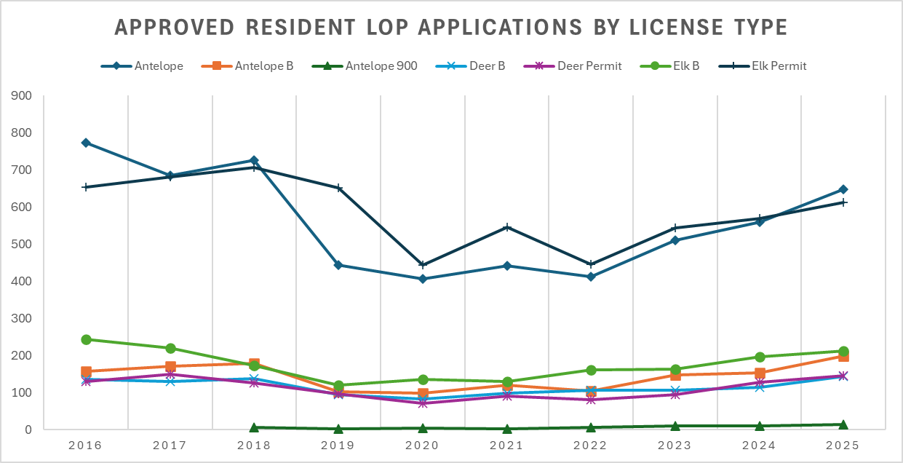
Resident LOP Application Numbers
Resident LOP Application Numbers
10-year averages (2016-2025):
  Antelope: 560
  Antelope B: 143
  Antelope 900 (2018-2025)*: 7
  Deer B: 115
  Deer Permit: 111
  Elk B: 176
  Elk Permit: 585
15

Slide 16
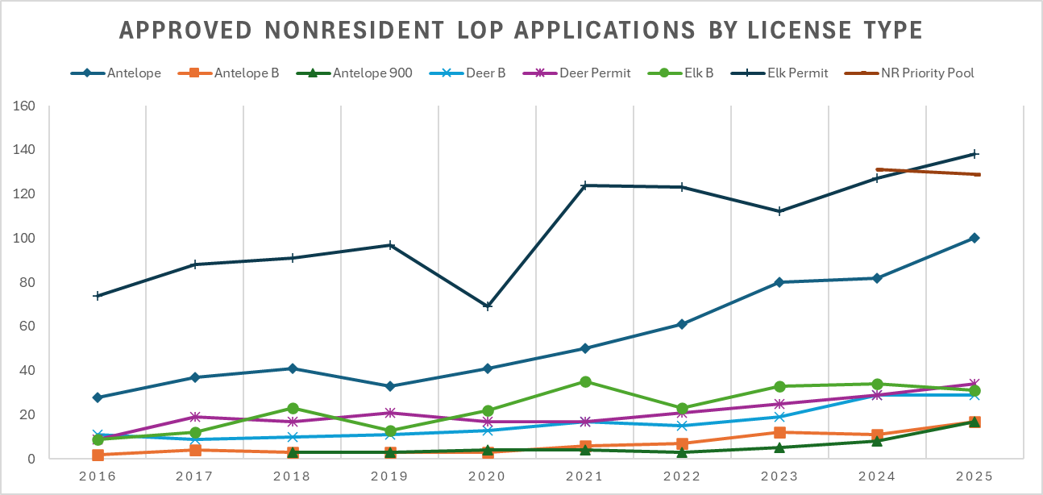
Nonresident LOP Application Numbers
10-year averages (2016-2025):
  Antelope: 55
  Antelope B: 7
  Antelope 900 (2018-2025)*: 6
  Deer B: 16
  Deer Permit: 21
  Elk B: 24
  Elk Permit: 104
  Priority Pool (2024-2025)*: 130
16

Slide 17
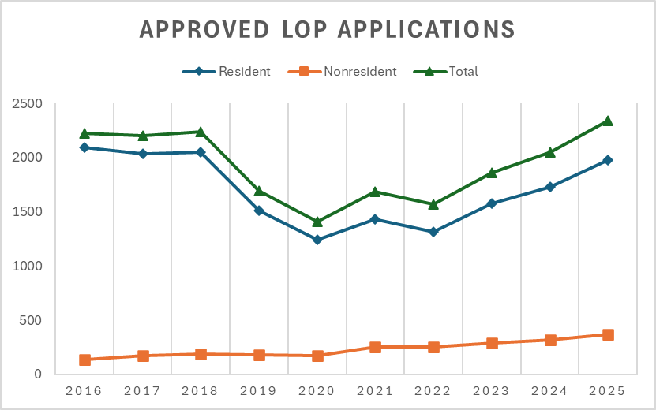
Overall LOP Application Numbers
Differences between 2016 & 2025 (10 years):
  Resident: -117
  Nonresident: +233
  Total: +116
10-year averages (2016-2025):
  Resident: 1,696 applications
  Nonresident: 232 applications
  Total: 1,927 applications
*2024 & 2025 nonresident numbers exclude Priority Pool to avoid data skewing. This graph does not represent unique individuals, but rather the overall number of license or permit applications approved for LOP.
17

Slide 18
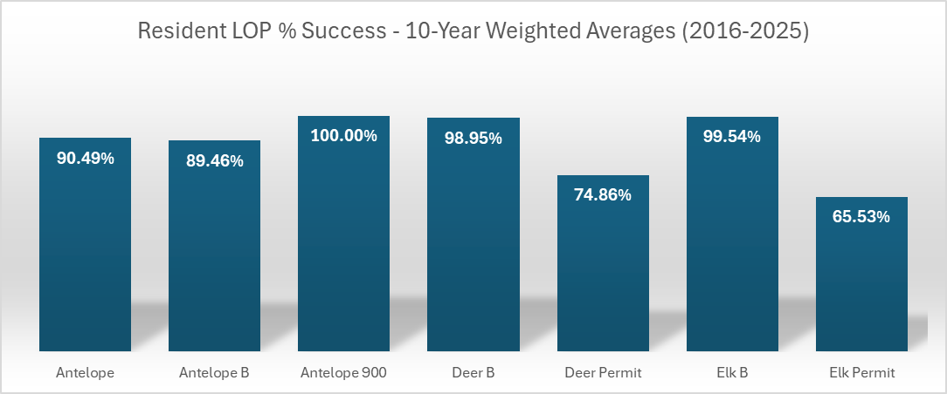
Resident LOP Drawing Success
# Successful Resident LOP applications / # Resident LOP applications = Resident LOP % Success
*Antelope 900 data is only available from 2018-2025.
18

Slide 19
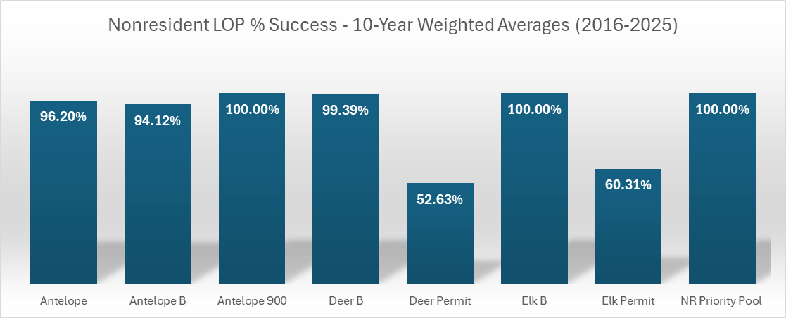
Nonresident LOP Drawing Success
# Successful Nonresident LOP applications / # Nonresident LOP applications = Nonresident LOP % Success
*Nonresident elk permit and deer permit applications are dependent upon successful drawing for a nonresident combination license. The figure above includes applications in which the applicant did not draw their combination license and thus were never entered into the permit drawing.
*Antelope 900 data is only available from 2018-2025. NR Priority Pool data is only available from 2024-2025.
19

Slide 20
Nonresident Elk & Deer Permit Success
Nonresidents must first draw their general elk or general deer license before they are eligible to enter the deer or elk permit drawings.
  This means that not every elk permit or deer permit application which is approved for LOP enters the permit drawings.
Of those nonresident applications approved for LOP:
  Elk Permit: 76.32% are entered on average over the past 10 years.
  Deer Permit: 77.03% are entered on average over the past 10 years.
Of those nonresident LOP applications that entered the permit drawings:
  Elk Permit: 79.02% were successful on average over the past 10 years.
  Deer Permit: 68.32% were successful on average over the past 10 years.
20

Slide 21
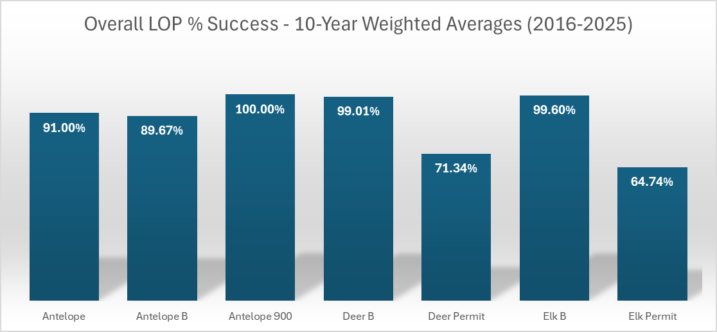
Overall LOP Drawing Success
# Successful LOP applications / # LOP applications = LOP % Success
*Antelope 900 data is only available from 2018-2025.
21

Slide 22
Summary
LOP applications have been increasing overall since 2020.
Applicants are using LOP for Antelope & Elk Permit drawings the most.
Success rates are generally high for LOP applicants but are the lowest for Deer and Elk Permit drawings.
Nonresident Priority Pool applications have been far fewer than the 2,550 quota, guaranteeing a successful draw in its first two years since implementation.
A contract to purchase no longer qualifies a person to use LOP for elk drawings – property must now be owned.
Legislation commonly changes (or attempts to change) the framework of these programs.
Although the programs work as they were intended, various challenges still exist for the department and for landowners.
22

