Slide 1
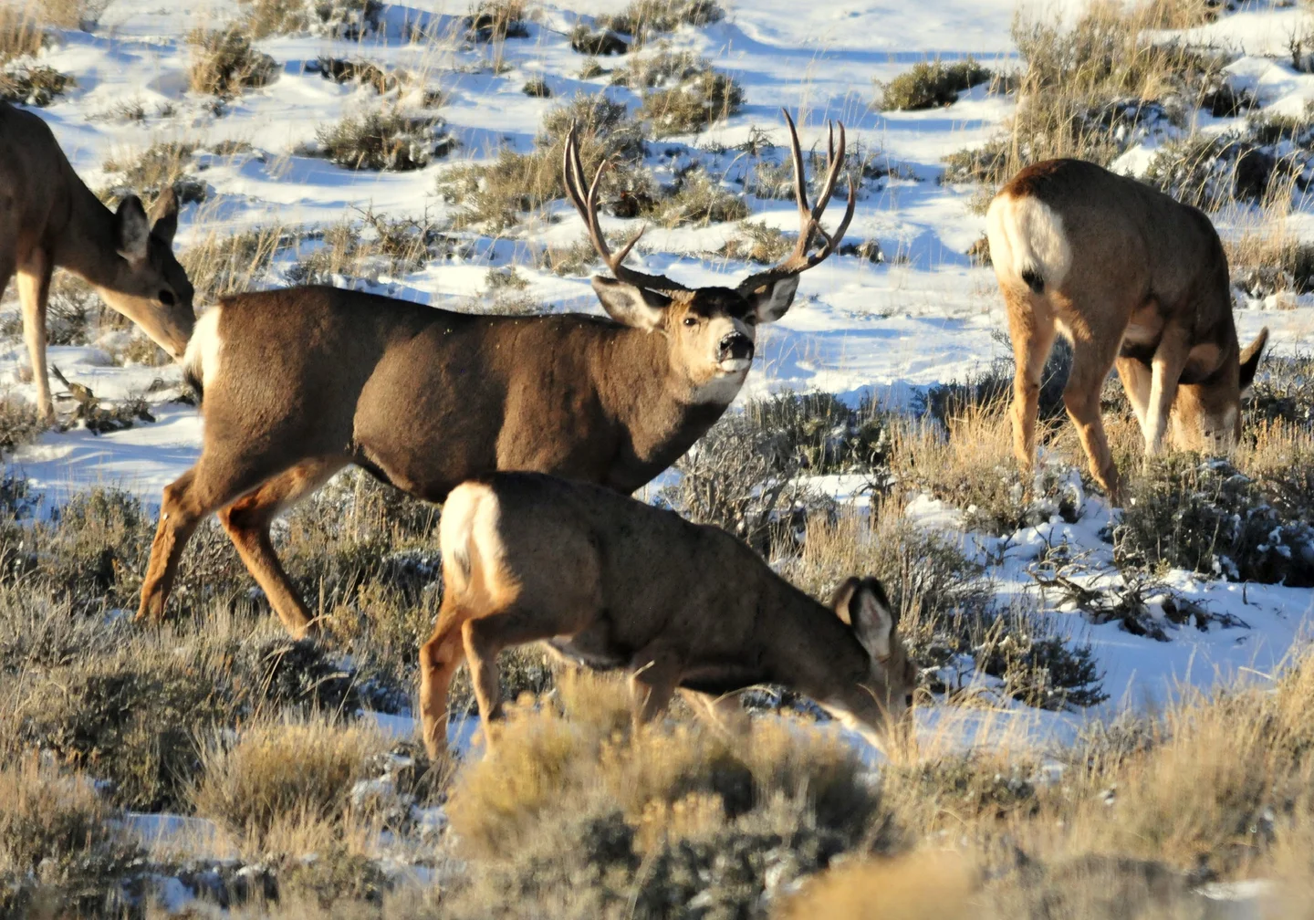
2022-23 Montana Mule Deer Hunter Survey
...Selected Statewide
Results

Slide 2
Survey methods...
Scientific mail back survey. Probability based sampling.
N=5000 randomly selected resident deer license holders pulled from the pool of all resident deer license holders for the 2022-23 season (as identified from FWP’s ALS database). Sample size allows regional analysis of data for key questions.
Two mailings of the survey: (1) initial mailing in late October; (2) replacement mailing to sent to nonrespondents 4-5 weeks after the initial mailing.
Successfully delivered to N=4881 resident deer license holders. N=2005 respondents.
41 percent survey response rate.
78 percent of respondents reported they have hunted mule deer in Montana during the past five years (they are the focus of the survey)
N=800 nonresidents
(795, 350)
(44%)
(85%)
Notes:
Resident license holders (a little over 137,000); nonresidents (a little over 28,000). We would only need 350 respondents for both the resident/nonresident surveys to provide estimates at the 95 percent confidence level (with no more than plus/minus 5 percent sampling error). Considering this, we significantly oversampled for the resident survey (which resulted in a little over two thousand survey respondents).

Slide 3
Importance of mule deer hunting in Montana
(21%)
(60%)
(17%)
No significant change from a nearly identical resident mule deer hunter survey conducted in 2011.

Slide 4
Reasons for hunting mule deer in Montana
To enjoy nature and outdoors (93%)
To get venison for eating (76%)...up from 69% in 2011
To do something with my family (75%)
To be with friends who have similar interests (73%)
To experience solitude (72%)
To develop my skills and abilities (64%)
To test my hunting skills (61%)
To feel a sense of accomplishment (61%)
To harvest a trophy buck (59%)...up from 47% in 2011
To feel the exhilaration of the hunt (65%)
(94% nonresidents)
(68%)
(69%)
(85%)
(76%)
(81%)
(68%)
(70%)
(68%)
(72%)

Slide 5
Overall perceptions regarding opportunities to hunt mule deer in Montana
On a scale from 1 (poor) to 5 (excellent), 85 percent of survey respondents rate overall opportunities to hunt mule deer in Montana as being average or better than average (a score of three out of five or better)...no change from 2011.
Using the same scale as above, 64 percent of respondents rate opportunities to hunt mature mule deer bucks in Montana as being average or better than average (a score of three out of five or higher)...this is up from 50 percent in 2011.
(92% nonresidents)
(73% nonresidents)

Slide 6
Satisfaction with current mule deer hunting regulations in Montana
On a scale from 1 (very dissatisfied) to 5 (very satisfied), 76 percent of survey respondents rate mule deer hunting regulation as being satisfactory (a score of three out of five or better)...no change from 2011.
Only three percent of the respondents believe the mule deer hunting regulations are “very difficult to understand”...no change from 2011.
(91% nonresidents)
(3% nonresidents)
Notes:
Merriam-Webster definition of satisfactory: ADEQUATE. Fulfilling expectations or needs, acceptable, though not outstanding or perfect. FWP considers a score of 3 out of five or better on the satisfaction scale used in the survey as meeting the definition of satisfactory. And, FWP has been consistently transparent in providing the raw data results for each survey question, so people can draw their own conclusions regarding interpretations of the survey results.

Slide 7
Opinions regarding how restrictive mule deer hunting regulations should be in Montana
Force-Choice Question...communicating potential tradeoffs. Respondents could choose only one.
(57% nonresidents)
(43% nonresidents)
No significant change from a nearly identical resident mule deer hunter survey conducted in 2011.

Slide 8
Opinions regarding the timing of the mule deer hunting season in Montana
Nearly two-thirds of the survey respondents “support” or “strongly support” hunting mule deer bucks in Montana during the rut.
A strong majority (71 percent) “support” or “strongly support” the current timing of the five-week general rifle season for mule deer hunting in Montana.
Two-thirds believe it is “important” or “very important” that the general rifle season for mule deer hunting matches up with the timing of the general rifle season for elk hunting in Montana.
(70% nonresidents)
(70% nonresidents)
(59% nonresidents)

Slide 9
Overall satisfaction with mule deer management and trust in FWP to manage mule deer in Montana
On a scale from 1 (very dissatisfied) to 5 (very satisfied), 75 percent of survey respondents rate mule deer management in Montana as being satisfactory (a score of three out of five or better).
On a scale from 1 (little or no trust) to 5 (very high trust), 74 percent of survey respondents place trust in the agency to manage mule deer in Montana (a score of three out of five or better).
(91% nonresidents)
(90% nonresidents)
Notes:
Merriam-Webster definition of satisfactory: ADEQUATE. Fulfilling expectations or needs, acceptable, though not outstanding or perfect. FWP considers a score of 3 out of five or better on the satisfaction scale used in the survey as meeting the definition of satisfactory. And, FWP has been consistently transparent in providing the raw data results for each survey question, so people can draw their own conclusions regarding interpretations of the survey results.

Slide 10
Thank you for attending today!

