Slide 1
Process Overview
Mule Deer Citizens Advisory Council

Slide 2
MULE DEER CITIZENS ADVISORY COUNCIL CHARTER
The Mule Deer Citizens Advisory Council (MDCAC) will determine and strive for consensus on guiding principles that identify collective expectations for plan development and public engagement, identify important issues in mule deer management, and provide statewide guidance for management.
The department will use these principles to develop the plan including specific proposals and geographically specific management strategies across the state to address the guiding principles identified by the MDCAC.
The MDCAC will not be tasked with writing or approving the plan. Environmental analyses and assessmentsfor the plan and drafting specific management actions in the plan will be the responsibility of the department.

Slide 3
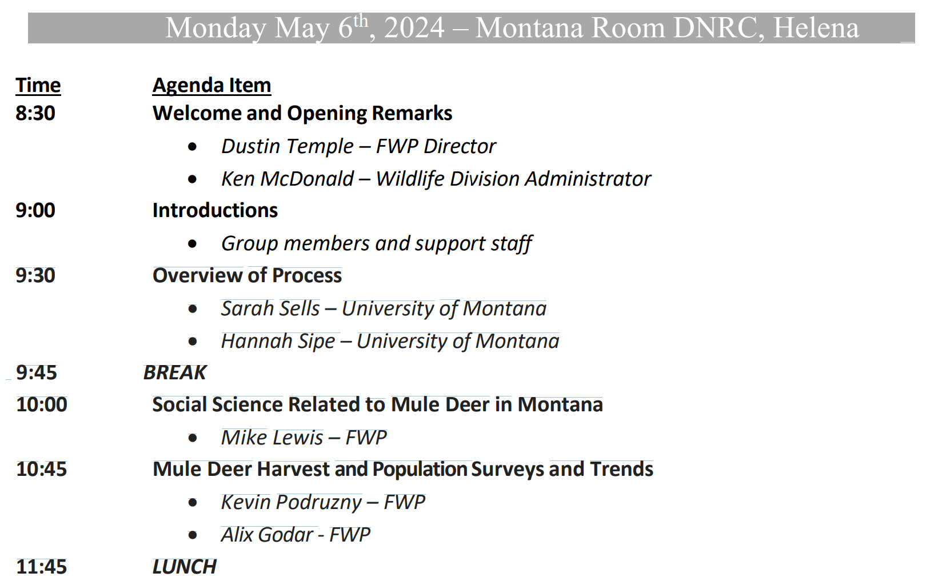

Slide 4
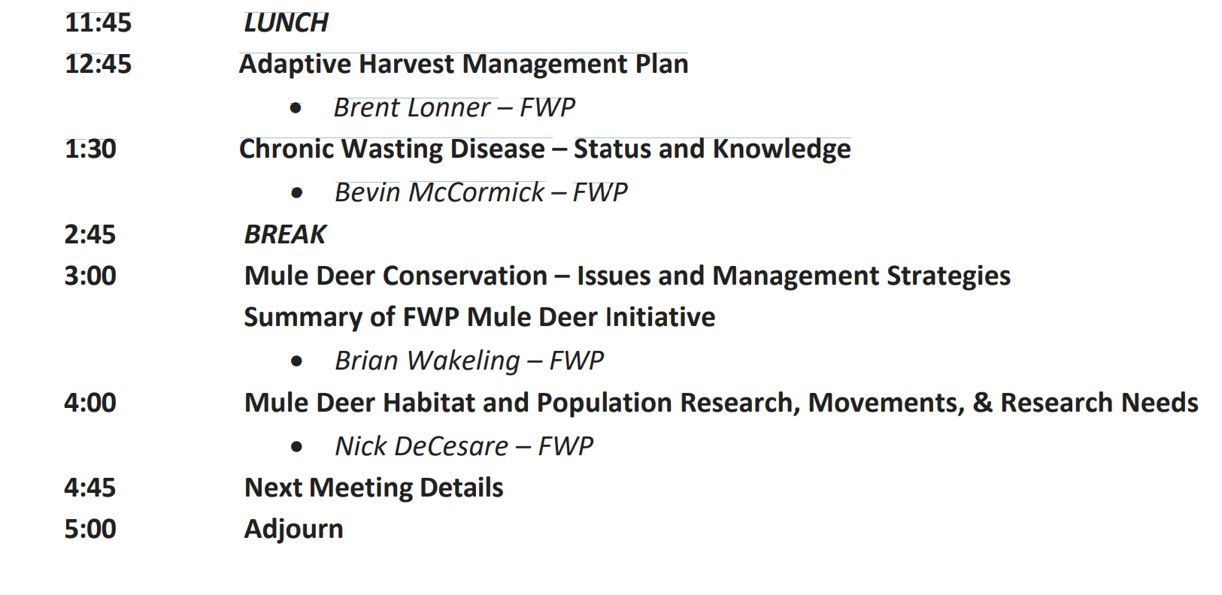

Slide 5
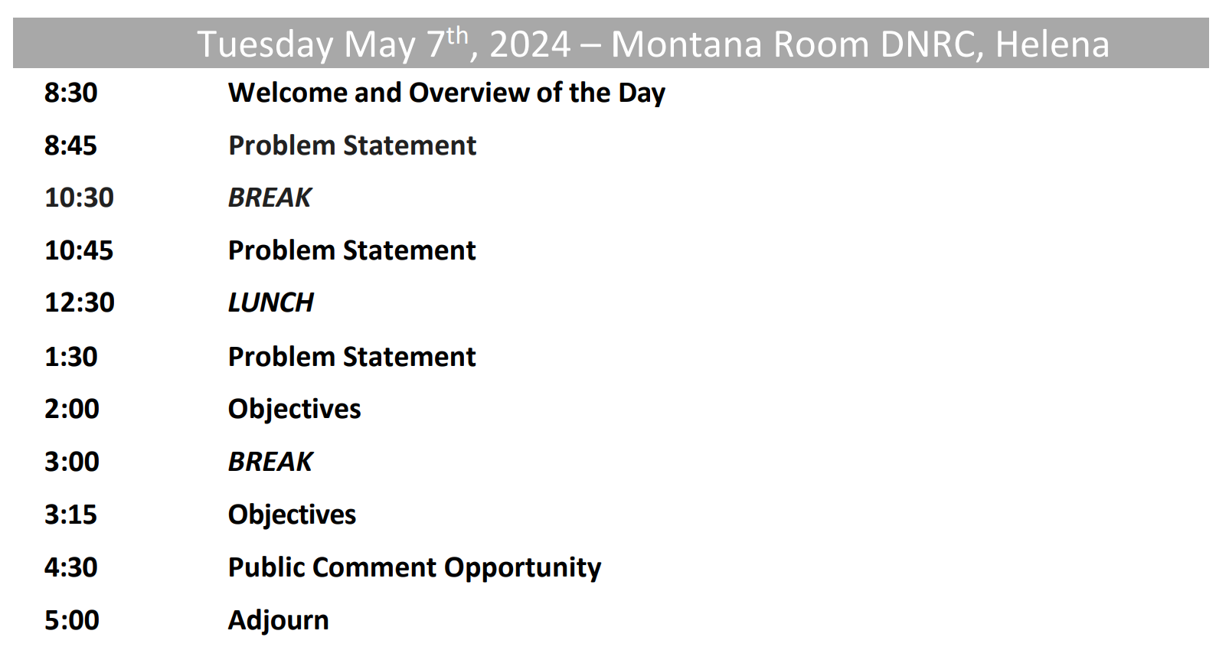

Slide 6
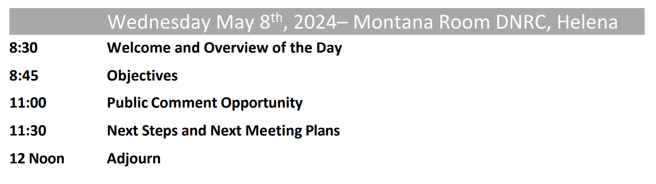

Slide 7
Problem Statement
Foundation of decision-making process
Most difficult step – but critically important to get right
Creates explicit, shared understanding of the problem
Sketches guiding principles
Bounds the problem spatially, temporally, and legally

Slide 8
Problem Statement
Trigger – Why is this mule deer plan needed? Why does it matter?
Constraints – What are legal, financial, political, or other constraints?
Frequency and Timing – What is the periodicity of the decision FWP will make? Are other decisions linked to this one?
Scope – How broad or complicated will the plan and final decision likely be?

Slide 9
Objectives (Guiding Principles)
What you ultimately care about and want to achieve
Values, agency mission, public trust
Consider:
What do you hope FWP will achieve with this mule deer plan?
What concerns will this plan address?
How can the current situation be improved?
What are the best and worst possible outcomes from the plan and associated management decisions?
What do you like and dislike about solutions you can think of?
What does this issue look like from the perspective of other stakeholders?

Slide 10
Rules of the road
Please:
Mutual respect (listen)
Honor the process (be patient)
Stay on course
Honor time lime limits
Please don’t:
Filibuster
Debate
Tell stories
Worry… your perspective will be heard and included

