Slide 1
Mule Deer Population Estimates
Presented to the Mule Deer Advisory Committee on 6 May 2024
by
Alix Godar – FWP Population Ecologist/Biometrician

Slide 2
Mule Deer Population Estimates
Montana has monitored mule deer populations for decades
Mule deer are challenging to count
We do not have absolute abundance estimates (or a “true count”)
Current population estimate methods were agreed upon in 2015
Minor changes have been made over time to accommodate changes in Hunting Districts and other changes

Slide 3
Mule Deer Population Estimates
Without an absolute abundance, population indices are a feasible alternative
We cannot compare potential population indices directly to absolute abundance
The state tested two potential population indices by comparing them to each other
If they are both population indices, they should trend together

Slide 4
Population Indices
The number of bucks harvested on a General License is an index to population trend
The number of deer counted on survey areas is an index to the population trend
Surveys are conducted in the spring (April) and post-hunting (December) by FWP biologists
Compared the two indices to each other since we lack an absolute abundance

Slide 5
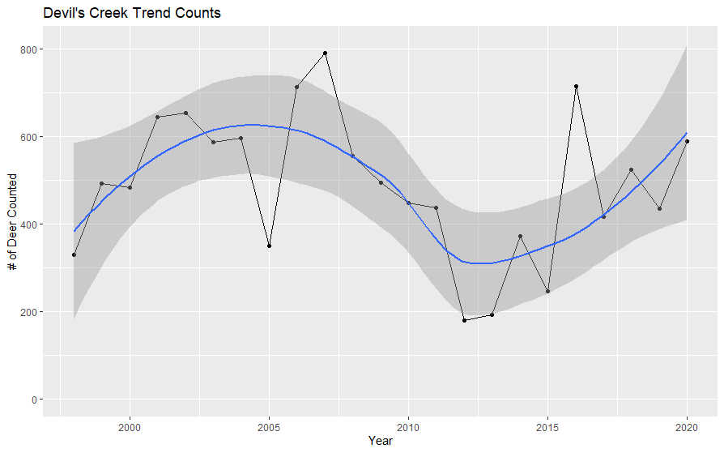
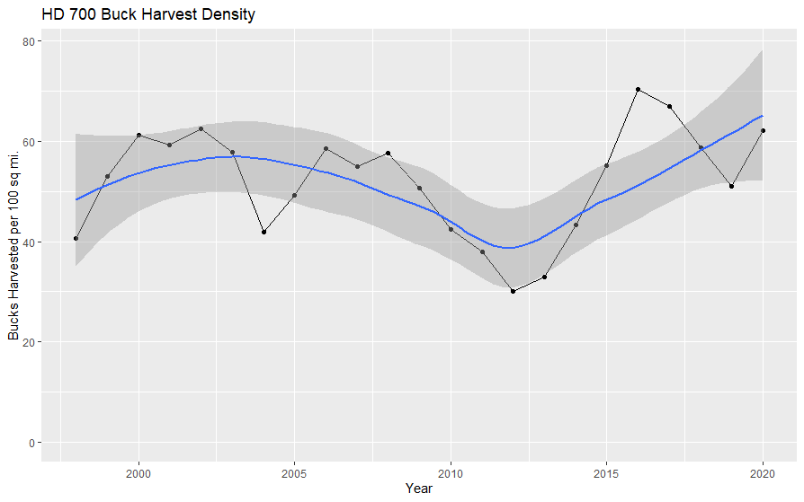
Comparing Population Indices
Figure 20. Points represent the total number of deer counted on a trend area in eastern Montana from 2000–2020. Blue line represents a local regression line with grey confidence intervals.
Figure 21. Points represent buck harvest density from the same HD as the above trend area 2000–2020. The blue line represents a local regression line with grey confidence intervals.
Citation: MT FWP. Mule Deer Initiative. pp. 22

Slide 6
Population Estimates
Each hunting district decided on a method to estimate their mule deer: either a buck harvest multiplier or a density estimate from the aerial surveys
Buck harvest multipliers can either be:
static - the same annually OR
Non-static - calculated annually from buck:doe (post-hunting season) and fawn:adult (spring) ratios
Mule deer are estimated for each hunting district but combined by Region to account for the mobility of mule deer

Slide 7
Statewide Mule Deer Trend

Slide 8
Mule Deer Regional Estimates

Slide 9
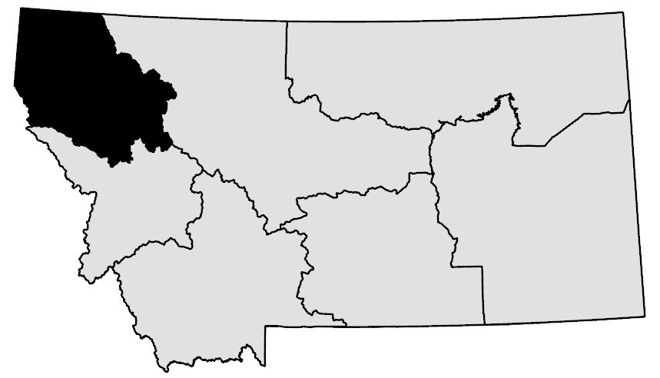
Mule Deer Regional Estimates – Region 1

Slide 10
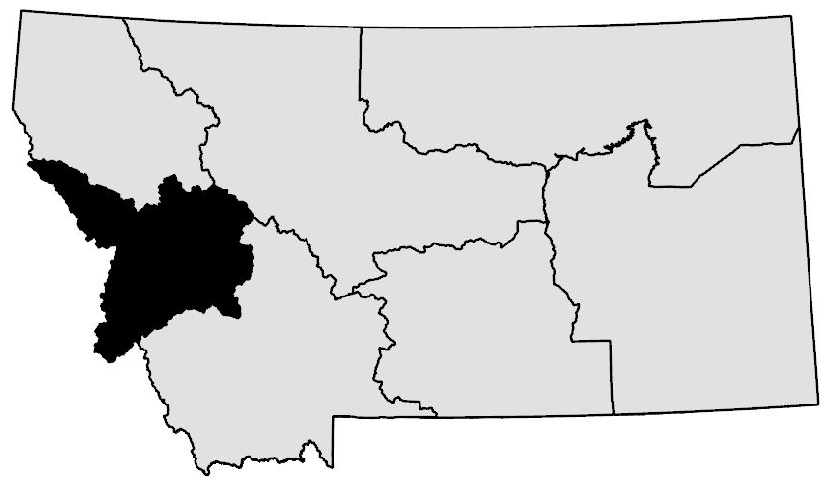
Mule Deer Regional Estimates – Region 2

Slide 11
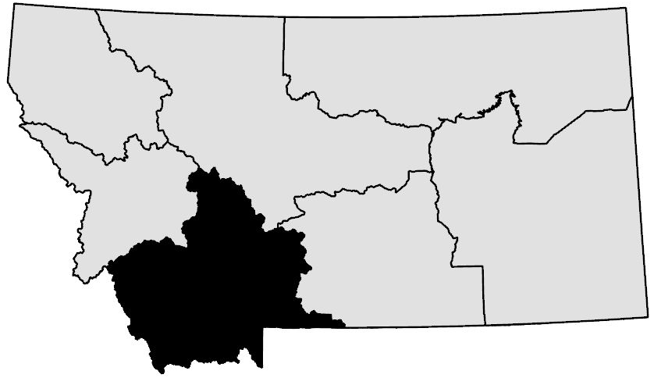
Mule Deer Regional Estimates – Region 3

Slide 12
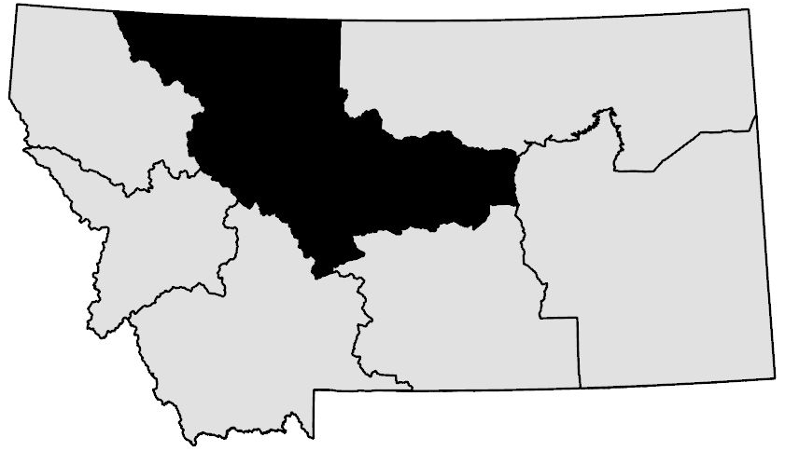
Mule Deer Regional Estimates – Region 4

Slide 13
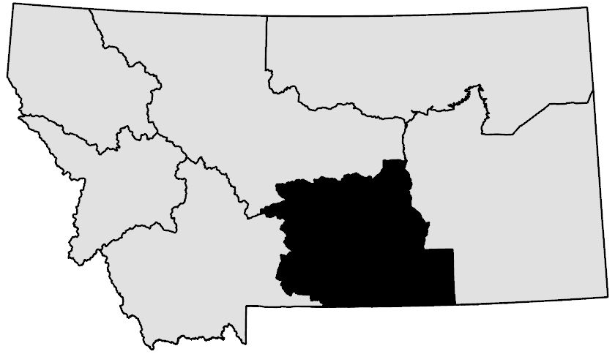
Mule Deer Regional Estimates – Region 5

Slide 14
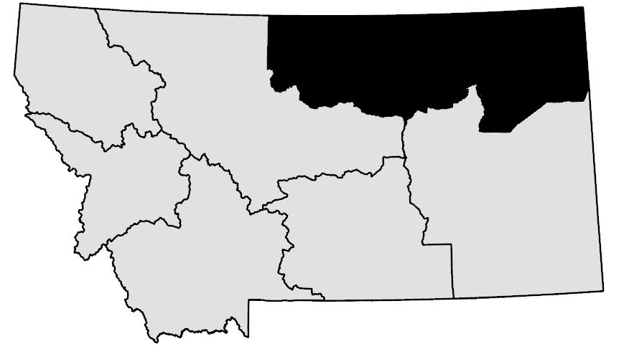
Mule Deer Regional Estimates – Region 6

Slide 15
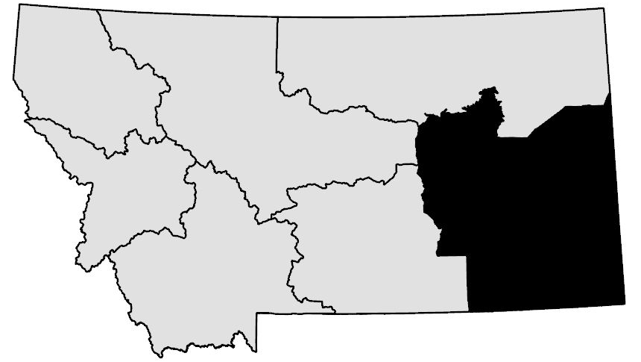
Mule Deer Regional Estimates – Region 7

Slide 16
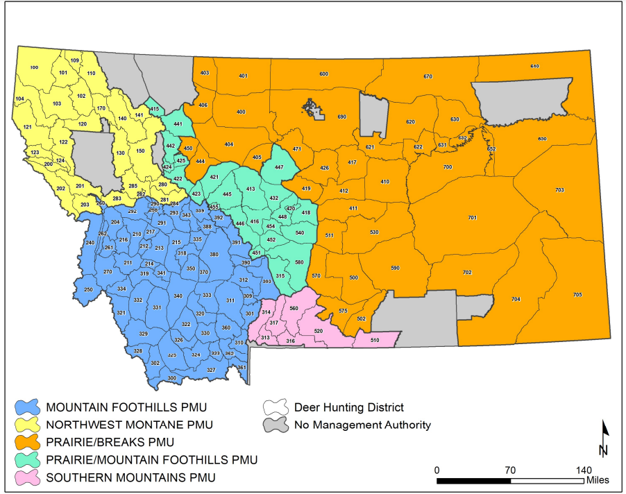
Population Management Units (PMUs)

Slide 17
Total Counts – Spring

Slide 18
Statewide Mule Deer Trend Vs. Total Counts

Slide 19
Fawn:Adult Ratio – Spring

Slide 20
Fawn:Doe Ratio – Post Season

Slide 21
Buck:Doe Ratio – Post Season

Slide 22
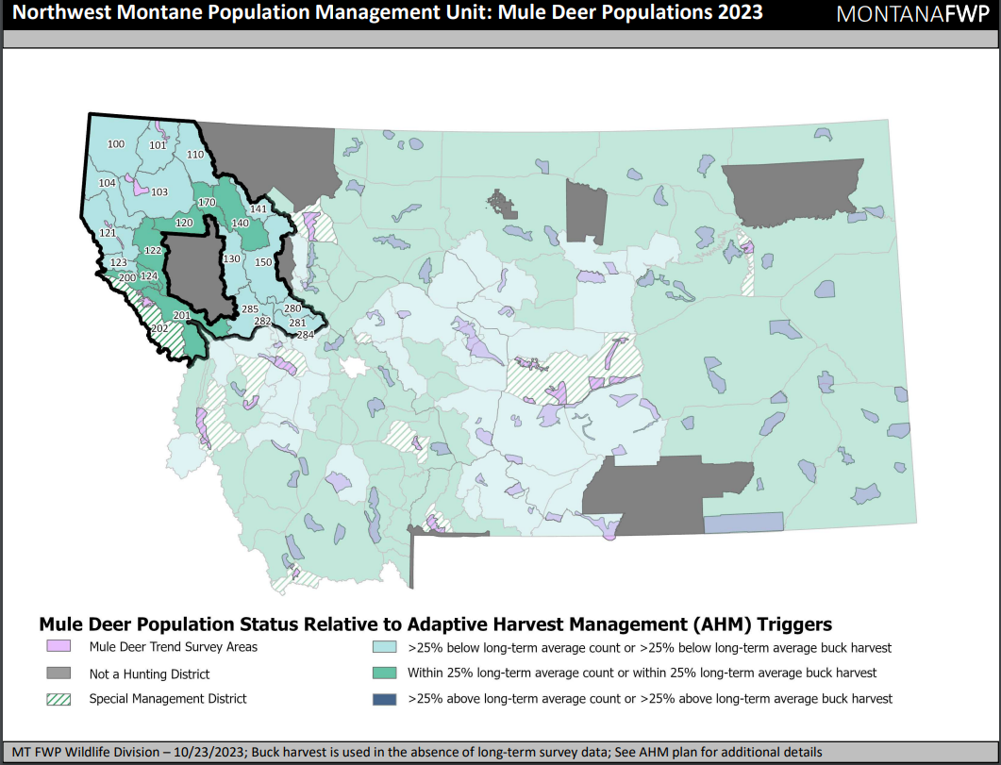
PMU: Northwest Montana (Regions 1 & 2)

Slide 23
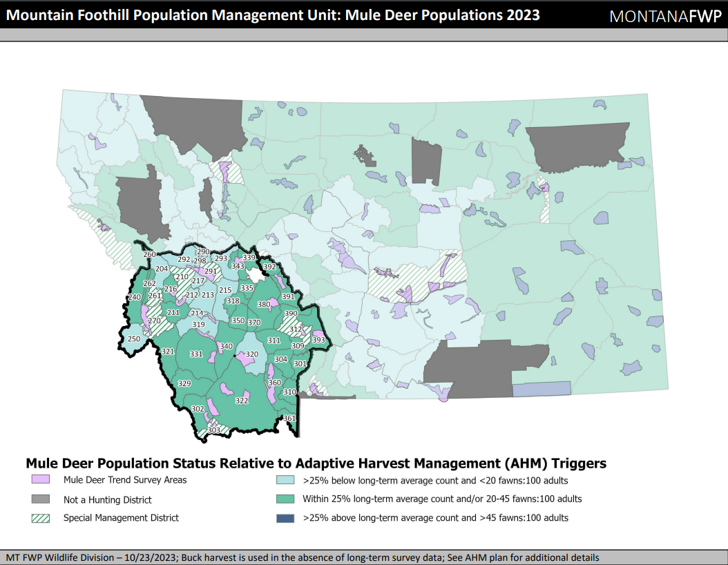
PMU: Montana Foothills (Regions 2 & 3)

Slide 24
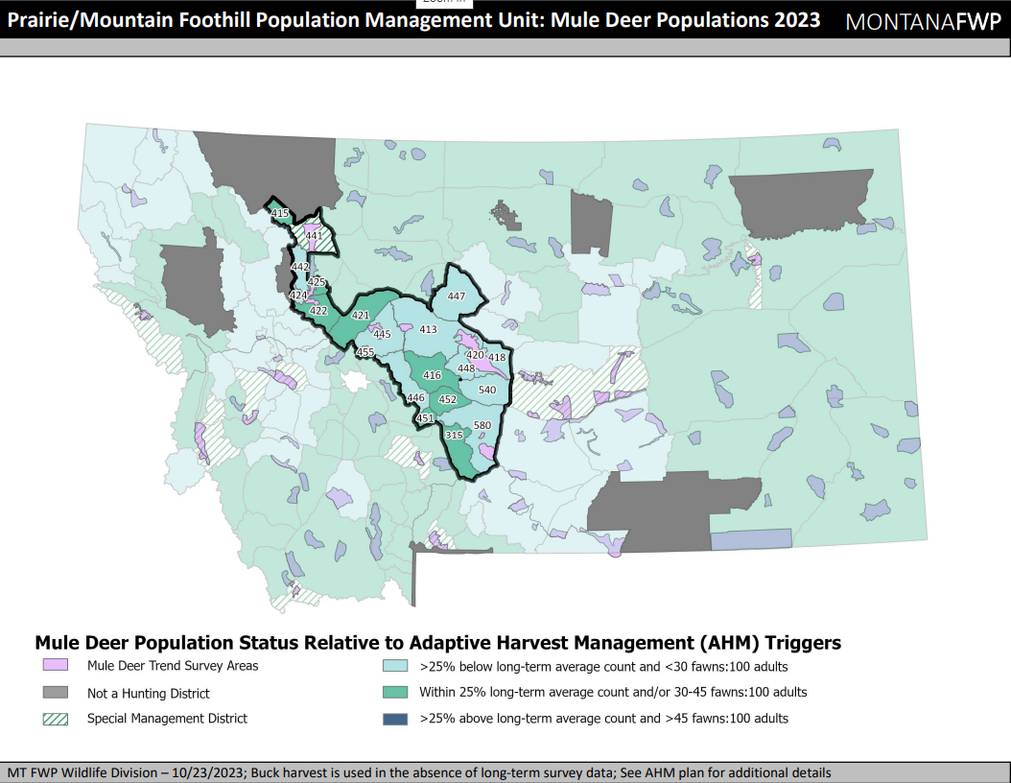
PMU: Prairie/Mountain Foothill (Regions 3, 4, & 5)

Slide 25
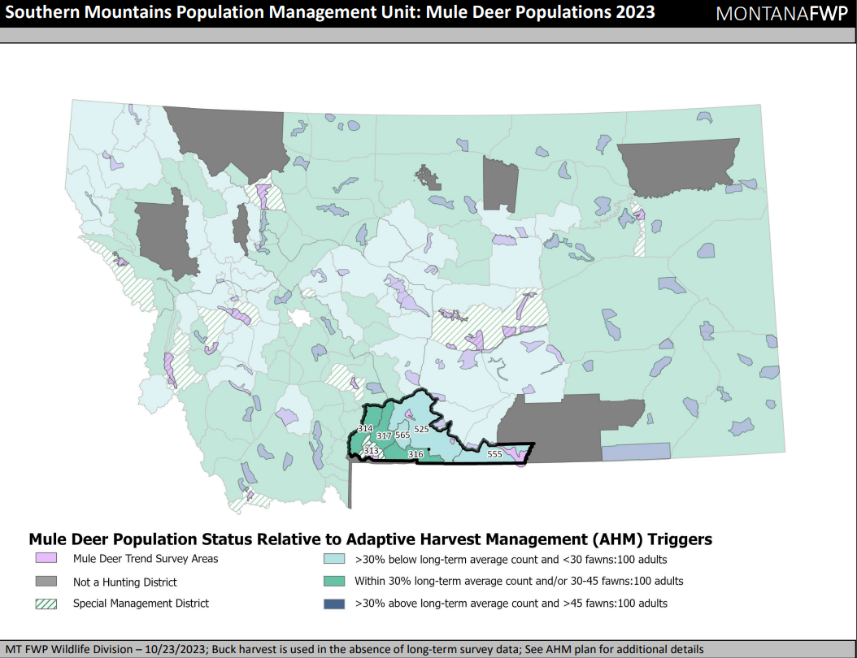
PMU: Southern Mountains (Regions 3 & 5)

Slide 26
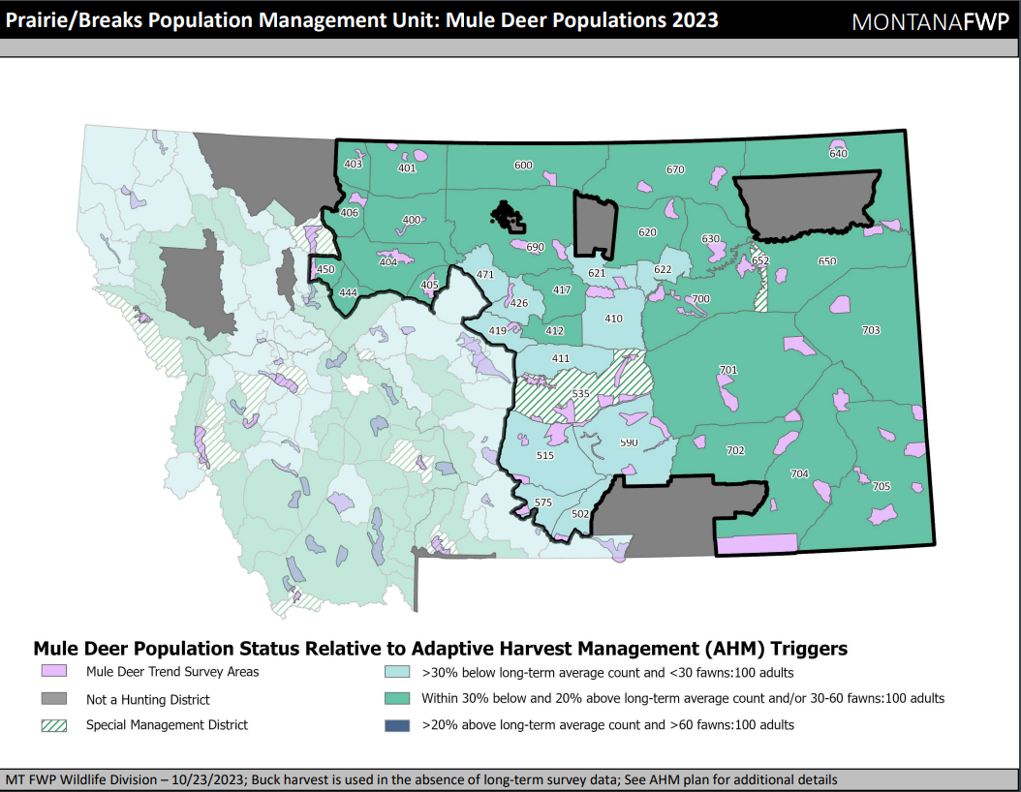
PMU: Prairie Breaks (Regions 4, 5, 6 & 7)

Slide 27
Summary
Montana does not have an absolute abundance of mule deer in the state
The mule deer population is estimated from population indices
We are working toward developing more robust methods to estimate mule deer abundance that incorporate additional data

