Slide 1

MDCAC
Background Information
What we think we know

Slide 2
Mule Deer Declines
Historically cyclic
Highs not always as high as before?
Issue that is broader than Montana
Recognized by Western Association of Fish and Wildlife Agencies in 1997
First meeting of Mule Deer Working Group in June 1998

Slide 3
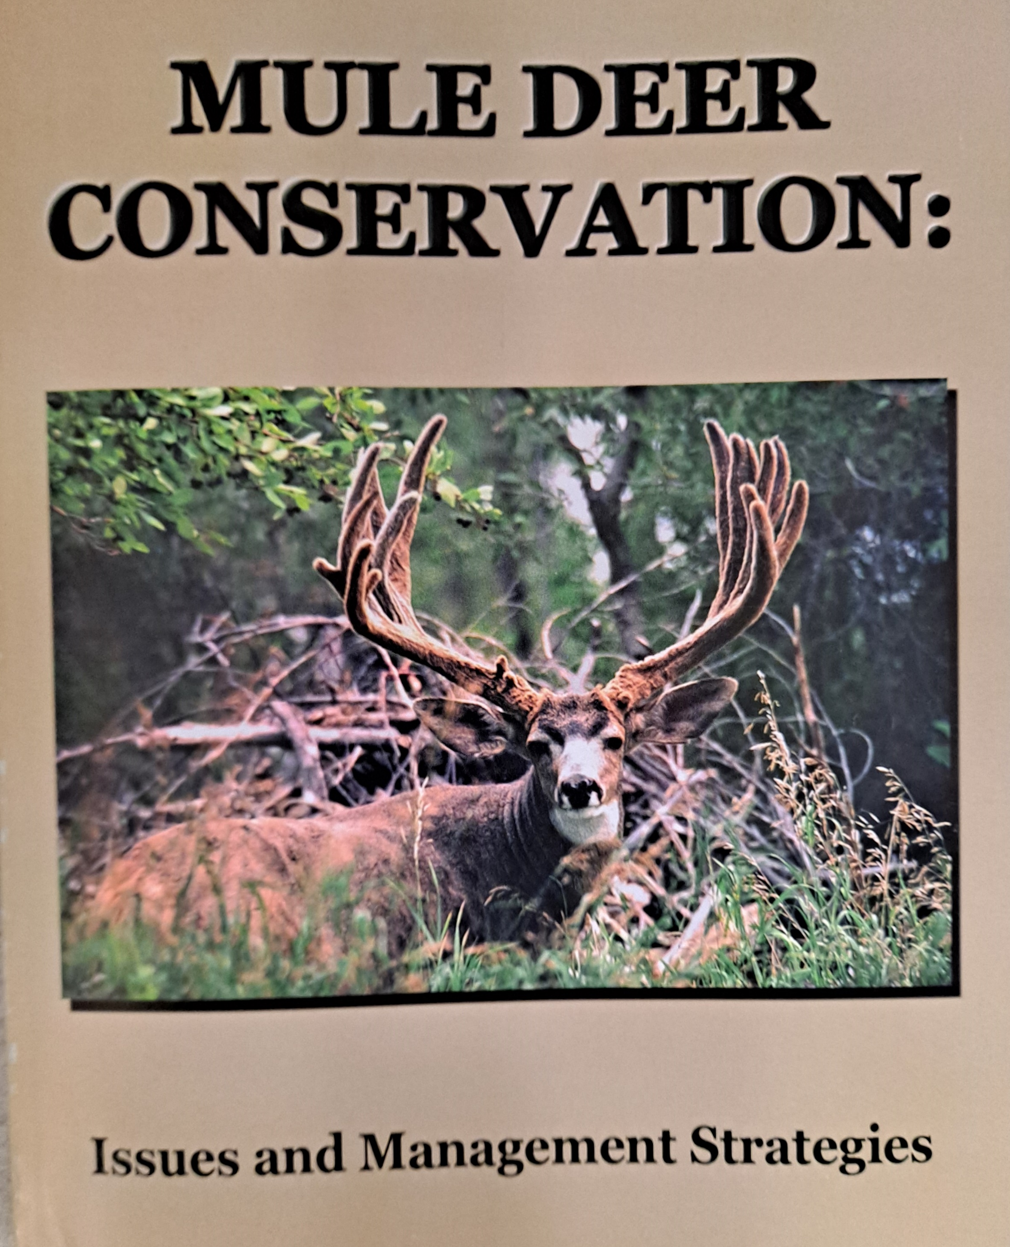
Root Cause Analysis
Exercise involving representative biologists from WAFWA states and provinces (24 member agencies)
Identify the potential causes for decline, but push to determine least common denominators to consider
Arrived at 9 potential causes for declines, although many potential causes are influenced by others
Published in 2003

Slide 4
What are they?
Changes to mule deer habitat
Nevada example
Ecoregional differences in population dynamics
Pregnancy rates routinely high, fawn survival variable, influenced by drought, winter severity, hiding cover (predation), and forage quality
Effects not consistent across the range of mule deer
Nutrition
Diet and forage quality influence nutritional status

Slide 5
What are they?
Hunting and hunt structure
Buck:doe ratios rarely influence recruitment, but clear objectives needed for management
Choice of management may influence hunter participation and experience
Disease
CWD most prevalent issue, but others like EHD play important role
Management objectives for hunting may influence likelihood for disease prevalence

Slide 6
What are they?
Data
Consistency, statistical validity, compatibility, and comparable data sets
Deer-predator relationships
When is predation management effective, how have relationships changed with time?
Precipitation and weather
Effects on deer and influence on a changing habitat such as Nevada

Slide 7
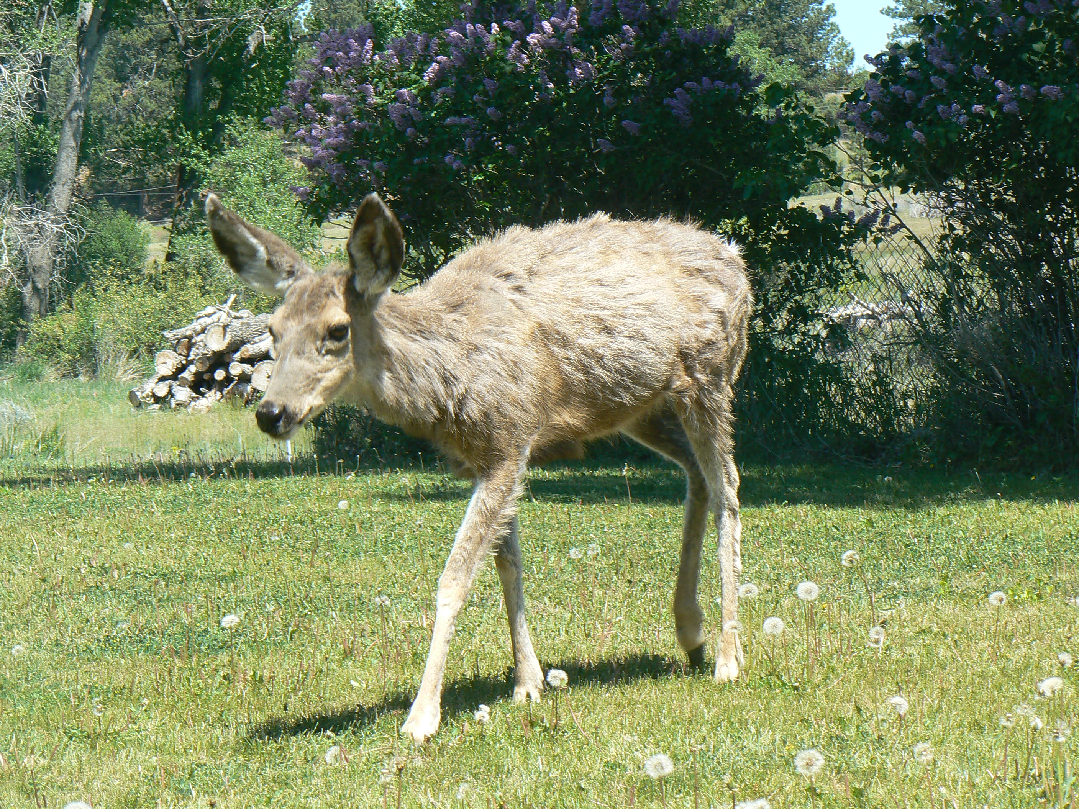
Crafting a Mule Deer Initiative In Montana
Where can we continue to learn based on recent evaluations?

Slide 8
Assumptions and Testing
Mule deer population dynamics vary across ecoregions within Montana (confirmed).
Mule deer population dynamics adjust as the environment fluctuates within predictable bounds; the outcome is a characteristic set of population parameters that reflect the environmental variation (confirmed).
Interaction between fawn recruitment and natural mortality provides the “window of opportunity for hunter harvest;” for most populations, fluctuations in recruitment rates are more influential to harvest opportunity than fluctuations in natural adult mortality (opportunity for additional evaluation).

Slide 9
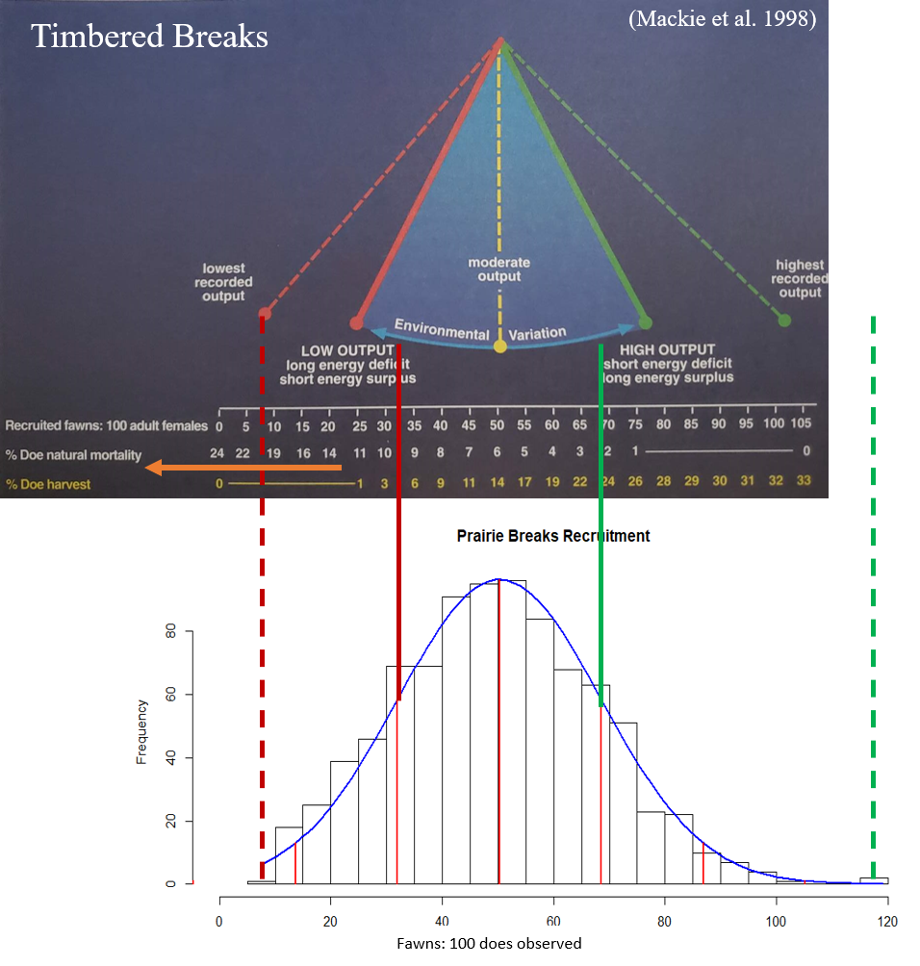

Slide 10
Assumptions and Testing
Average annual rates of natural mortality (e.g., malnutrition, predation, disease, accidents) of adult female mule deer are low and similar (5–7%); unfavorable conditions can triple or even quadruple these rates (opportunity for additional evaluation).
Predation can be compensatory or additive depending on which individuals are preyed upon (confirmed).
Buck:doe ratios within the typical range observed in Montana do not limit fawn production (confirmed).

Slide 11
Assumptions and Testing
Mule deer management must function within the realm of ecological variation that is specific to each PMU (confirmed).
FWP provides opportunity aimed to direct the population towards management goals (confirmed).
Montana’s AHM plan has worked to moderate population fluctuations since its original implementation beginning in 2001 (confirmed).

Slide 12
Assumptions and Testing
Using the number of bucks harvested on a general license is a reliable index to population size (opportunity for additional evaluation).
Using aerial surveys on trend areas is a reliable index to population size (opportunity for additional evaluation).
Some (15–37%) hunters are in favor of restrictions to manage for older age class bucks (confirmed).
A majority of hunters want the opportunity to hunt mule deer bucks every year somewhere in Montana, with a lower probability of harvesting a mature buck (confirmed).

Slide 13
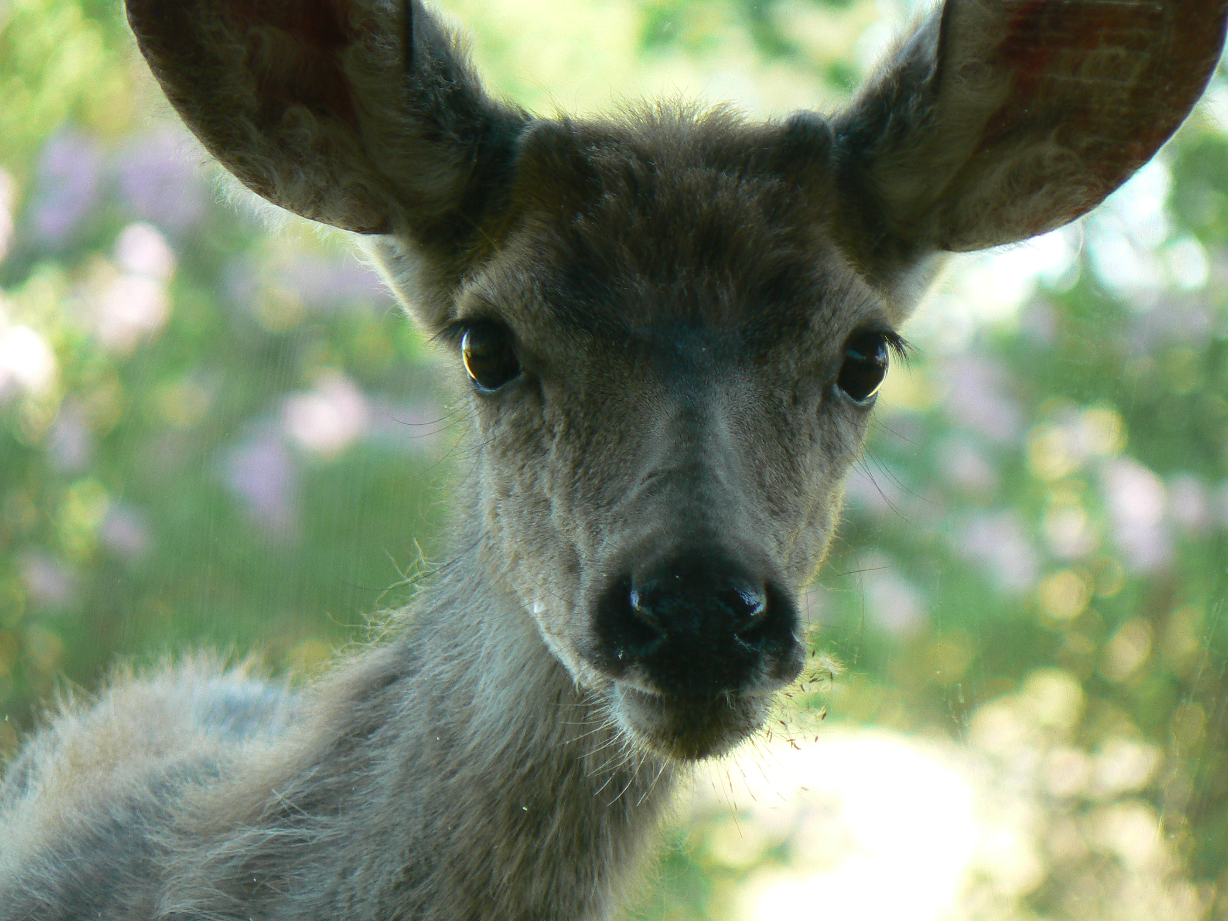
Questions?

