Slide 1
MULE DEER CITIZENS ADVISORY COUNCIL CHARTER
The Mule Deer Citizens Advisory Council (MDCAC) will determine and strive for consensus on guiding principles that identify collective expectations for plan development and public engagement, identify important issues in mule deer management, and provide statewide guidance for management.
The department will use these principles to develop the plan including specific proposals and geographically specific management strategies across the state to address the guiding principles identified by the MDCAC.
The MDCAC will not be tasked with writing or approving the plan. Environmental analyses and assessmentsfor the plan and drafting specific management actions in the plan will be the responsibility of the department.

Slide 2
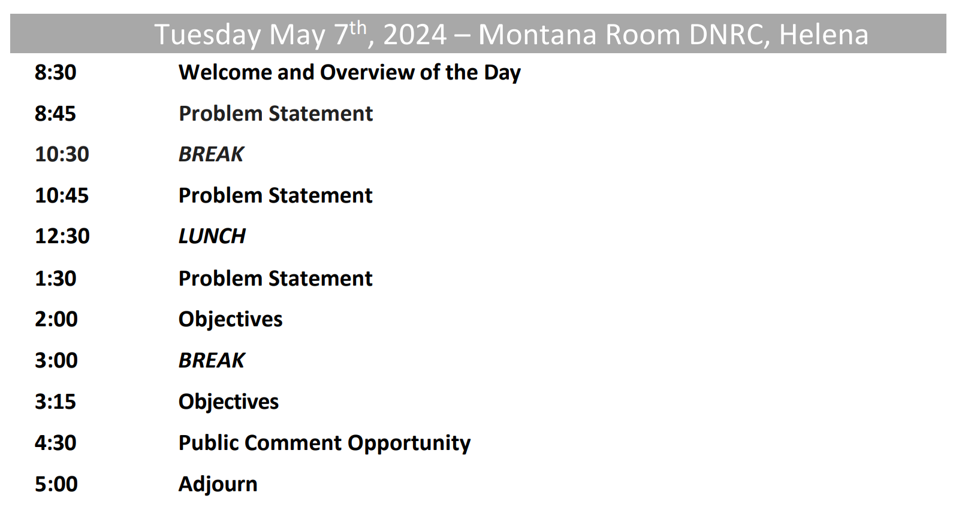

Slide 3
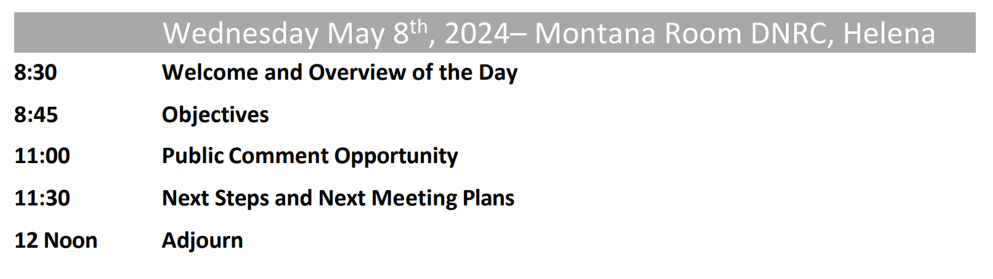

Slide 4
Questions or thoughts after yesterday?

Slide 5
Problem Statement

Slide 6



Problem statements help frame decisions

Slide 7

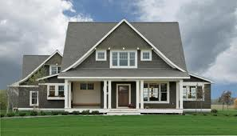
Everyday example

Slide 8
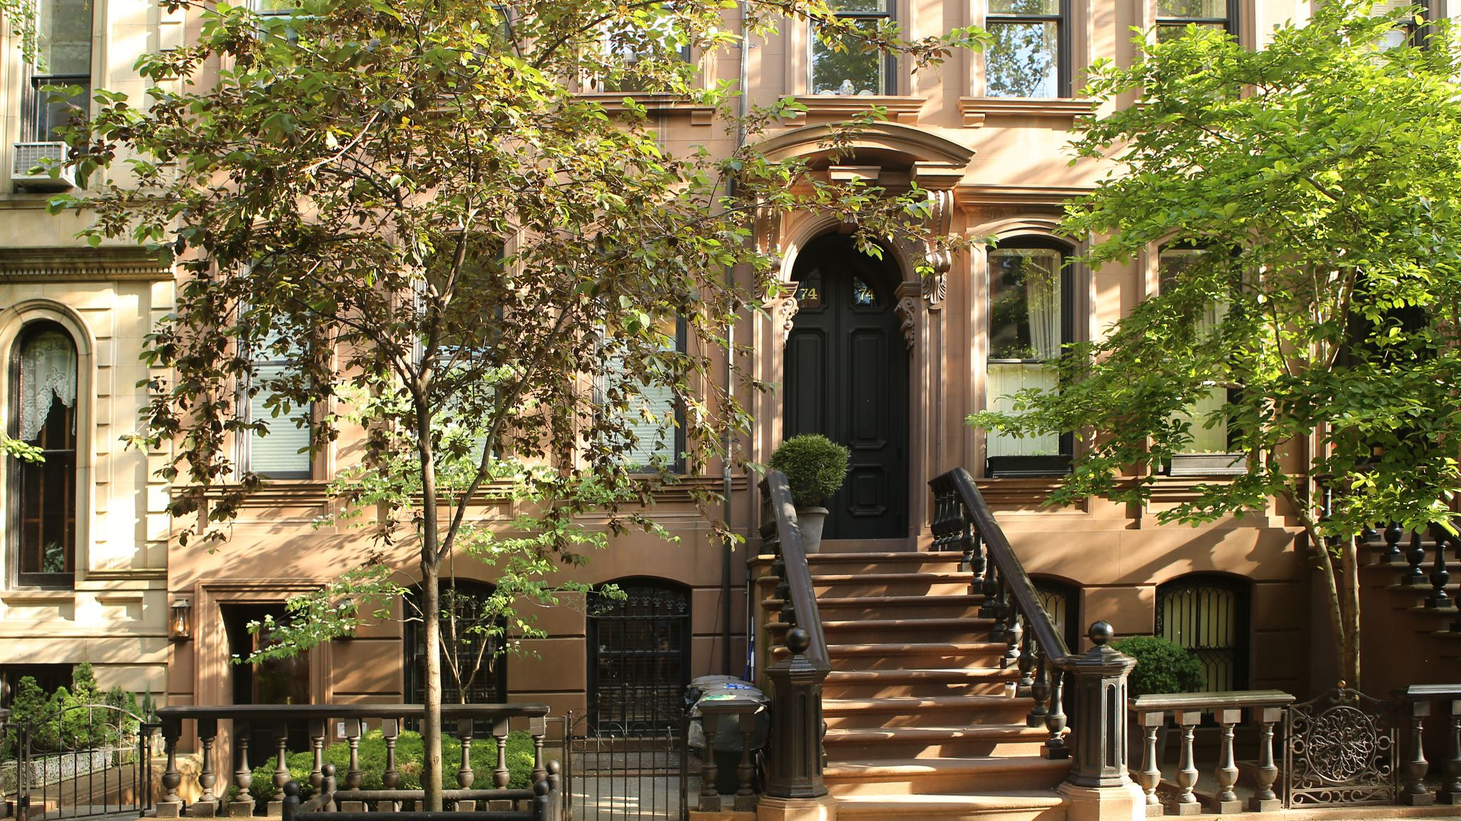
Problem statement
Our house is too small for our family and we have a small yard for the kids to play in. Adding on to our current house (and living with the small yard) or purchasing a larger house with a larger yard would be costly. We live in the city so commute times to work are short, but schools in the suburbs can be better. We can afford to increase our monthly mortgage payments, but need to stay within our budget.

Slide 9
Problem Framing: Why is it Important?
Will identify framework for mule deer plan and associated management decisions
Provides explicit, shared understanding of problem at hand
Defines boundary of problem—spatial and temporal extent, legal considerations, etc.
Notes:
Close encounter of the third kind
Picture frame

Slide 10

Problem Framing: Elements
Identify key players
The range of stakeholders
The public
FWP & Commission
Others?
Notes:
Close encounter of the third kind
Picture frame

Slide 11

Problem Framing: Elements
Consider legal and regulatory context
How does legislation or other associated regulations bound the decision problem?
Objectives
Constraints
Set of choices
Notes:
Close encounter of the third kind
Picture frame

Slide 12

Problem Framing: Elements
Frequency and Timing – What may be the periodicity of the decision FWP will make? Are other decisions linked to this one?
Scope – How large, broad, complicated is the problem?
Objectives – Roughly, what are desired outcomes?
Actions – What kinds of decision might be made?
Constraints – Legal, financial, political
Uncertainty – Is it present?
Notes:
Close encounter of the third kind
Picture frame

Slide 13

Problem Framing: Elements
Revisit & revise as needed:
Problem framing among most difficult steps – first try is never right
Insights are likely to arise that cause you to rethink the very nature of the problem itself
Problem definition is likely to change as you proceed with development
Notes:
Close encounter of the third kind
Picture frame

Slide 14
Statement Template
“Decision maker (D) is trying to do (X) to achieve (Y) over time (Z) and in place (W) considering (B).”
D = decision maker
X = type of action(s) that need to be taken
Y = the ultimate goal to be achieved
Z = temporal extent of decision
W = spatial extent of decision
B = potential constraints or uncertainties

Slide 15
Framing the Problem
Trigger: why is a plan needed, & why does it matter?
Decision maker: who will make decisions from the plan?
Key parties: who are the stakeholders?
Action: what is the decision to be made?
Timing & frequency: how often will a decision be made, and when?
Scope: spatial & temporal scale of plan and decisions?
Objectives: desired outcomes?
Constraints: legal, political, financial?
Uncertainty: is it present?

Slide 18
Bighorn Pneumonia
Trigger
MFWP has direct experience with bighorn sheep pneumonia epizootic events that have affected conservation and public enjoyment of bighorn sheep. MFWP currently has no tools for evaluating whether taking actions to proactively prevent similar events will produce more desirable results. MFWP wildlife managers and biologists need risk assessment and decision analysis tools to help prioritize and allocate resources to identify and manage the risk of major disease events. These tools need flexibility in their implementation so that decisions about bighorn sheep management and conservation remain local and community-based. Management actions and tools should be implemented with a monitoring program in a way that will reduce uncertainty and risk in the future.

Slide 19
Bighorn Pneumonia
Decision Maker
MFWP has direct experience with bighorn sheep pneumonia epizootic events that have affected conservation and public enjoyment of bighorn sheep. MFWP currently has no tools for evaluating whether taking actions to proactively prevent similar events will produce more desirable results. MFWP wildlife managers and biologists need risk assessment and decision analysis tools to help prioritize and allocate resources to identify and manage the risk of major disease events. These tools need flexibility in their implementation so that decisions about bighorn sheep management and conservation remain local and community-based. Management actions and tools should be implemented with a monitoring program in a way that will reduce uncertainty and risk in the future.

Slide 20
Bighorn Pneumonia
Action
MFWP has direct experience with bighorn sheep pneumonia epizootic events that have affected conservation and public enjoyment of bighorn sheep. MFWP currently has no tools for evaluating whether taking actions to proactively prevent similar events will produce more desirable results. MFWP wildlife managers and biologists need risk assessment and decision analysis tools to help prioritize and allocate resources to identify and manage the risk of major disease events. These tools need flexibility in their implementation so that decisions about bighorn sheep management and conservation remain local and community-based. Management actions and tools should be implemented with a monitoring program in a way that will reduce uncertainty and risk in the future.

Slide 21
Bighorn Pneumonia
Timing, Scope
MFWP has direct experience with bighorn sheep pneumonia epizootic events that have affected conservation and public enjoyment of bighorn sheep. MFWP currently has no tools for evaluating whether taking actions to proactively prevent similar events will produce more desirable results. MFWP wildlife managers and biologists need risk assessment and decision analysis tools to help prioritize and allocate resources to identify and manage the risk of major disease events. These tools need flexibility in their implementation so that decisions about bighorn sheep management and conservation remain local and community-based. Management actions and tools should be implemented with a monitoring program in a way that will reduce uncertainty and risk in the future.

Slide 22
Bighorn Pneumonia
Objectives, Uncertainty
MFWP has direct experience with bighorn sheep pneumonia epizootic events that have affected conservation and public enjoyment of bighorn sheep. MFWP currently has no tools for evaluating whether taking actions to proactively prevent similar events will produce more desirable results. MFWP wildlife managers and biologists need risk assessment and decision analysis tools to help prioritize and allocate resources to identify and manage the risk of major disease events. These tools need flexibility in their implementation so that decisions about bighorn sheep management and conservation remain local and community-based. Management actions and tools should be implemented with a monitoring program in a way that will reduce uncertainty and risk in the future.

Slide 23
Framing the Problem
Trigger: why is a plan needed, & why does it matter?
Decision maker: who will make decisions from the plan?
Key parties: who are the stakeholders?
Action: what is the decision to be made?
Timing & frequency: how often will a decision be made, and when?
Scope: spatial & temporal scale of plan and decisions?
Objectives: desired outcomes?
Constraints: legal, political, financial?
Uncertainty: is it present?

Slide 25
Objectives (Guiding Principles)

Slide 26
Objectives (guiding principles) specify what we value & hope to achieve

Slide 27
Everyday example

Slide 28
Problem statement
Our house is too small for our family and we have a small yard for the kids to play in. Adding on to our current house (and living with the small yard) or purchasing a larger house with a larger yard would be costly. We live in the city so commute times to work are short, but schools in the suburbs can be better. We can afford to increase our monthly mortgage payments, but need to stay within our budget.

Slide 29

Objectives (Guiding Principles)
House should be large enough
Yard should be large enough for kids
Schools should be high quality
Neighborhood should be family friendly
Commute time should be reasonable
Costs should be minimized

Slide 30
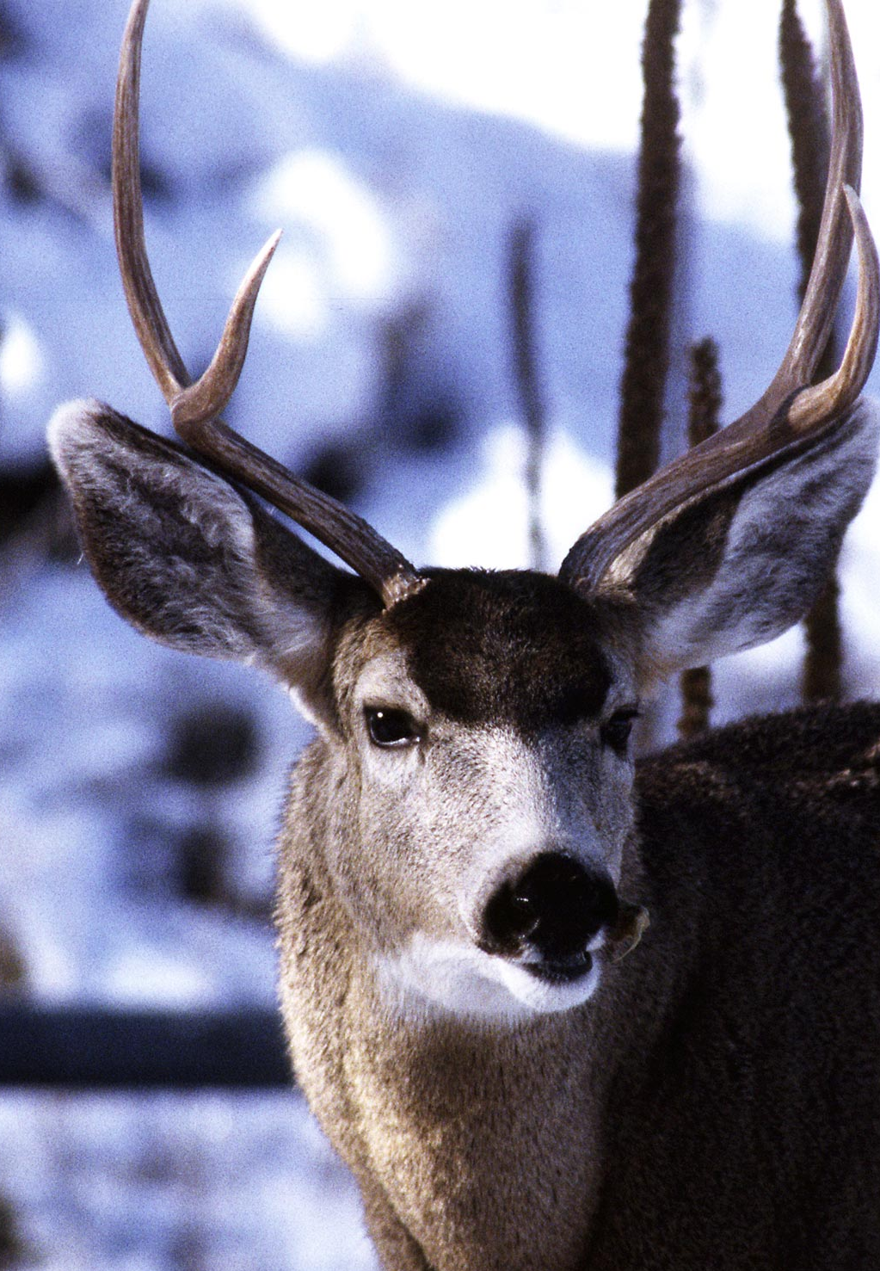
Spending time and careful thought identifying guiding principles will pay off by helping FWP to:
Be able to compare potential management options using the right criteria
Develop more creative alternatives
Know what to make predictions about
Plan & associated decisions will build on objectives
Notes:
If you don’t know where you are going (what you want the decision problem to achieve), you are going to solve the wrong problem. This is among the very top reasons why decision are not acted upon or otherwise go wrong.​
​

Slide 31


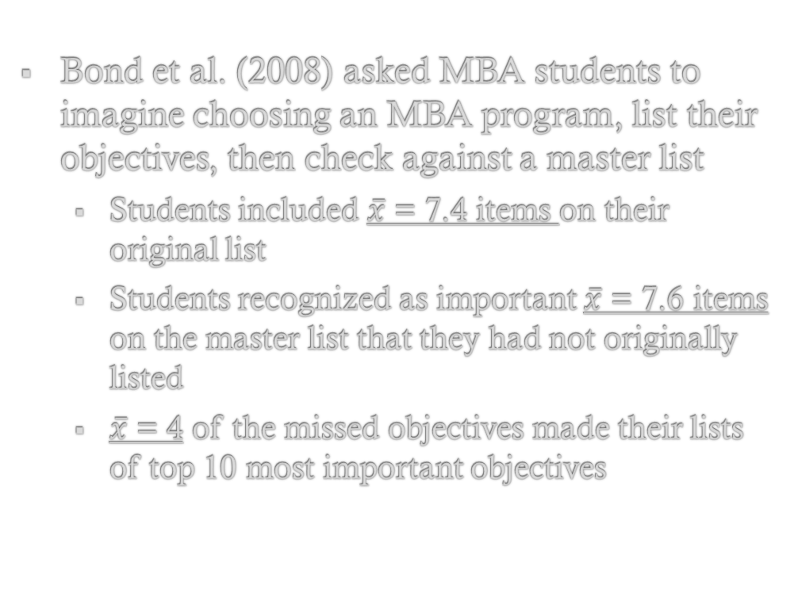
People are often poor at identifying their objectives
Bond et al. (2008) asked MBA students to imagine choosing an MBA program, list their objectives, then check against a master list
Students included $\overline{x}$ = 7.4 items on their original list
Students recognized as important $\overline{x}$ = 7.6 items on the master list that they had not originally listed
$\overline{x}$ = 4 of the missed objectives made their lists of top 10 most important objectives
Notes:
Point is that generating a complete list of objectives is hard and challenging, especially on a single try. So, plan on iterating (trying over and over) until new objectives do not come up.​

Slide 32
Articulate concerns and convert to objectives
Consider:
What do you hope to achieve with this decision?
What concerns will this decision address?
How can the current situation be improved?
What are the best and worst possible outcomes from this decision?
What do you like and dislike about solutions you can think of?
What does this issue look like from the perspective of other stakeholders?

Slide 33
Articulate concerns and convert to objectives
Goal or Concern | Hope to Achieve | Potential Objective
It’s hard to catch trout any more | Improve fishing | Maximize recreational fishing success
Many loons die ingesting lead tackle | Reduce loon mortality and increase loon populations | Maximize persistence of loon populations
Boats can carry and spread invasive mussels | Avoid release of invasive mussels and protect native species | Maintain native invertebrate and fish communities in MT rivers and lakes
Certain stakeholders feel excluded | Organize an inclusive decision process | Create an inclusive and transparent process that allows relevant viewpoints to be heard
I won’t have enough money for this | Reduce cost and manage within budget | Minimize cost

Slide 34
2. Distinguish types of objectives
1. Fundamental
the basic reason for caring about the decision (essential)
2. Means
influence the achievement of fundamental objectives (not necessarily essential)
3. Process
concern for how the decision is made rather than what decision is made
4. Strategic
higher level – objectives covering all decisions made by the organization or person

Slide 35
Classify Objectives
Examples of strategic objectives
For an individual: Maximize my quality of life
For a natural resource stewardship agency:
Manage for population health of wildlife resources
Act consistently with the public’s environmental values
Maximize contribution to quality of life in Montana
Increase public trust in the agency
Maintain the integrity and consistency of regulations
Notes:
To be a leader in scientific forest management
Increase capacity
Increase trust
Good stewards of tax dollars

Slide 36
2. Distinguish types of objectives
1. Fundamental
the basic reason for caring about the decision (essential)
2. Means
influence the achievement of fundamental objectives (not necessarily essential)
3. Process
concern for how the decision is made rather than what decision is made
4. Strategic
higher level – objectives covering all decisions made by the organization or person

Slide 37
2. Distinguish types of objectives
Ask “Why Is That Important?”
You have reached a fundamental objective when your answer is:
“Just because”
“It’s the law”
“This is important”
“Inherent value”
Ask “How?”
You can identify means objectives with answers to:
How can I address this concern?
What are some steps for getting where I want to be?
FUNDAMENTAL
Ask “Why”
Ask “How”
MEANS

Slide 38
Example
Concern | Objectives
Boats can carry and spread invasive mussels | Require boat inspections
 | Minimize invasive species introductions
 | Sustain native species
You aren’t talking with landowners | Increase communication
 | Maximize community engagement
 | Maximize habitat conservation
You don’t have enough money for this | Minimize cost
 | Maximize conservation within budget

Slide 39
Example
Concern | Objectives
Boats can carry and spread invasive mussels | Require boat inspections
 | Minimize invasive species introductions
 | Sustain native species
You aren’t talking with landowners | Increase communication
 | Maximize community engagement
 | Maximize habitat conservation
You don’t have enough money for this | Minimize cost
 | Maximize conservation within budget

Slide 40
Example
Concern | Objectives
Boats can carry and spread invasive mussels | Require boat inspections
 | Minimize invasive species introductions
 | Sustain native species
You aren’t talking with landowners | Increase communication
 | Maximize community engagement
 | Maximize habitat conservation
You don’t have enough money for this | Minimize cost
 | Maximize conservation within budget

Slide 41
Example
Concern | Objectives
Boats can carry and spread invasive mussels | Require boat inspections
 | Minimize invasive species introductions
 | Sustain native species
You aren’t talking with landowners | Increase communication
 | Maximize community engagement
 | Maximize habitat conservation
You don’t have enough money for this | Minimize cost
 | Maximize conservation within budget
This is a separate objective!

Slide 42


Objectives Jargon
Maximize = more of something
Minimize = less of something
Notes:
Note – max and min are often used to represent preferred direction, knowing you will be trading off (e.g., don’t mean you have a specific target of the absolute max or min possible, just that you want to get the most/least given other competing objectives!)​

Slide 43
Identifying Objectives
Consider:
What’s wrong with current situation?
If no plan is written or decision made, what will happen?
What concerns will the plan & decision ideally address?
What does a perfect outcome look like?
What is the worst possible outcome; why is it bad?
What are stakeholders concerns?
Convert your list to objectives
Think broadly & creatively

