Slide 1

Chronic Wasting Disease in Montana 2017-2024
Mule Deer CAC Meeting--May 6, 2024
Prepared by Bevin McCormick and Emily Almberg

Slide 2
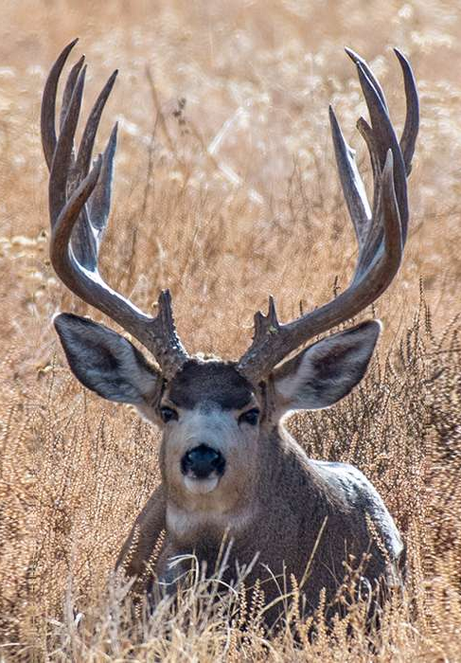

What is Chronic Wasting Disease (CWD)?
Slow-progressing, fatal, neurodegenerative disease
Cervidae family species
  White-tailed deer, mule deer, elk, and moose in MT
No cure, no treatment
Correlated with population declines
Classified as a Transmissible Spongiform Encephalopathy (TSE)
Other TSEs include:
  BSE (mad cow)
  Scrapie
  Creutzfeldt-Jakob Disease (CJD)
https://navajooutdoors.com/mule-deer-hunts/

Slide 3
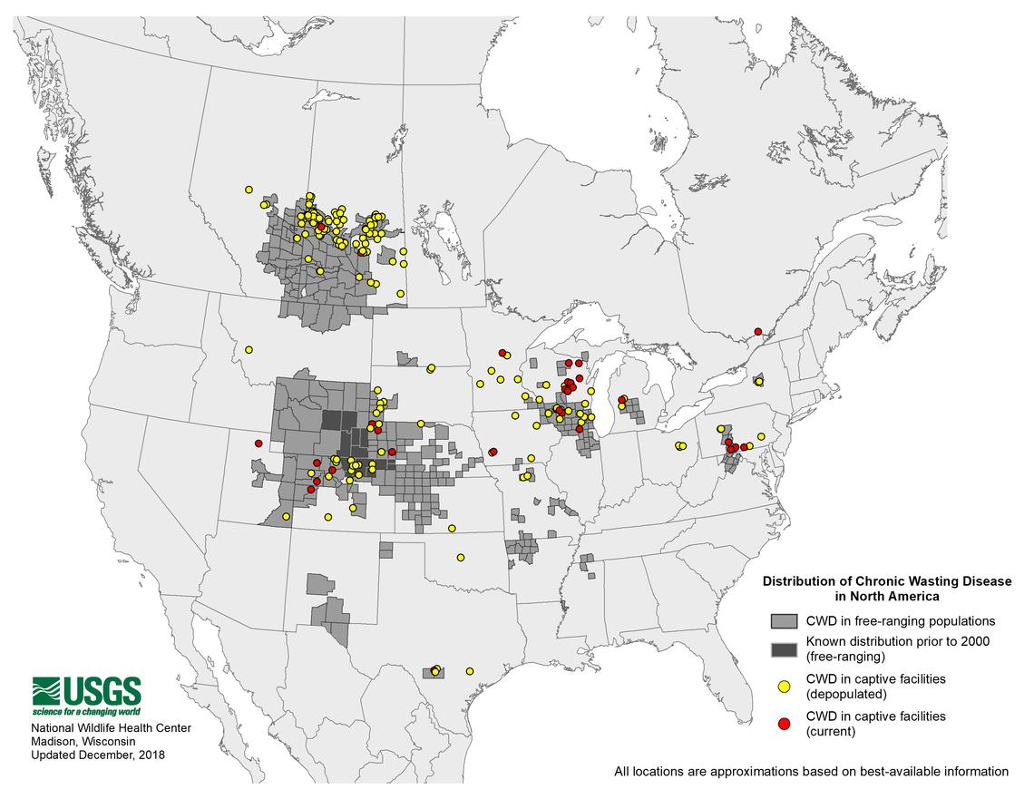
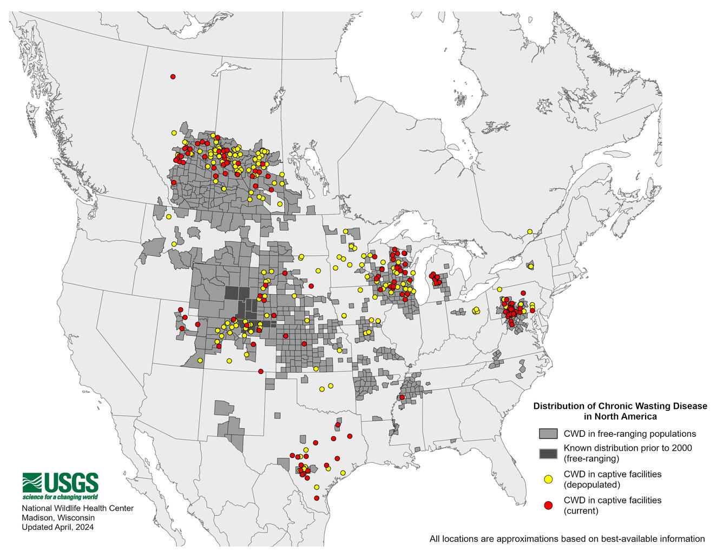
Where is CWD found?
2018
2018
2024

Slide 4
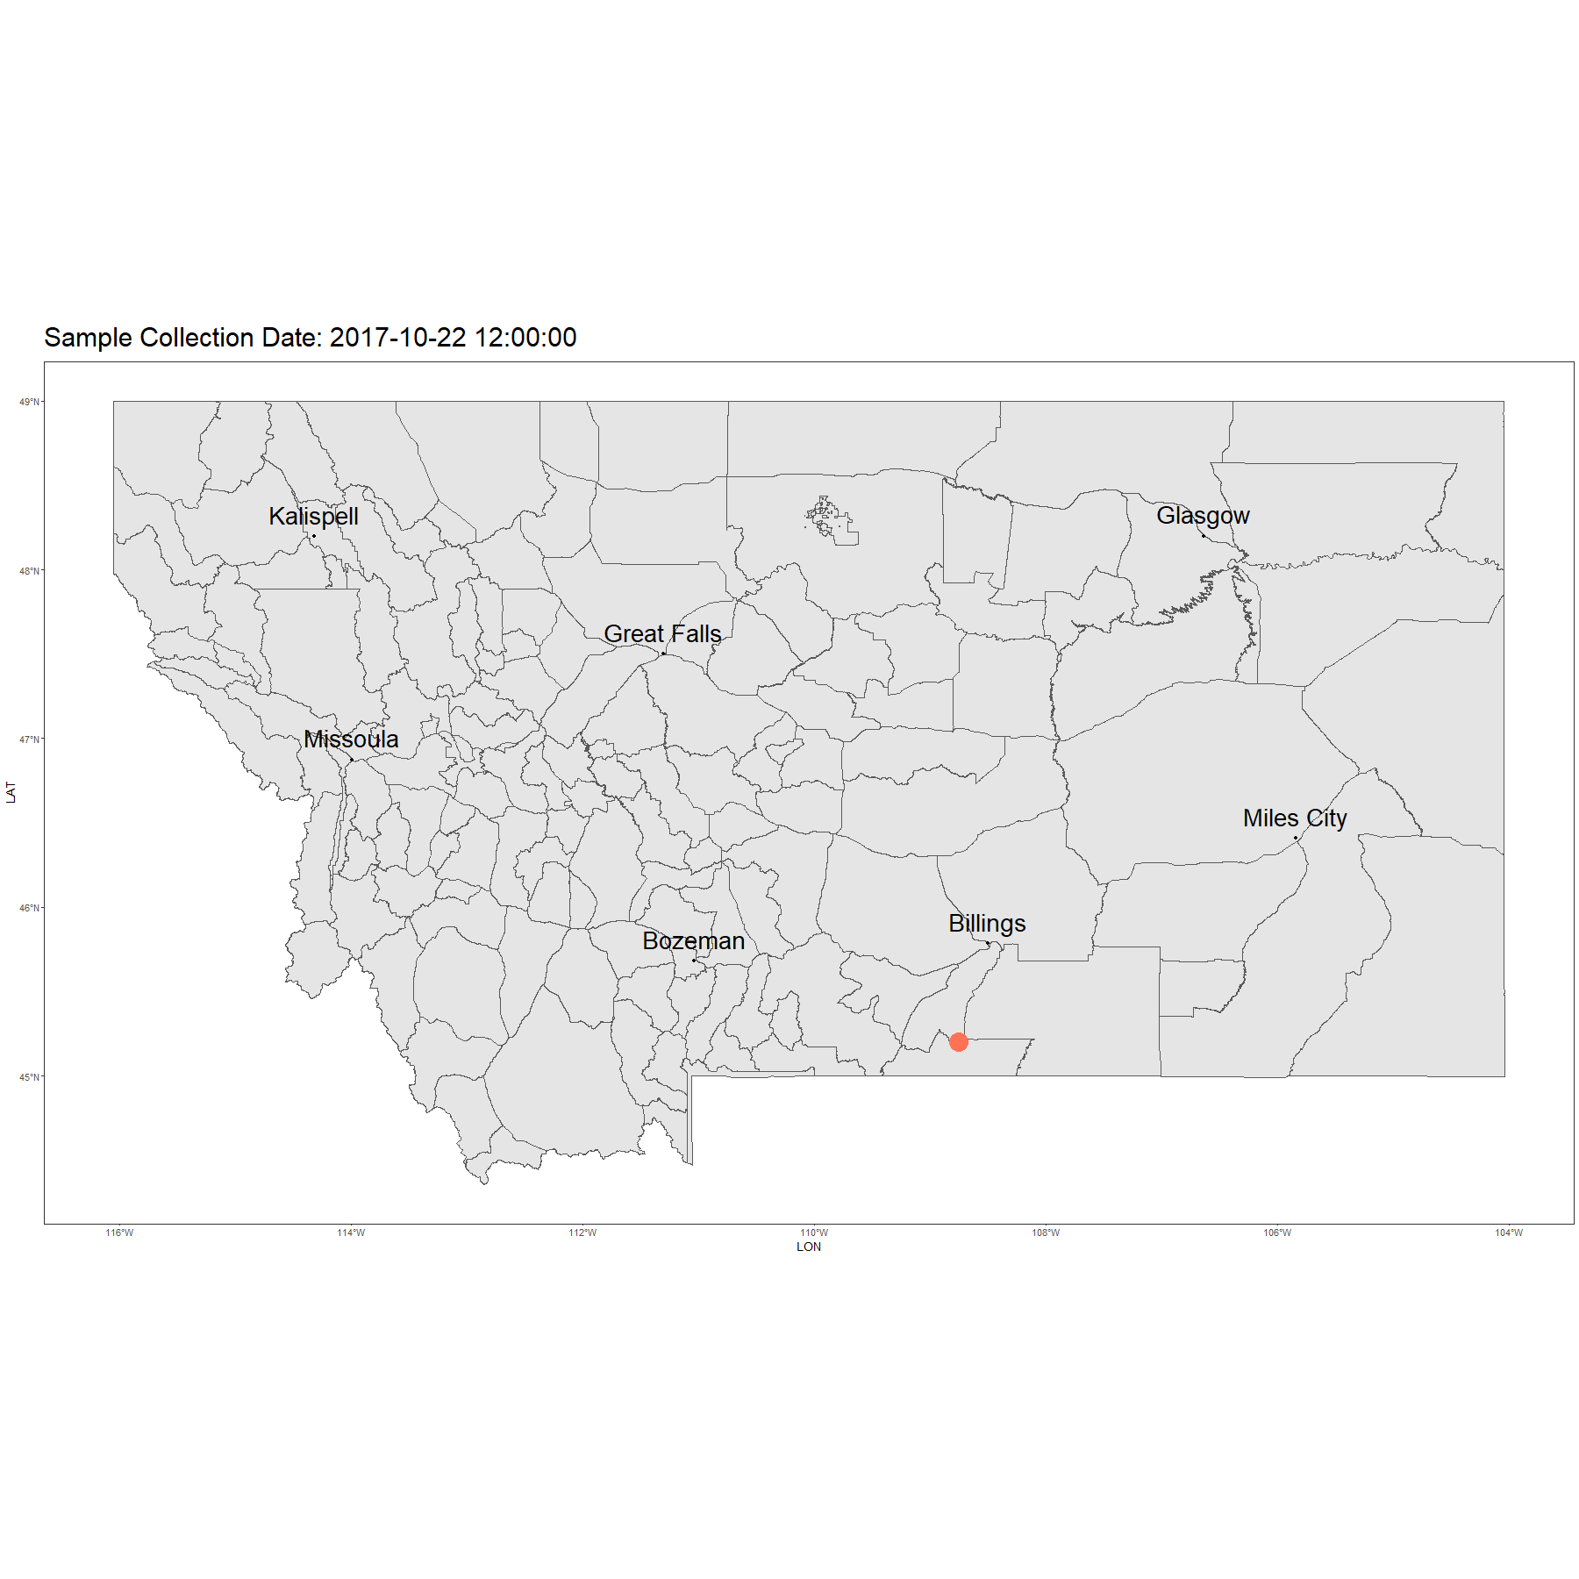
Positive Samples in Montana

Slide 5

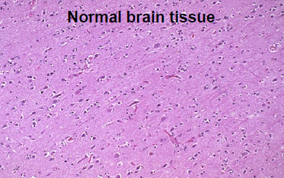
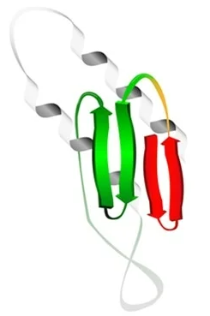
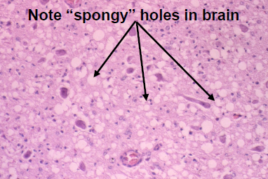
Causative Agent of TSEs
Normal Protein (predominant in nervous system cells)
Pathogen is an infectious misfolded prion protein
Transmissible and induce abnormal folding of specific normal cellular proteins
Prions are concentrated in an animal’s lymphatic and central nervous system tissues
Abnormal and Misfolded Prion Protein

Slide 6
Causative Agent of TSEs
Pathogen is an infectious misfolded prion protein
Transmissible and induce abnormal folding of specific normal cellular proteins
Prions are concentrated in an animal’s lymphatic and central nervous system tissues
Misfolded Prion
Normal Prion

Slide 7
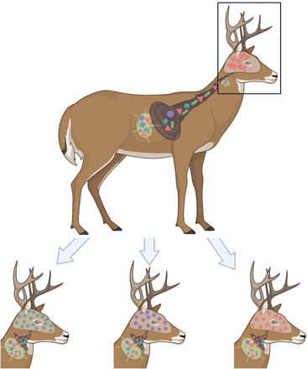
Causative Agent of TSEs
Pathogen is an infectious misfolded prion protein
Transmissible and induce abnormal folding of specific normal cellular proteins
Prions are concentrated in an animal’s lymphatic and central nervous system tissues
Wagner et al, 2022

Slide 8
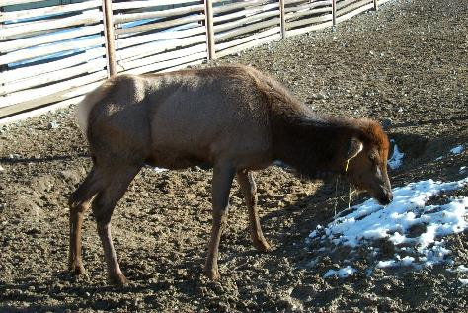
Late-Stage Clinical Signs
Clinical signs occur after an estimated minimum of 14 – 18 months, but likely vary broadly in wild cervids
Clinical signs:
  Stumbling and unsteady
  Loss of awareness
  Drooling
  Weight loss (wasting)
  Head droop
Photo credit: Wyoming Game and Fish Dept

Slide 9
CWD Infection Prior to Clinical Signs
CWD infected deer are more susceptible to other forms of mortality
  Predation
  Vehicle collision
  Hunter harvest
Infected animals may shed prions as early as 3 months
Majority of harvested CWD positive animals appear healthy and normal
Photo credit: Wyoming Game and Fish Dept

Slide 10
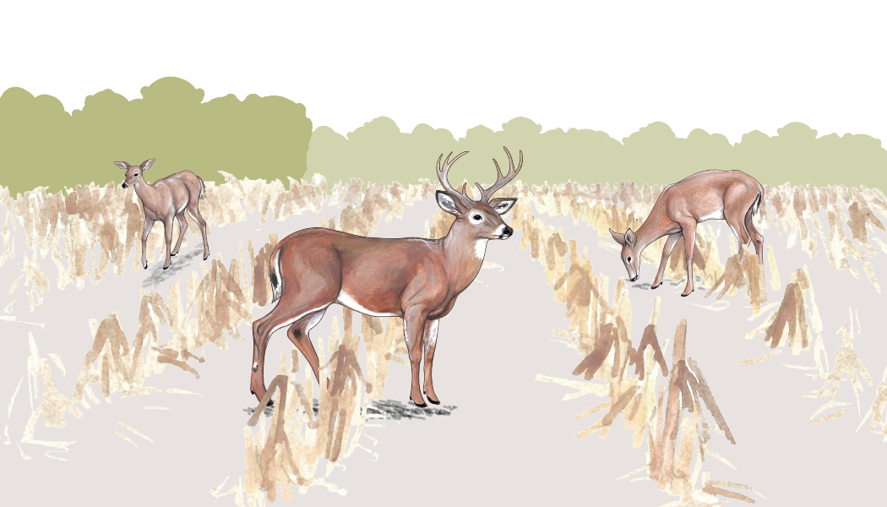
How does CWD spread?
Original drawing : https://www.purdue.edu/fnr/extension/help-research-chronic-wasting-disease-wild-bulletin/

Slide 11

CWD Transmission
Spreads through
  Animal to animal contact (direct transmission)
  Animal contact with contaminated environmental surfaces (indirect)
Prions shed through bodily tissues and fluids
  Saliva
  Feces
  Urine
  Bodily tissues after death
Original drawing : https://www.purdue.edu/fnr/extension/help-research-chronic-wasting-disease-wild-bulletin/

Slide 12
CWD Transmission
Infected deer can be free of symptoms and shed prions for years
Environmental persistence of prions at least 2 years up to 16+ years (scrapie)
Original drawing : https://www.purdue.edu/fnr/extension/help-research-chronic-wasting-disease-wild-bulletin/

Slide 13
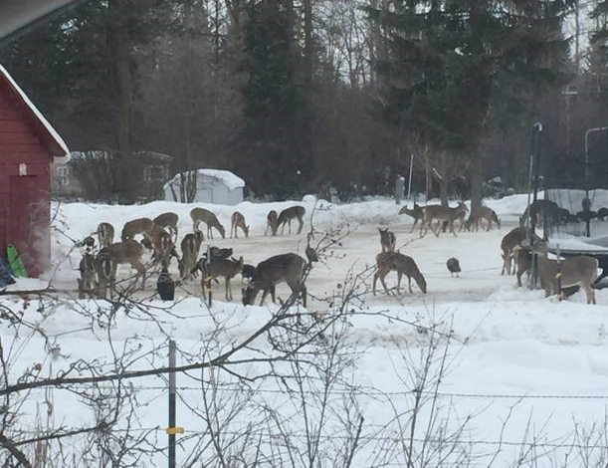
What contributes to CWD prevalence and spread?
Area of active research:
Population density
Age & sex structure
Feeding wildlife
  Shared feed and water sources
  Law on feeding wildlife (2011)
Movement of captive and wild cervids
Possible: Movement of infected carcasses and contaminated feed

Slide 14
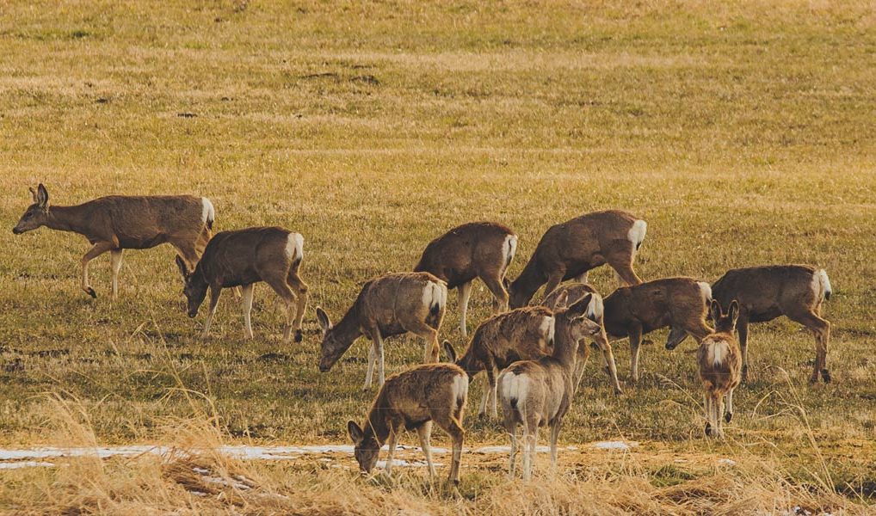
Potential Impacts
Infected animal die at a faster rate
Population declines in deer in heavily infected herds
A decrease in Montana’s wildlife recreation activities

Slide 15
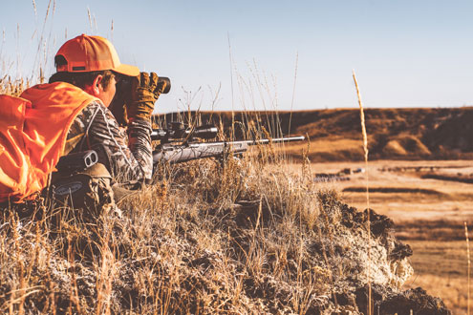
CWD & Human Health
An area of active research
Has not been observed in humans
Human health agencies recommend against consuming meat from CWD+ animals

Slide 16
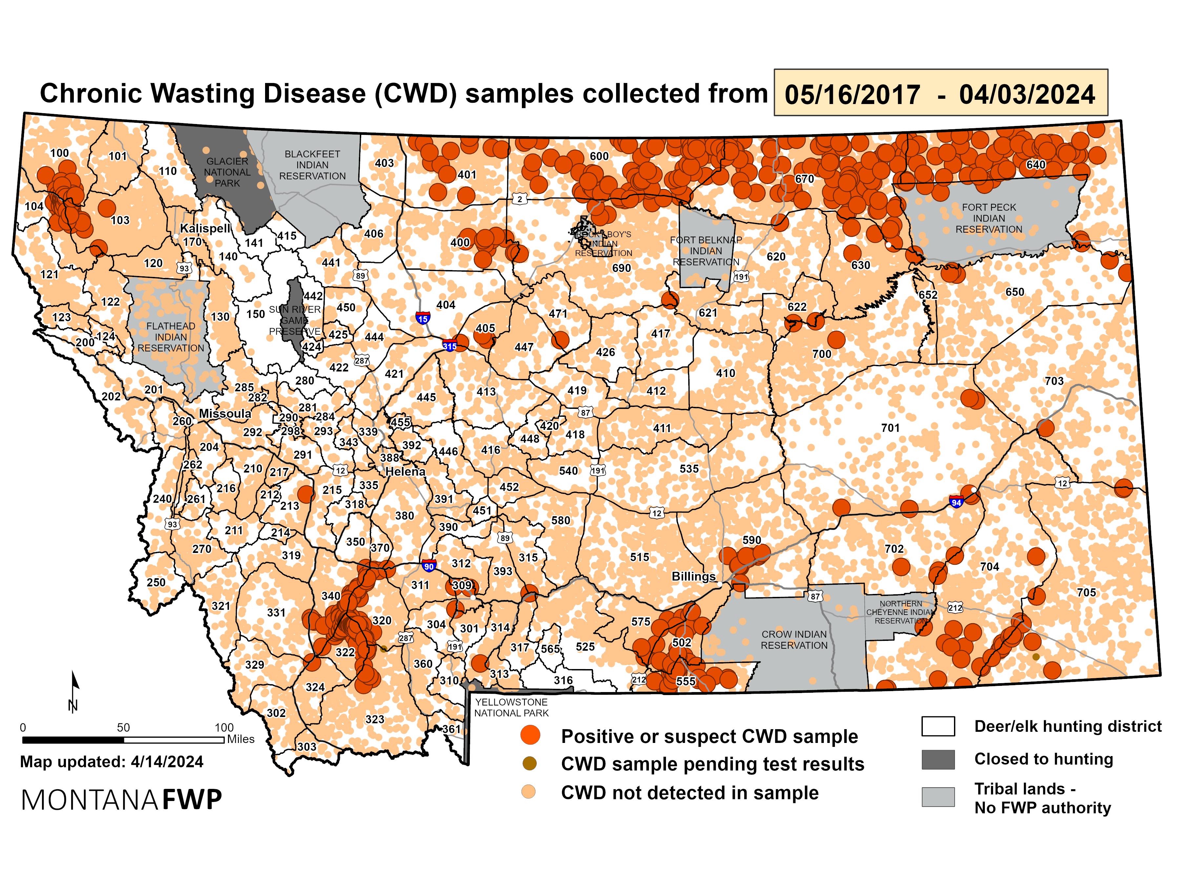
CWD in Montana

Slide 17
History of CWD in Montana
1998: Began statewide surveillance for CWD
1999: 1st CWD detection in Montana – in captive game farm
2005: FWP’s 1st CWD Management Plan
2014: Increasing surveillance in high-risk areas
2017: Renewed CWD Management Plan and 1st CWD detection in wild deer (others followed…)
Notes:
-CWD Mgt beg in MT in 98,
-Led to 1st Mgt Plan 2005, outlined multi-faceted mgt incl: deer rmvl (esp bucks), red food attr, and prop disp of carcasses
-1st discov in wild deer in 2017,
-

Slide 18
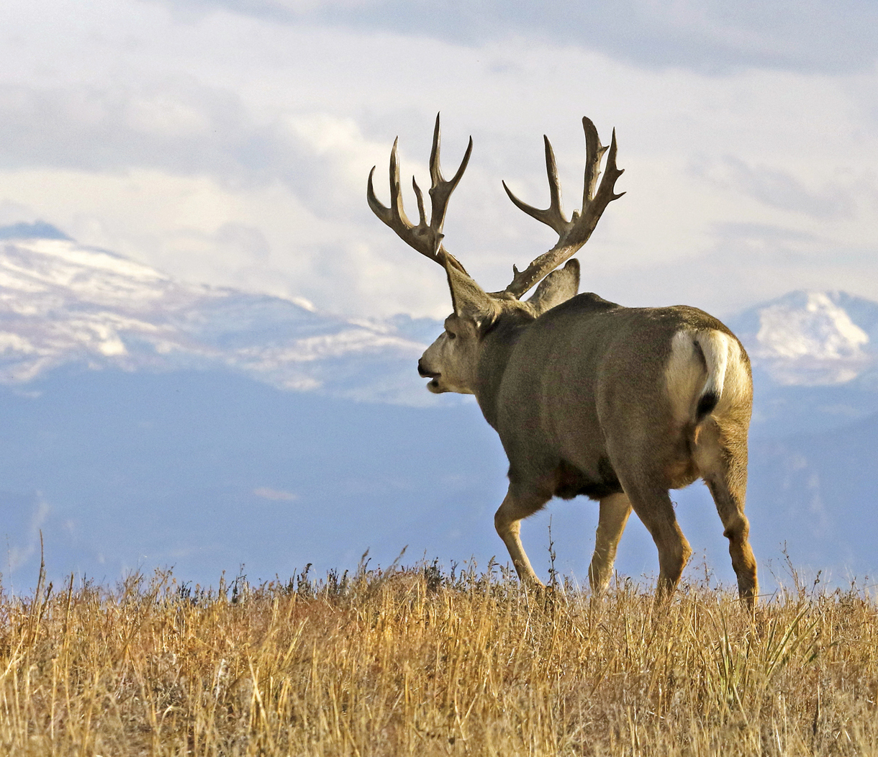
FWP Management
Main objective: Management, not eradication
Developed CWD Management Plans to outline specific goals
Use available Strategies and Tools to achieve goals
Strategies:
  Surveillance: look for CWD and describe presence/absence
  Monitoring: monitoring positive areas and describing prevalences
  Implementing (and evaluating) management techniques that limit spread
Vic Schendel, https://sportsafield.com/2020/high-country-mule-deer/

Slide 19
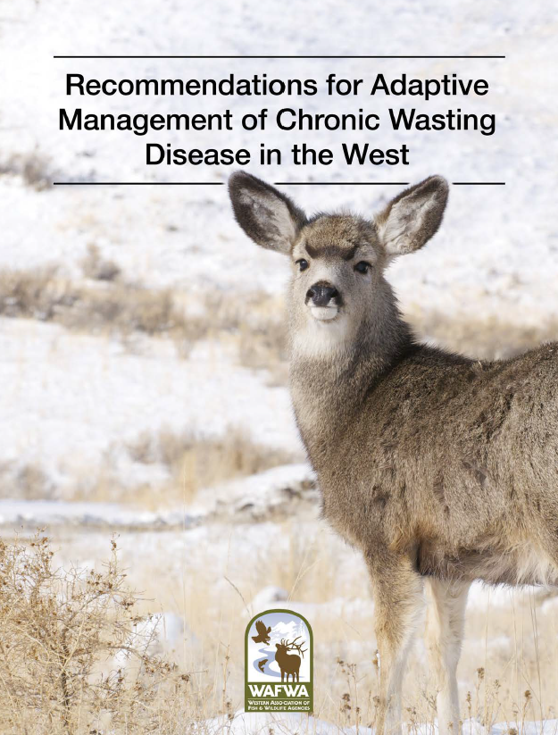
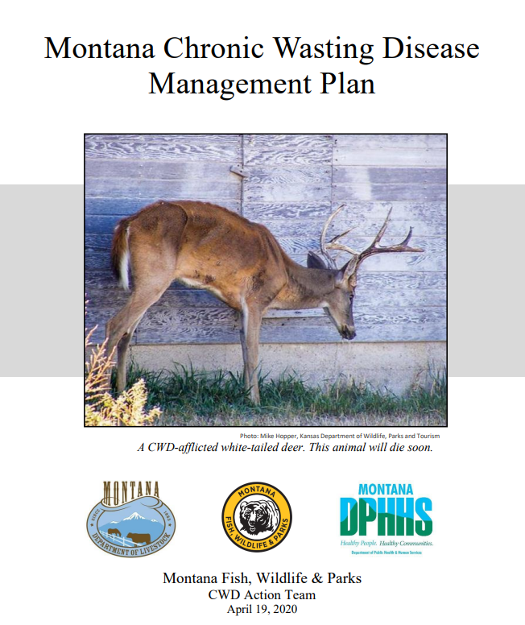
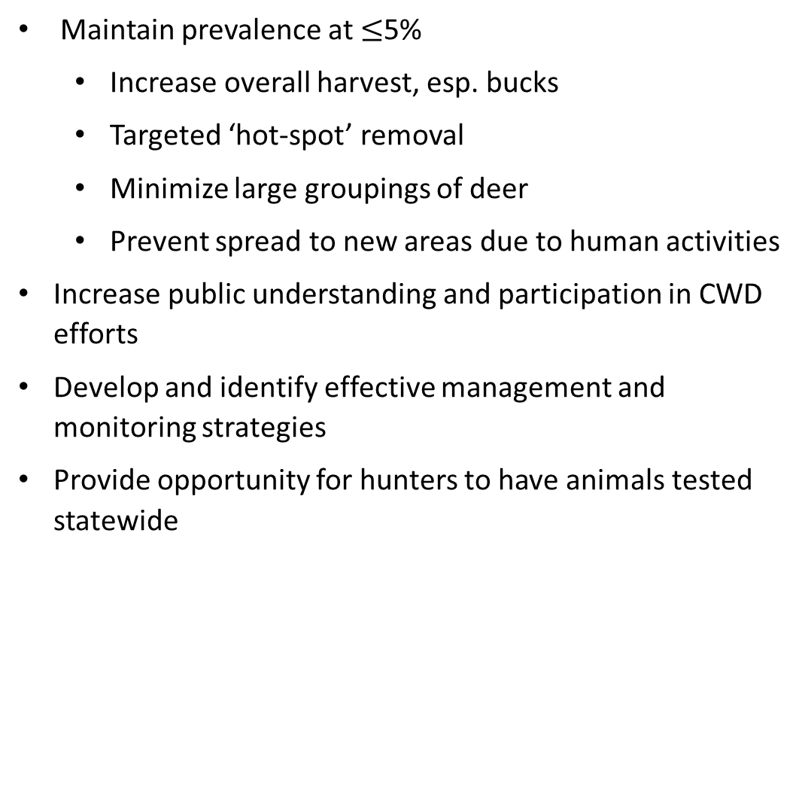
CWD Management Plan Goals
Maintain prevalence at $≤$5%
  Increase overall harvest, esp. bucks
  Targeted ‘hot-spot’ removal
  Minimize large groupings of deer
  Prevent spread to new areas due to human activities
Increase public understanding and participation in CWD efforts
Develop and identify effective management and monitoring strategies
Provide opportunity for hunters to have animals tested statewide

Slide 20
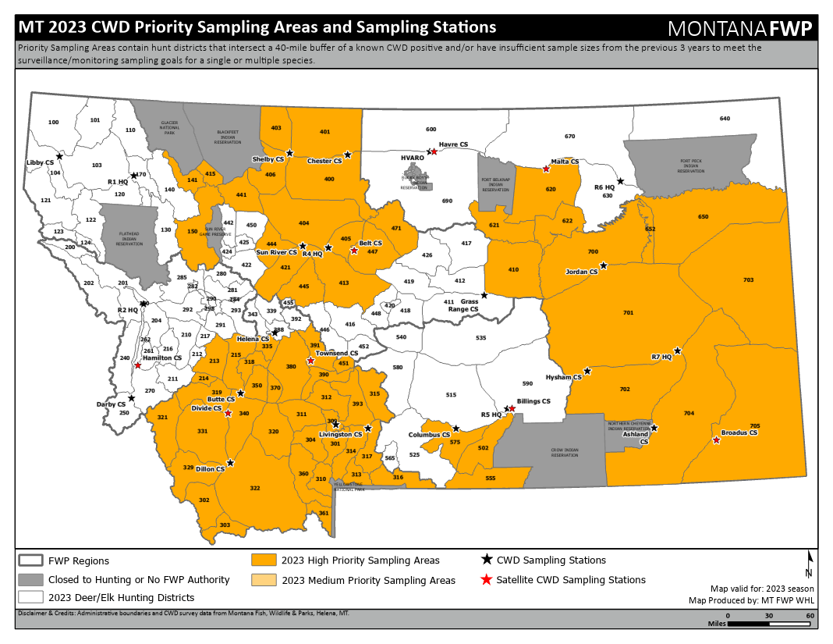
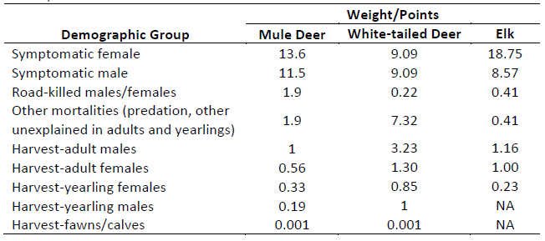
CWD Surveillance
Goal: Detect CWD if present at ≥1% with 95% confidence
Priority Surveillance Areas
Sample hunter harvested, symptomatic, and road-killed deer, moose, and elk
Weighted surveillance

Slide 21
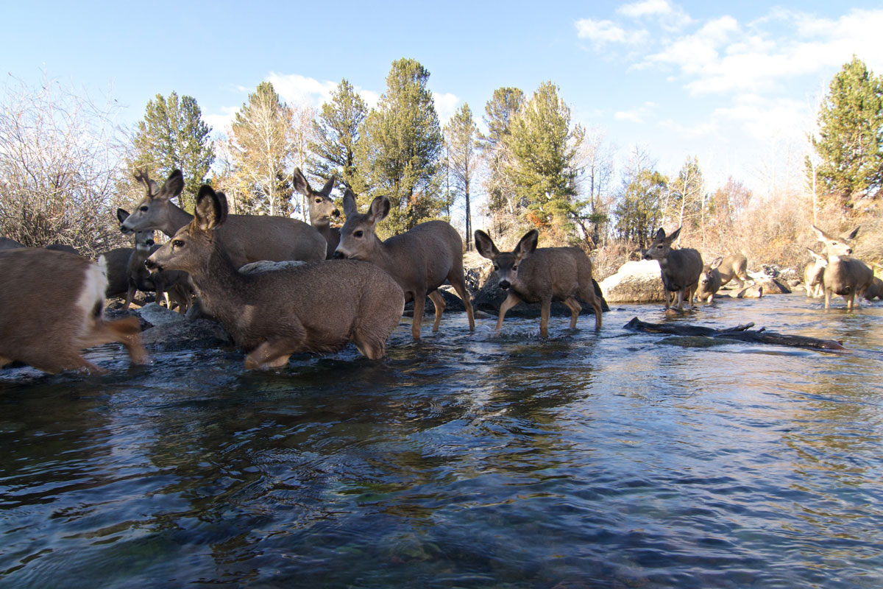
CWD Monitoring
Goal: Describe distribution and prevalence of CWD
Sample all species and age classes
Hunter harvest only
CWD Management Zones

Slide 22
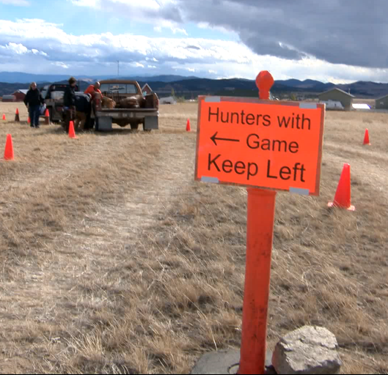
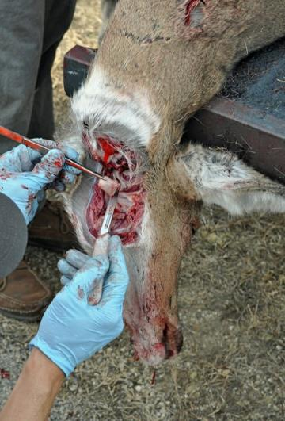
Sampling and Testing
Most sampling is voluntary and testing costs are covered by FWP
Samples include retropharyngeal lymph nodes or brain stem, tooth and genetic sample
Samples drop-off at FWP offices year-round or CWD stations (October 21 – Nov 26th)
Samples sent to Montana Vet Diagnostic Lab
Data entered into state database
Test results are viewable to the submitter online within 1-3 weeks

Slide 23
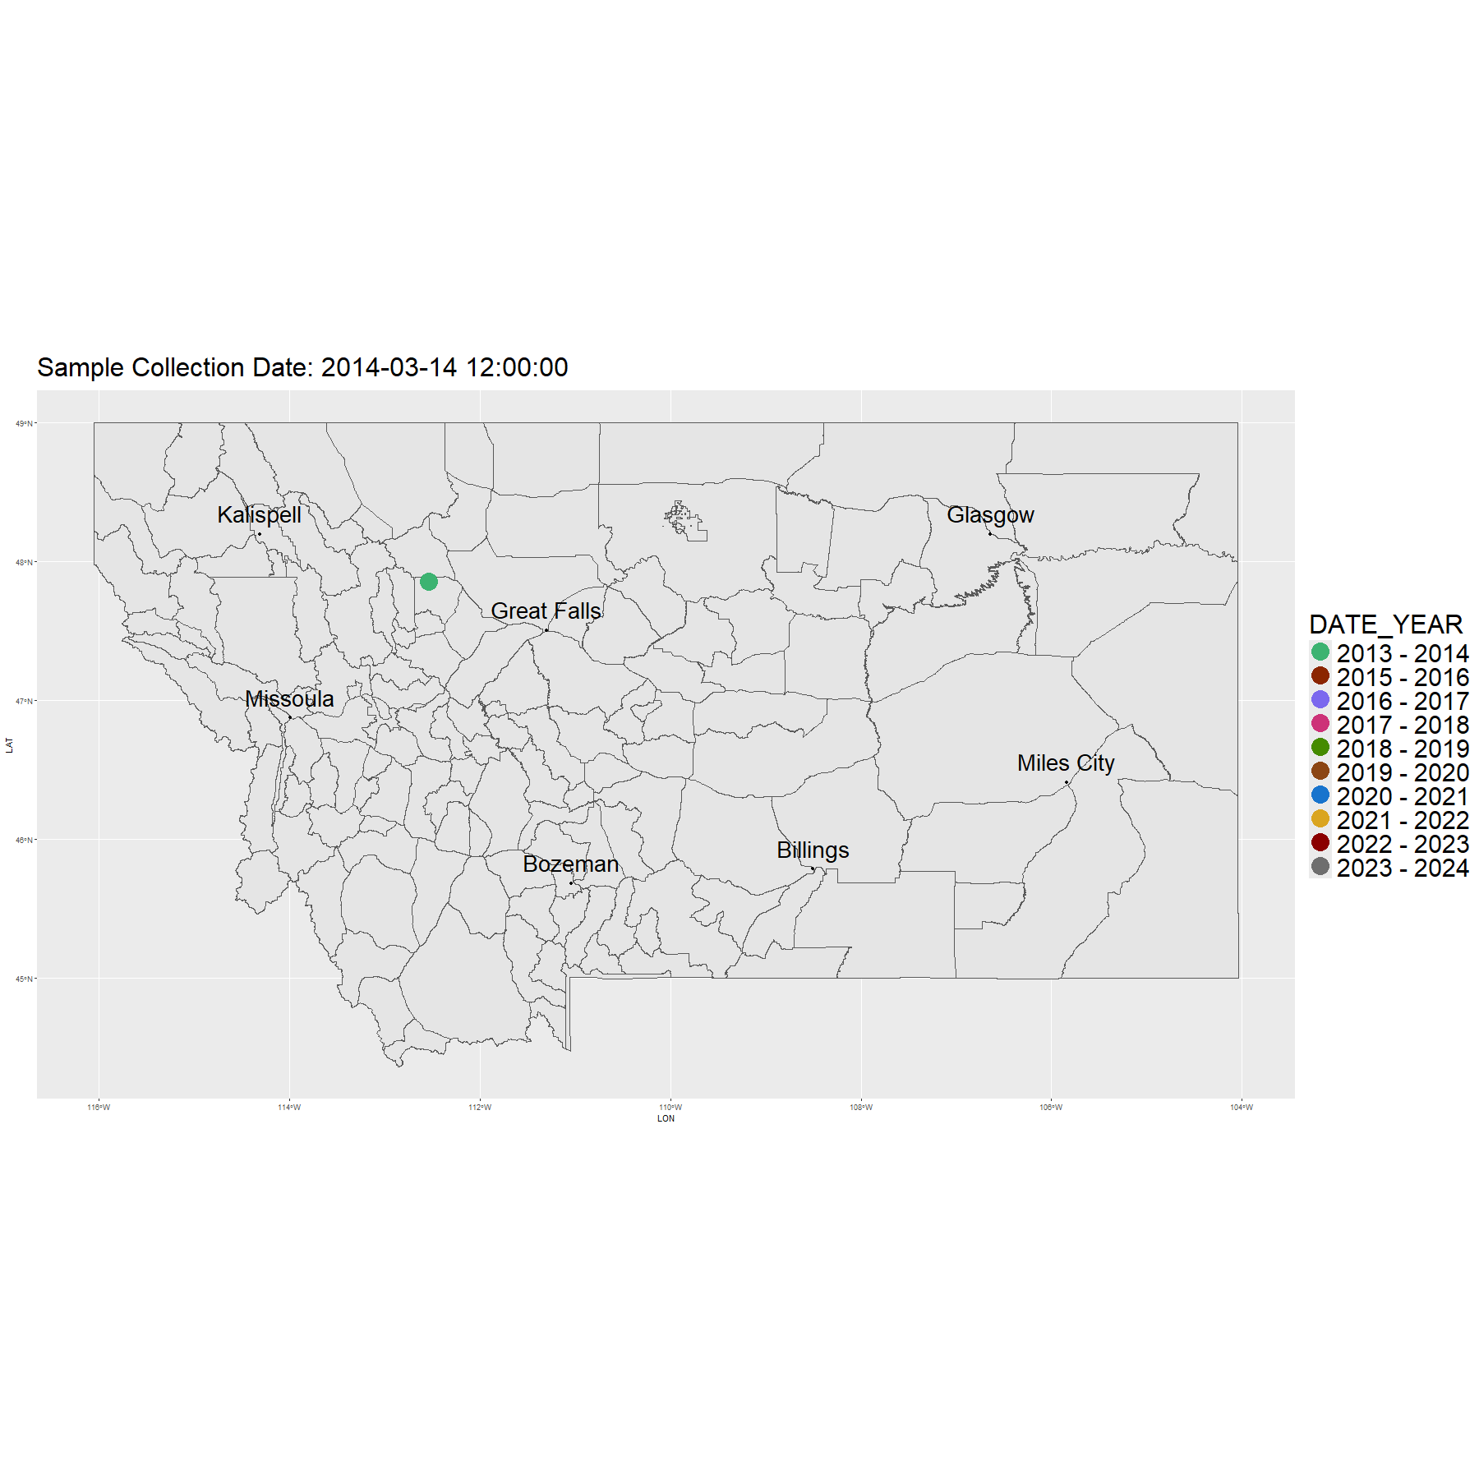
FWP Sampling Effort (All species)
Hunting Season

Slide 24
Positive Samples (All species)

Slide 25
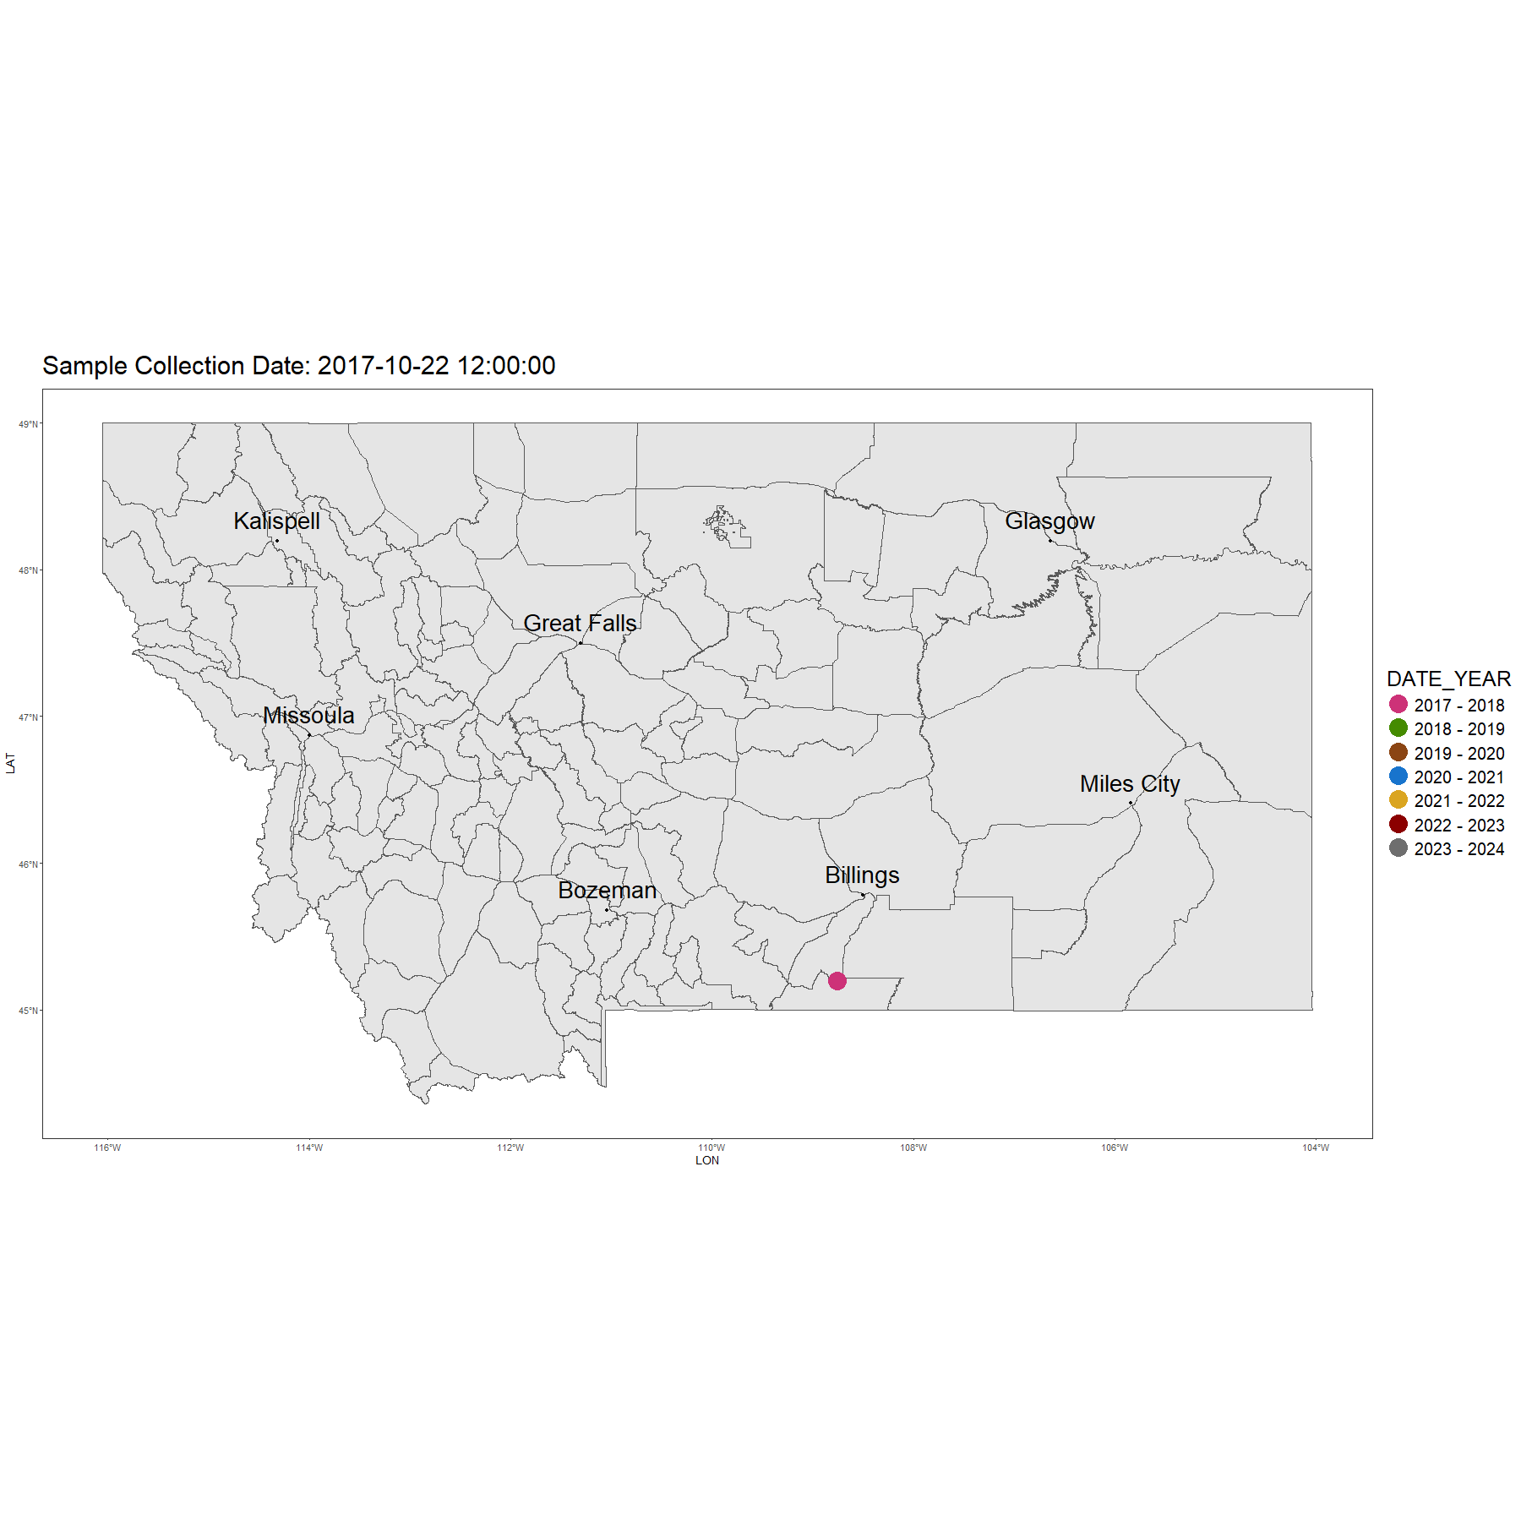
Positive Samples (all samples)
Hunting Season

Slide 26
CWD in Montana (2017 - Present)
42,503 hunter harvested, symptomatic and road-killed deer, elk, and moose
1184 total positive cases
Total positives by species
WTD - 847
MD - 331
Elk - 3
Moose - 3

Slide 27
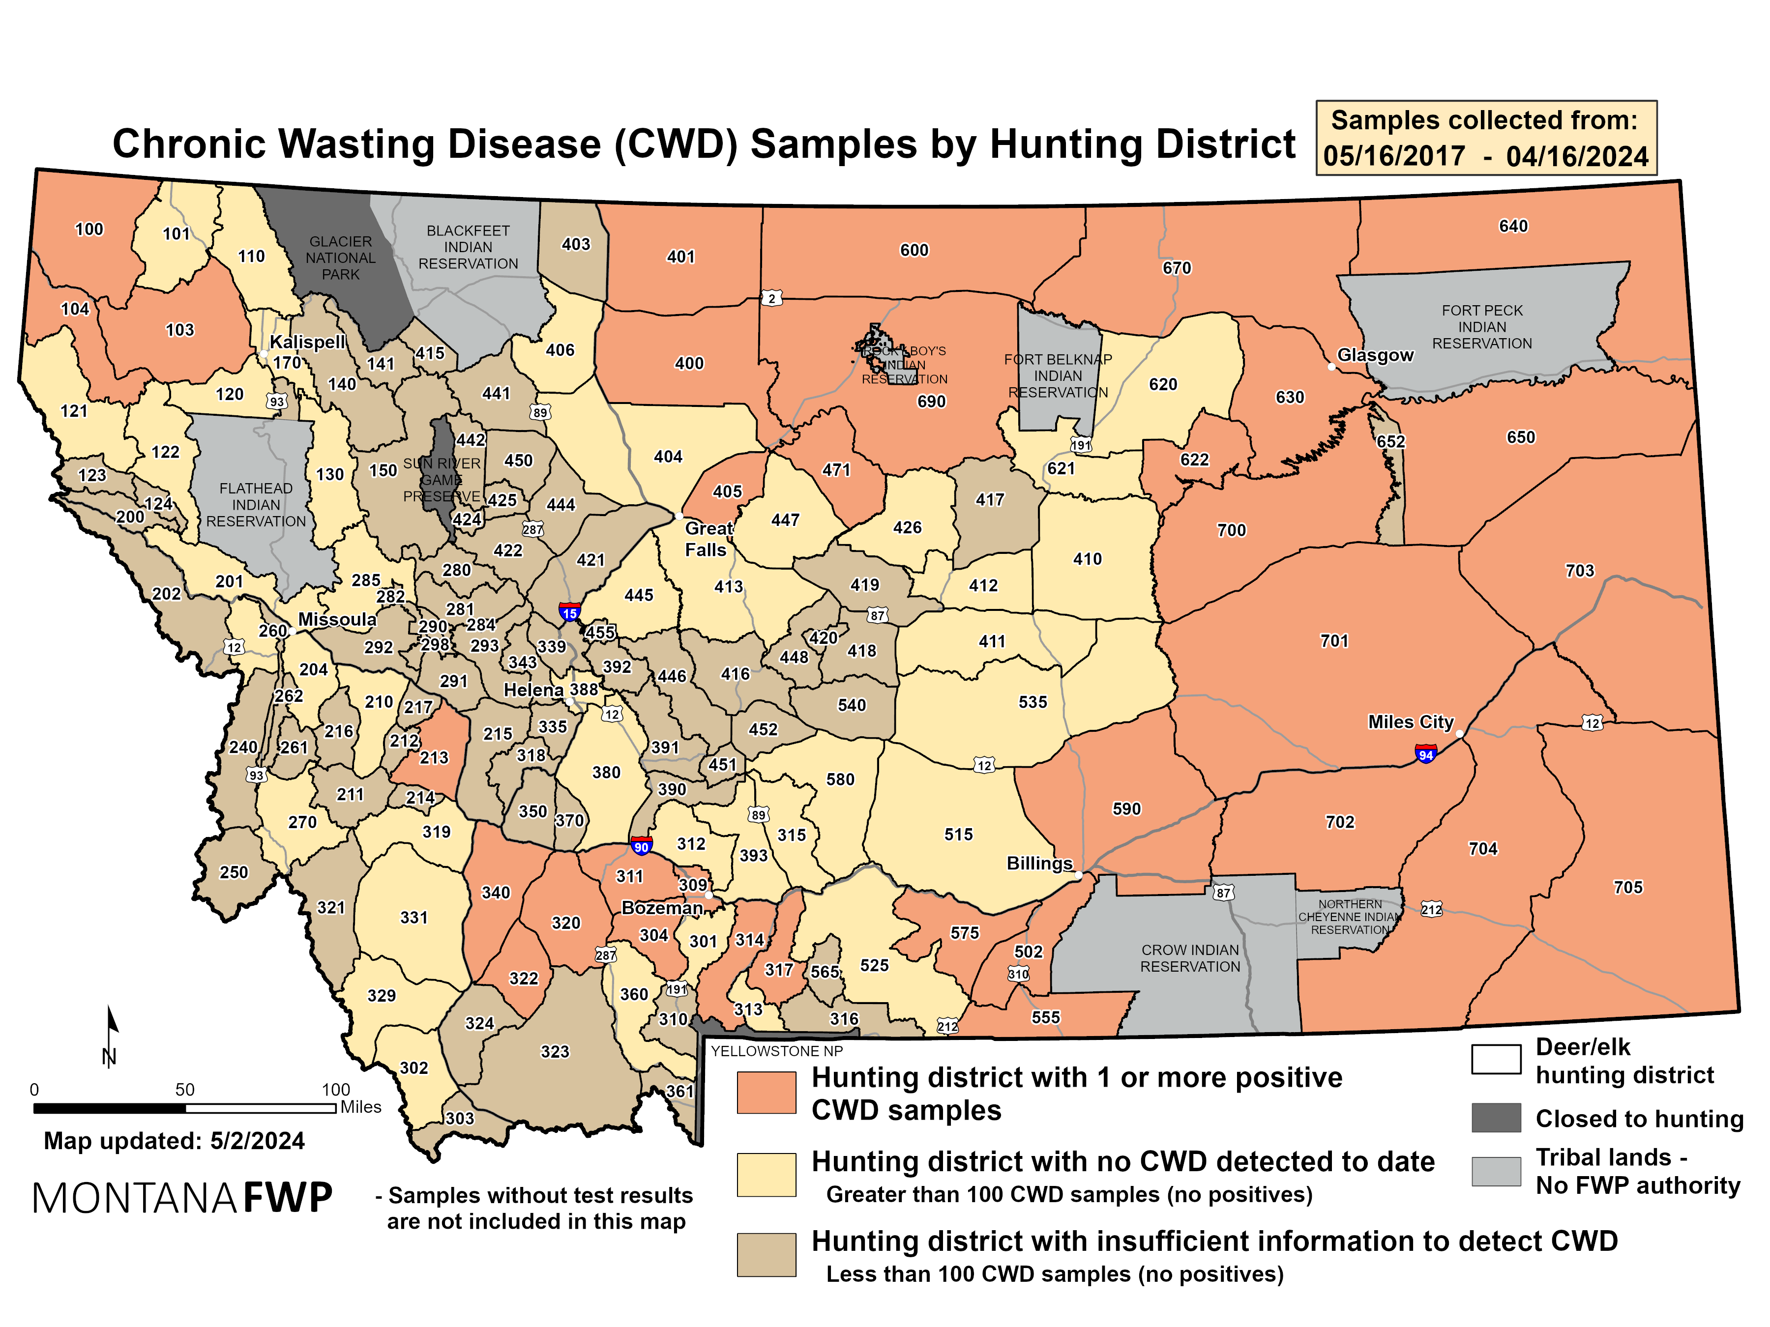

Slide 28
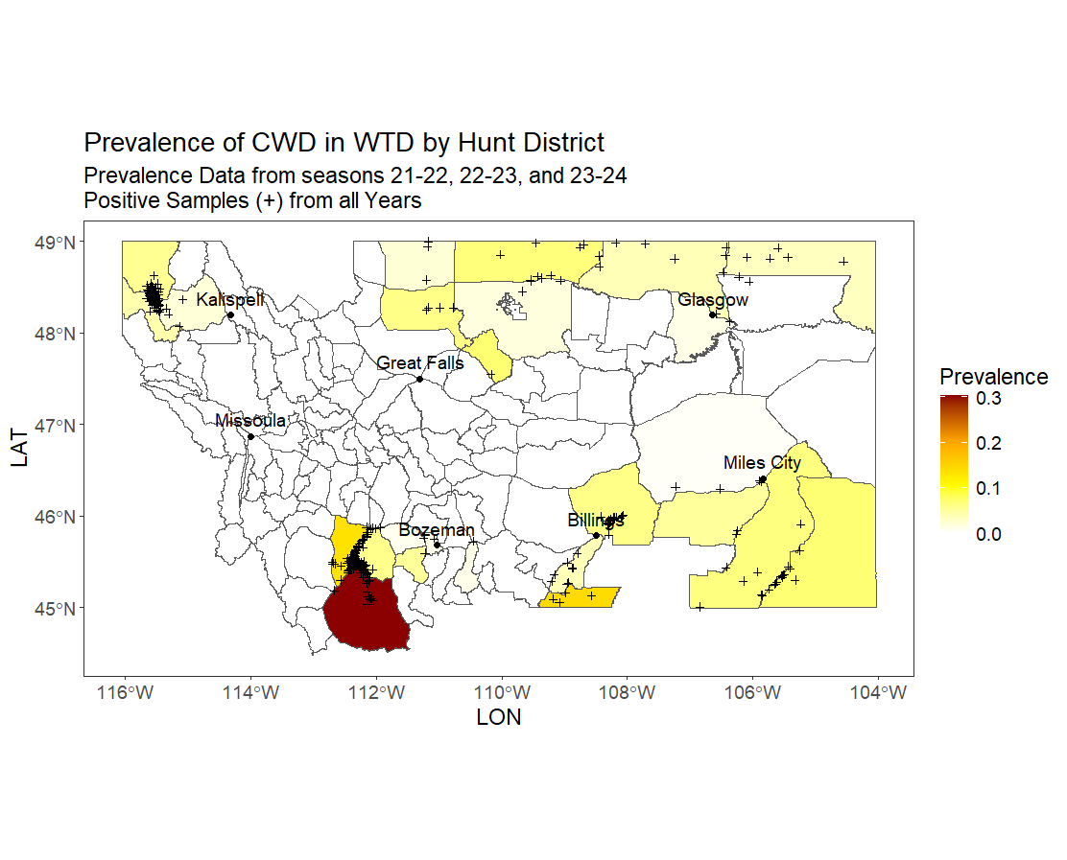

Slide 29
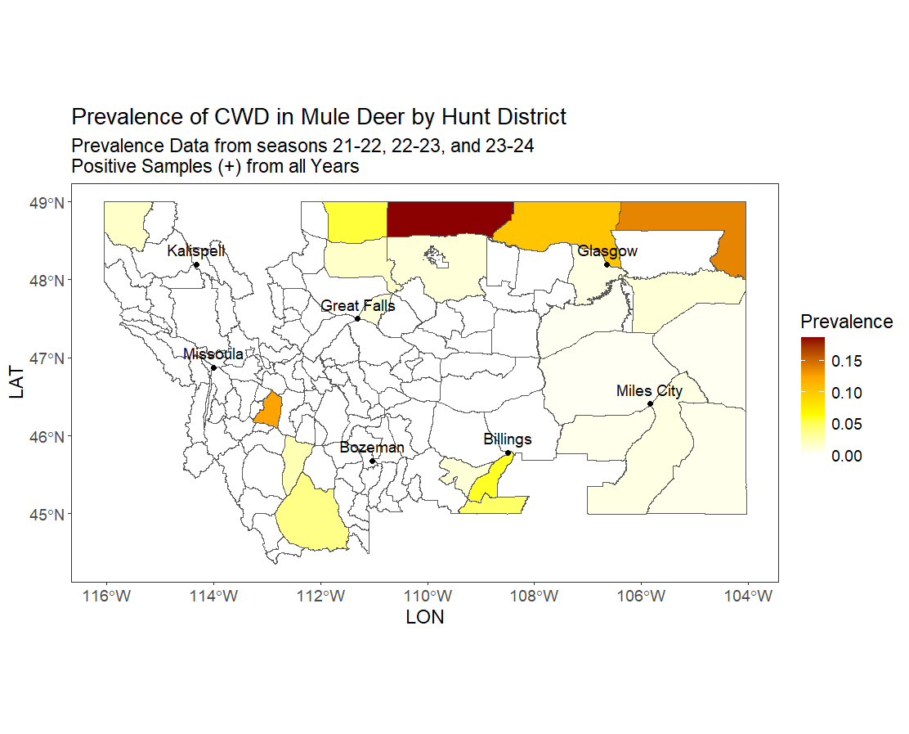

Slide 30
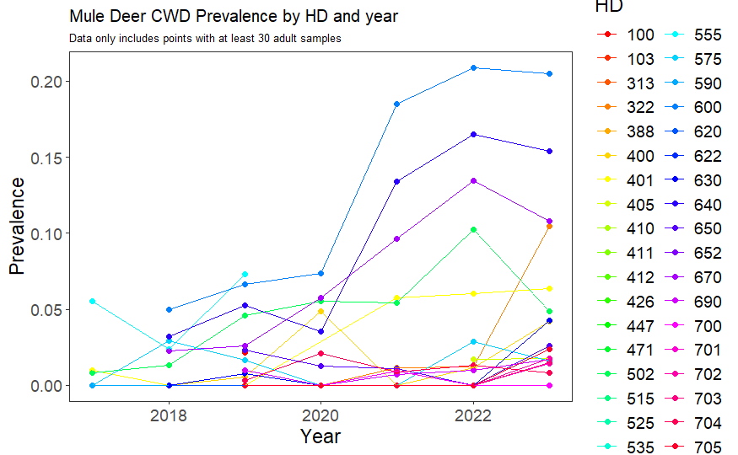

Slide 31
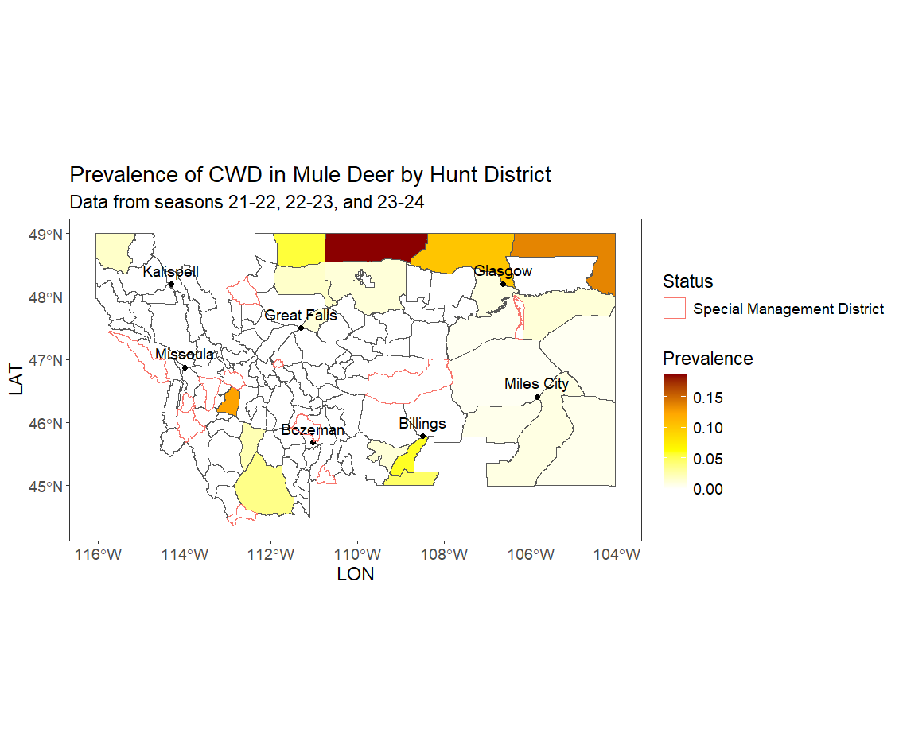

Slide 32
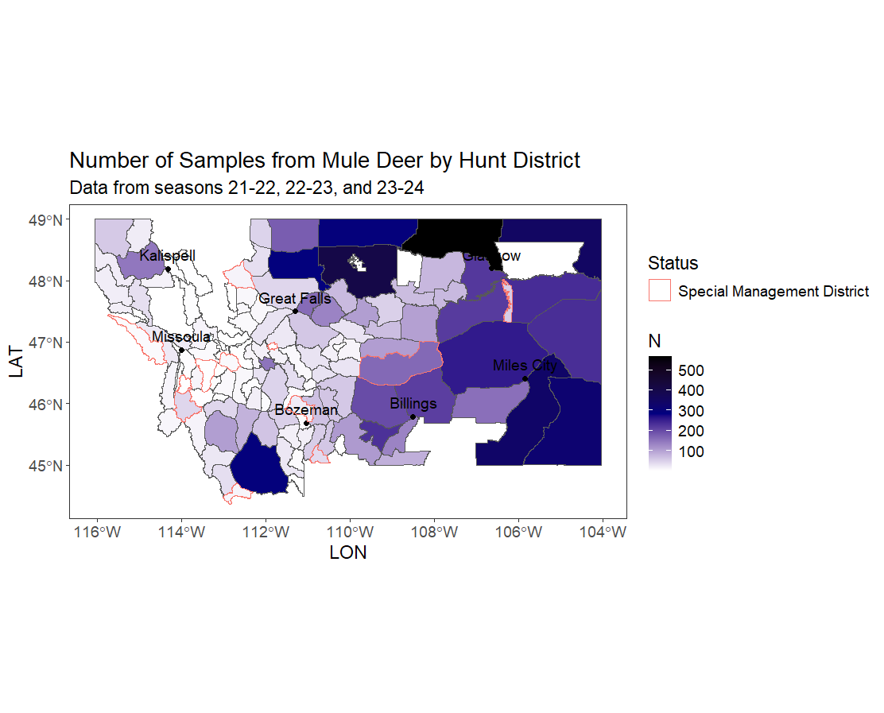

Slide 33
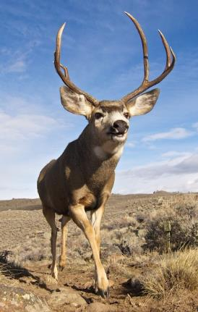
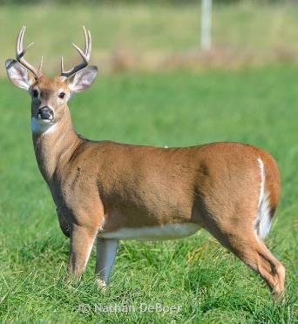
Mule Deer
Prev: <1% - 19%
Males > Females*
White-tailed Deer
Prev: <1% - 30%
Males ≈ Females*
Adults>
Yearlings>
Fawns
Joe Riis

Slide 34
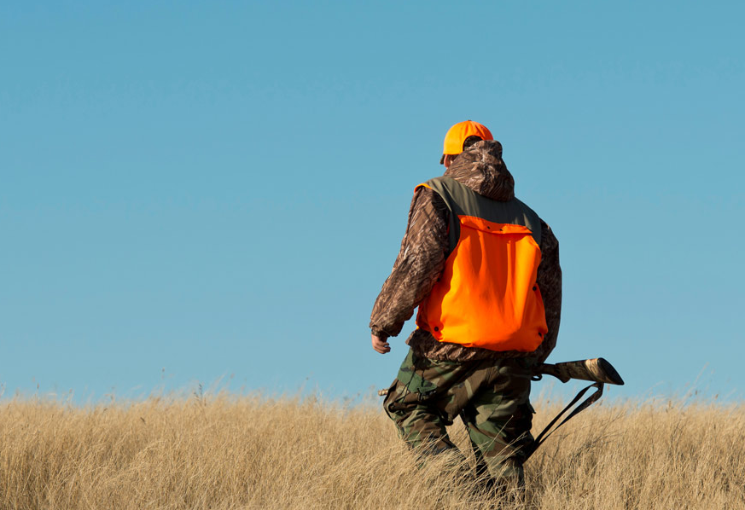
FWP’s Current Techniques to Control CWD
Preventing spread from human activity (several tools)
Increasing harvest via hunting license type and number
Controlled management hunts and removal at “hot spots”

Slide 35
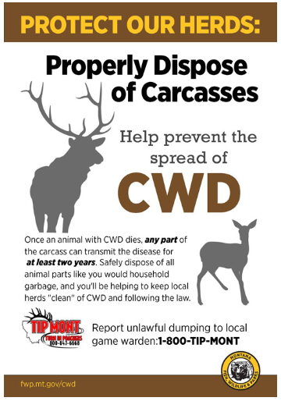
Preventing Spread
Prohibition of the transport of live cervids/carcasses of cervids from CWD-positive states
Carcass disposal rule
Voter initiative ban on new game farms
Historic management emphasizing opportunity
Law banning the feeding of wildlife
Law banning the use of cervid urine lures from CWD positive states
Cervid-derived glandular scents/lures must comply with the Responsible Hunting Scent Association standards

Slide 36
  Increase in antlerless B tags issued for MD & WTD, increase MD buck tags in HD 652 compared to 2017
Increased B tags in CWD Mgmt. Area; Created a Libby Urban Deer Mgmt. Plan; 2024 implementation of mandatory testing for some licenses.
Liberalized MD & WTD licenses, especially MD bucks
Increased antlered buck permits valid for 2 weeks after the 3- week general season
Southwestern MT CWD Mgmt Hunt

Slide 37
2024 and Beyond:
Evaluating Past Management & Updating Objectives
Evaluate associations between past management and CWD prevalences across HDs
Evaluate any changes in public viewpoints
Update plans now that CWD is observed in HDs across MT

Slide 38
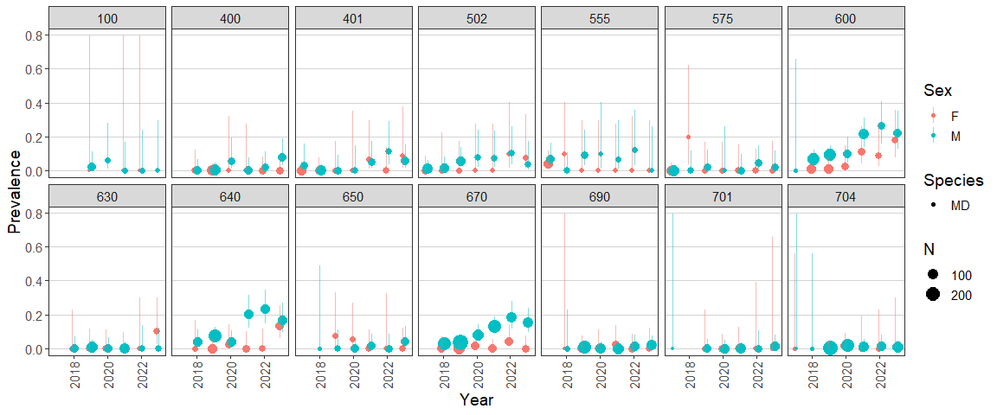
Variation in epidemic growth across districts
Analysis underway to determine impacts of deer density, buck:doe ratios, and historic harvest pressure
Notes:
These are only districts where we have data for 5+ years since detection, and where we have an average of 15 samples in at least one sex each year.

Slide 39
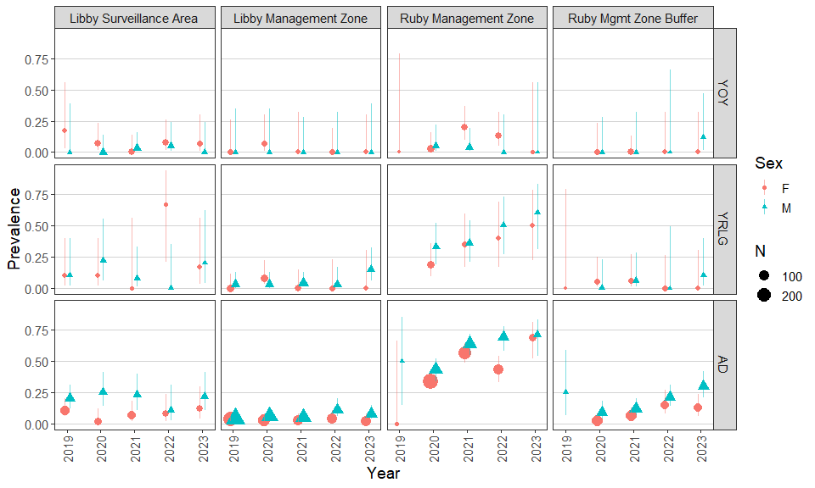
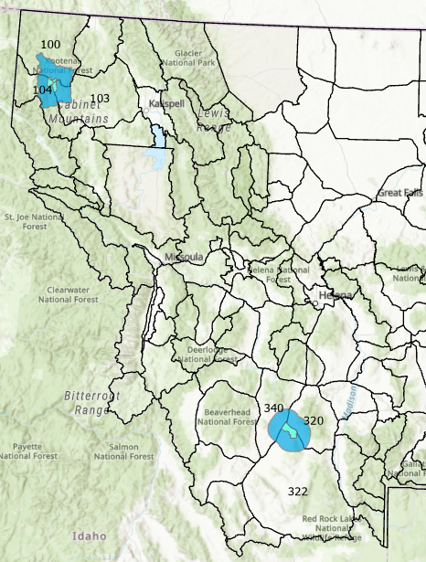
Libby and Ruby white-tailed deer management

Slide 40
Libby and Ruby white-tailed deer management
Core Area
Core Area

Slide 41
Libby and Ruby white-tailed deer management
Core Area
Core Area
Intense local management in both Libby and Ruby core areas
Epidemics were at different points when first detected
Libby appears to be holding prevalence steady
Ruby’s prevalence is still on upward trajectory

Slide 42
2024 and Beyond:
Evaluating Past Management & Updating Objectives
Evaluate associations between past management and CWD prevalences across HDs – and understanding future data and design needs
Evaluate any changes in public viewpoints
Update plans now that CWD is observed in HDs across MT

Slide 43
2024 and Beyond:
Evaluating Past Management & Updating Objectives
Evaluate associations between past management and CWD prevalences across HDs – and understanding future data and design needs
Evaluate any changes in public viewpoints
  Mule Deer and CWD CAC
  Regional stakeholder feedback
Update long-term management plans now that CWD is observed in HDs across MT

Slide 44
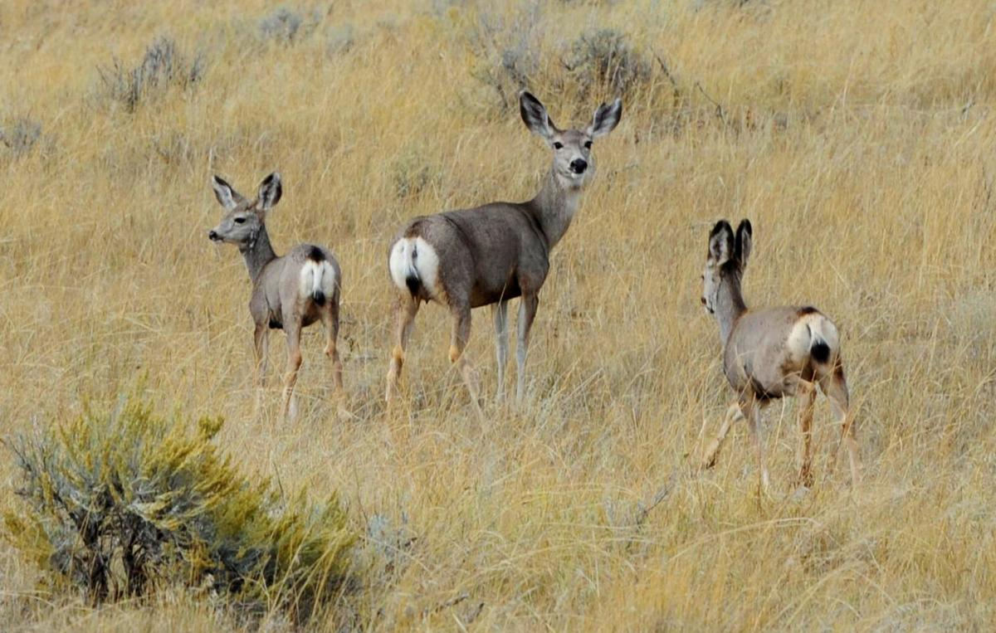
Thank you!
Contact:
Bevin McCormick
Wildlife Health Biologist
bevin.mccormick@montana.gov
https://billingsgazette.com/outdoors/mule-deer-fwp-region-6-region-7-southeastern-montana-hunting-tabor-robinson-lane-burrows-cwd/article_d64de284-ae76-11ee-bdf9-d74bf0512755.html

Slide 45
Where is CWD Found?

Slide 46
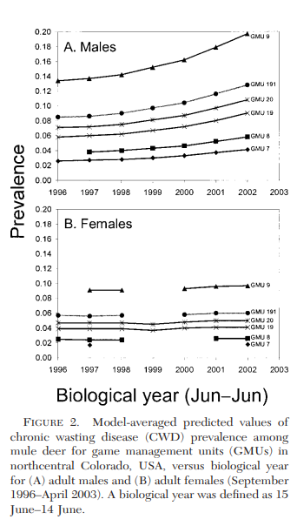
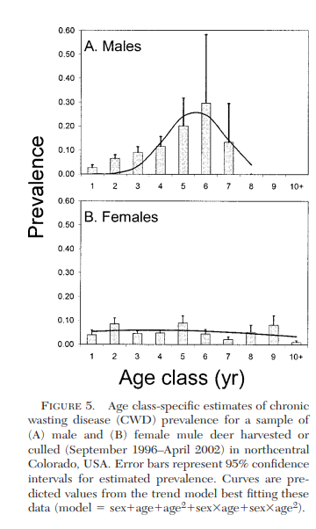
CWD Transmission: Buck:Doe Ratio
Miller & Connor, 2005

