Slide 1
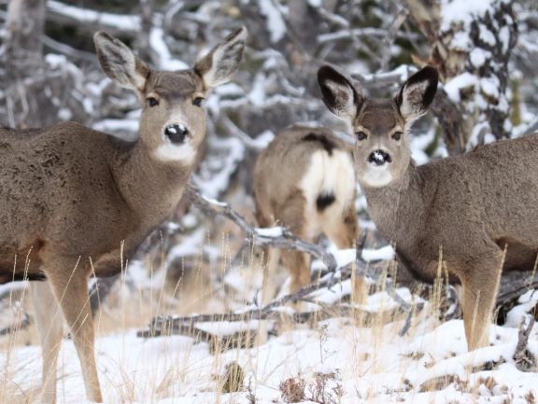
Mule Deer Adaptive Harvest Management
Deer Management Goal:
Manage for the long-term welfare of Montana’s deer resource and provide recreational opportunities that reflect the dynamic nature of deer populations.

Slide 2
Mule Deer Adaptive Harvest Management
Brief History/Background
General Concept and Components of AHM
Buck Management
CWD Management in the context of AHM

Slide 3
History of Adaptive Harvest Management (AHM)
1998- FWP Commission adopted Deer Management Policy
Provided basis for establishing deer
Population Objectives
Hunting Regulation Strategies
2001- Original AHM document adopted by Commission
Used guidance from Deer Management Policy
Further formalized protocols for establishing population objectives, hunter harvest management, monitoring of mule deer, etc.
2021- FWP completed/updated the current AHM document
Used the 2001 AHM plan as the base template
Updated and refined protocols for establishing population objectives, hunter harvest management, monitoring of mule deer, etc.
Important to note that all three documents reiterate the need for adaptive management and learning as deer demographics and ecological processes change in time.

Slide 4
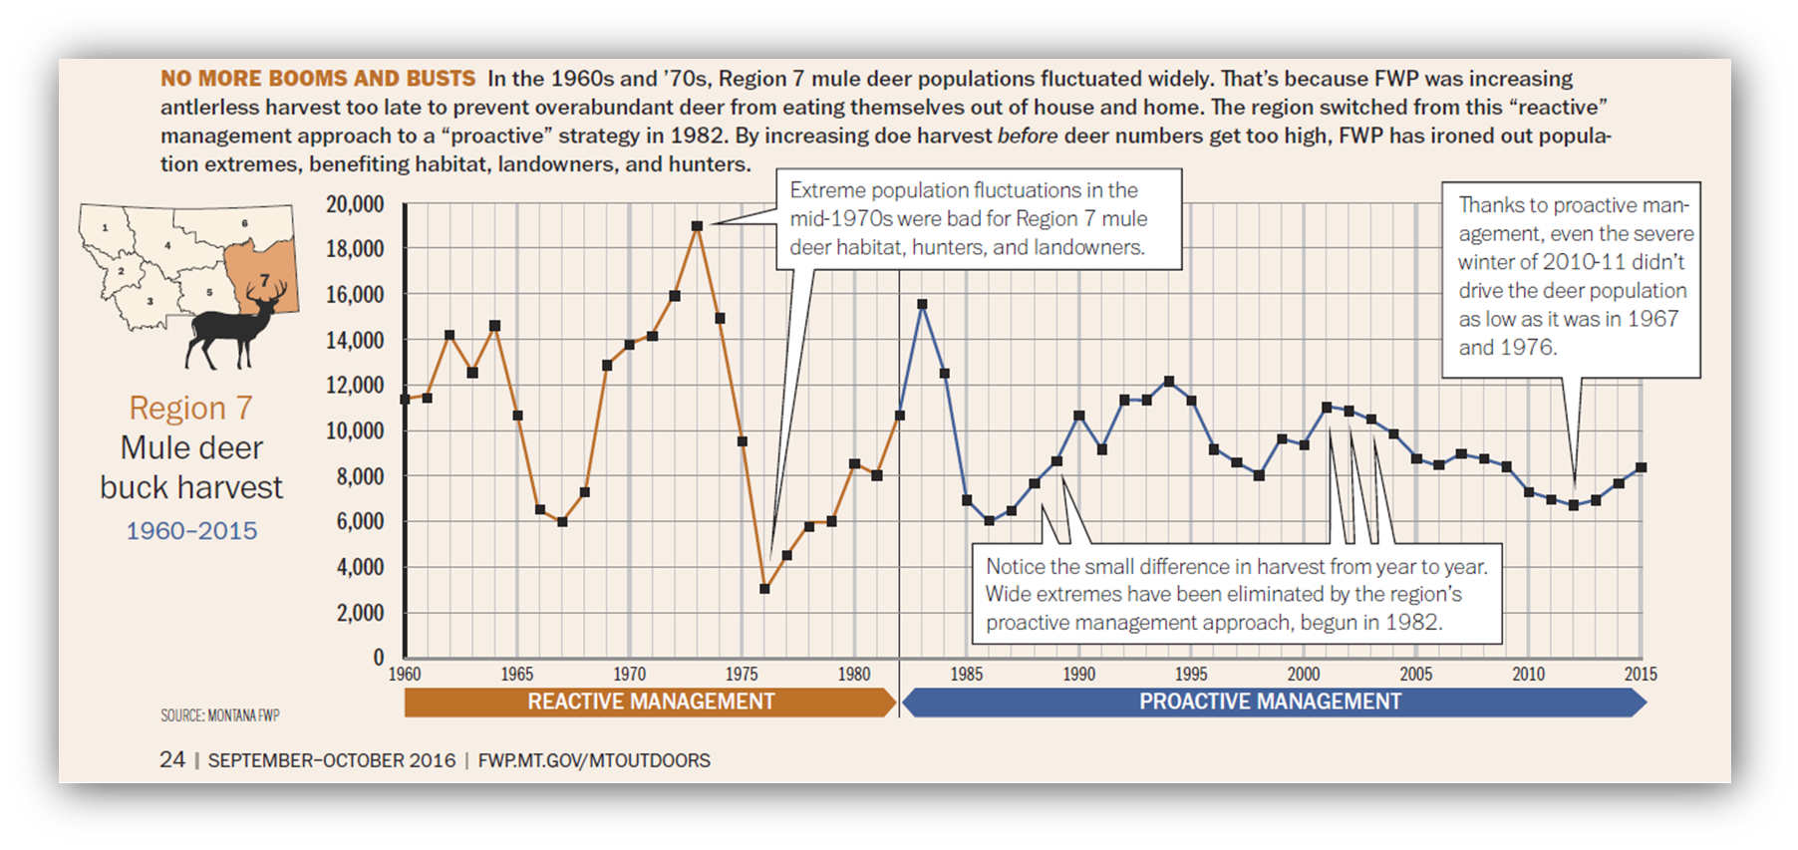
History of Adaptive Harvest Management (AHM)
1998- FWP Commission adopted Deer Management Policy
Provided basis for establishing deer
Population Objectives
Hunting Regulation Strategies
2001- Original AHM document adopted by Commission
Used guidance from Deer Management Policy
Further formalized protocols for establishing population objectives, hunter harvest management, monitoring of mule deer, etc.
2021- FWP completed/updated the current AHM document
Used the 2001 AHM plan as the base template
Updated and refined protocols for establishing population objectives, hunter harvest management, monitoring of mule deer, etc.
Important to note that all three documents reiterate the need for adaptive management and learning as deer demographics and ecological processes change in time.

Slide 5
Adaptive Management Perspective…
Fish, Wildlife & Parks has observed both positive and negative aspects of the AHM structure as laid out in the original 2001 document. Five major changes incorporated into the 2021 AHM revision:
Changing the definition of long-term average (LTA) as a metric for monitoring mule deer
Changing how population triggers are used to move from one mule deer hunting regulation package to another
Formally encouraging the alignment of hunting regulations among adjacent hunting districts (HDs)
Removing predictive population modelling as one of the four major components of AHM, though work on this aspect remains a priority for research and development
Updating correlations between this AHM document and chronic wasting disease (CWD) management

Slide 6
Montana’s mule deer management program integrates the following elements:
Habitat Protection and Enhancement
Population Surveys
Harvest Management
Access Management
Research
Information & Education
Enforcement of Hunting Regulations
Minimization of Game Damage Complaints from Private Landowners
Hunter and Public Preferences and Attitudes

Slide 7
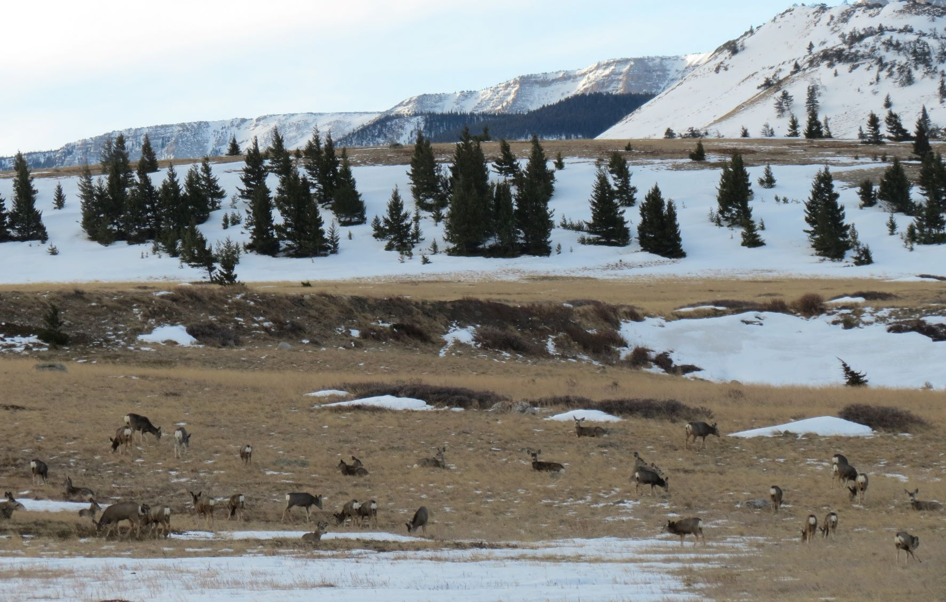
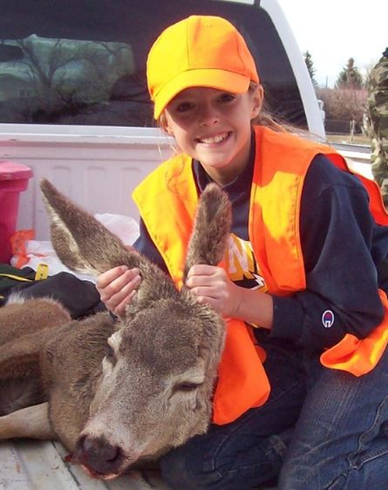
AHM focuses on correlations between population surveys and harvest management to develop hunting regulations
Habitat Protection and Enhancement
Population Surveys
Harvest Management
Access Management
Research
Information & Education
Enforcement of Hunting Regulations
Minimization of Game Damage Complaints from Private Landowners
Hunter and Public Preferences and Attitudes
AHM is part of Montana’s mule deer management program
Notes:
While recognizing the importance of each of these elements, the focus on AHM is only on these components.

Slide 8
Components of Adaptive Harvest Management
Population Objectives
Monitoring Program
Hunting Regulation Alternatives
Must be measurable via a strong monitoring program
When significant change in population status is detected, alternative hunting regulation may be triggered

Slide 9
Mule Deer Population Objectives and Monitoring Program
Objectives defined for groups of hunting districts known as Population Management Units (PMUs)

Slide 10
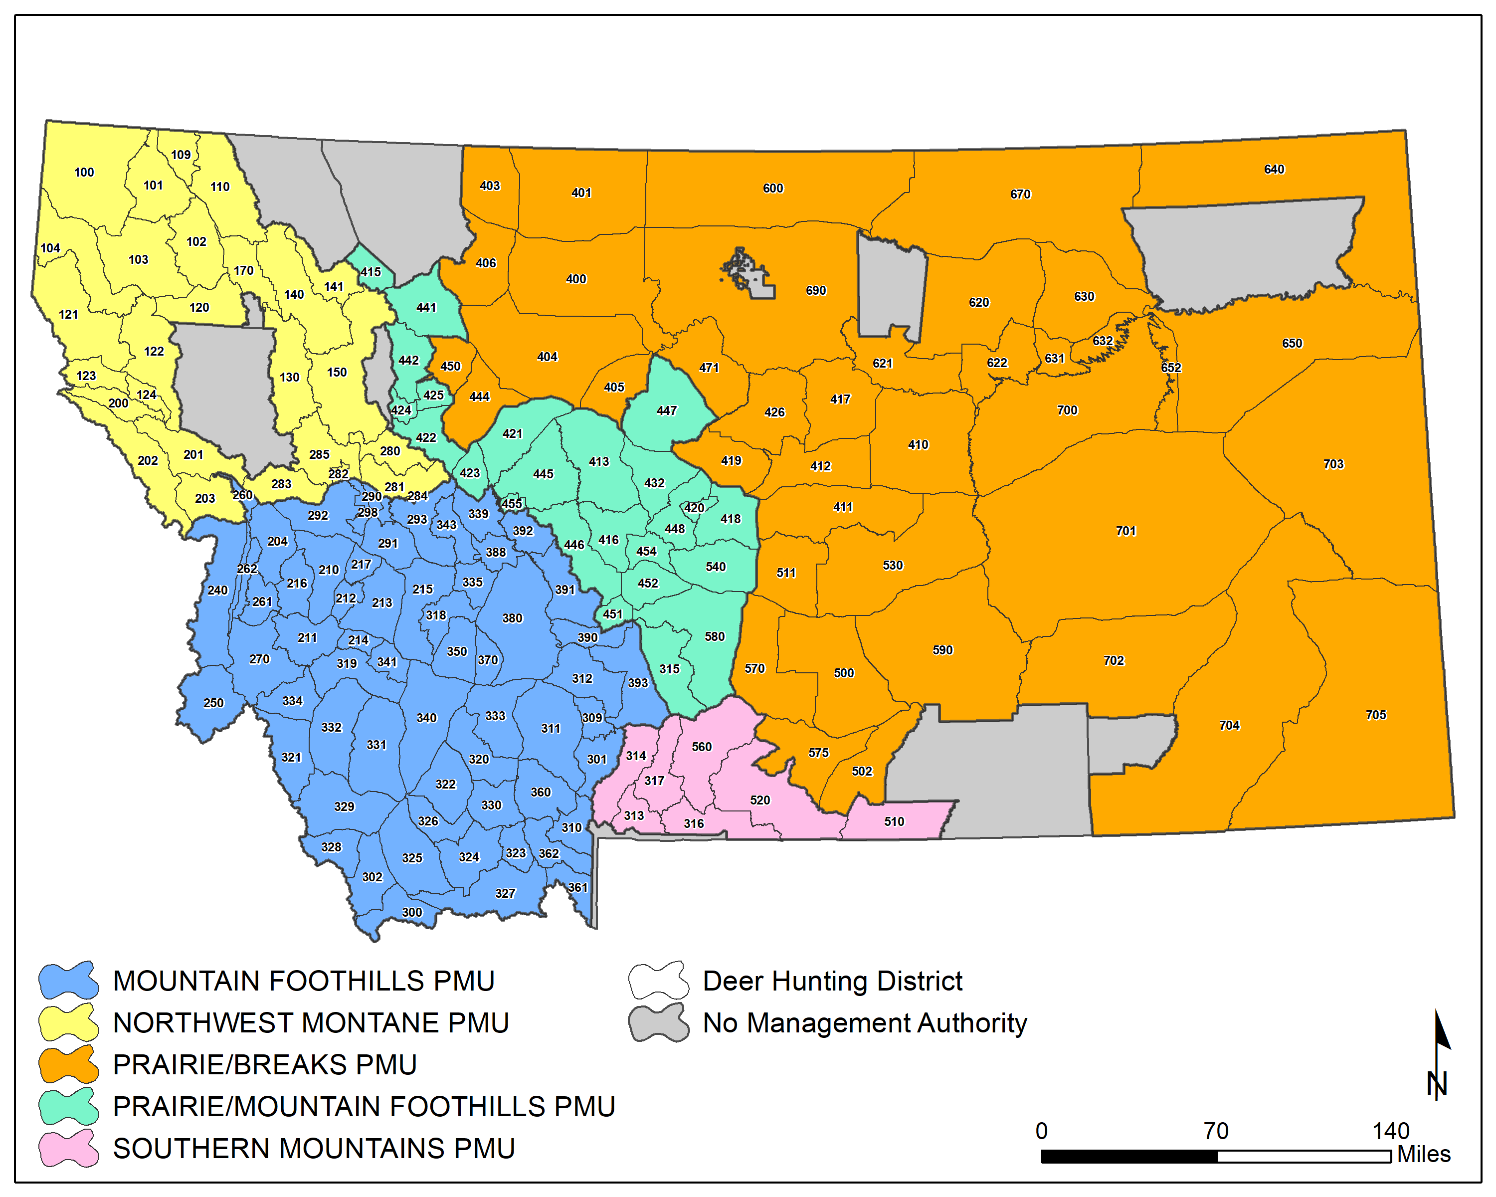
Population Management Units (PMUs)
Hunting Districts within a PMU share similar habitat and mule deer population dynamics
Delineated from:
Long-term research studies
Analysis and input from regional management biologists
Notes:
Long term research studies=Described deer population dynamics in open, complex ecological systems

Slide 11
Mule Deer Population Objectives and Monitoring Program
Objectives defined for groups of hunting districts known as Population Management Units (PMUs)
Objectives and hunting regulations listed for each PMU are largely determined by characteristics of the population and the potential for hunter harvest

Slide 12
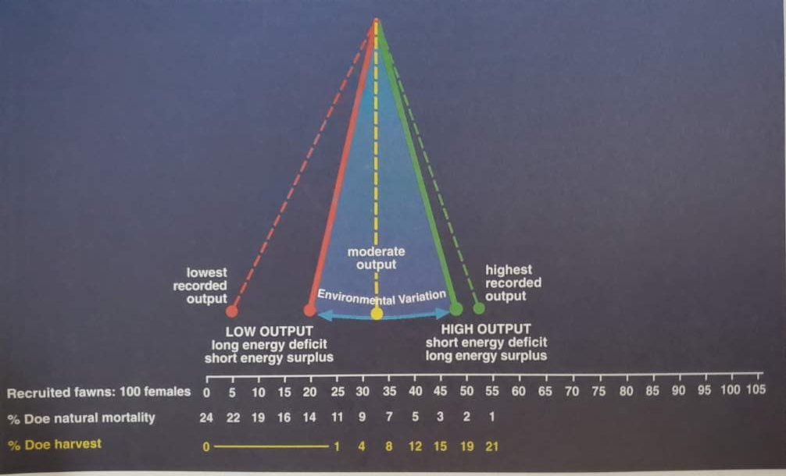
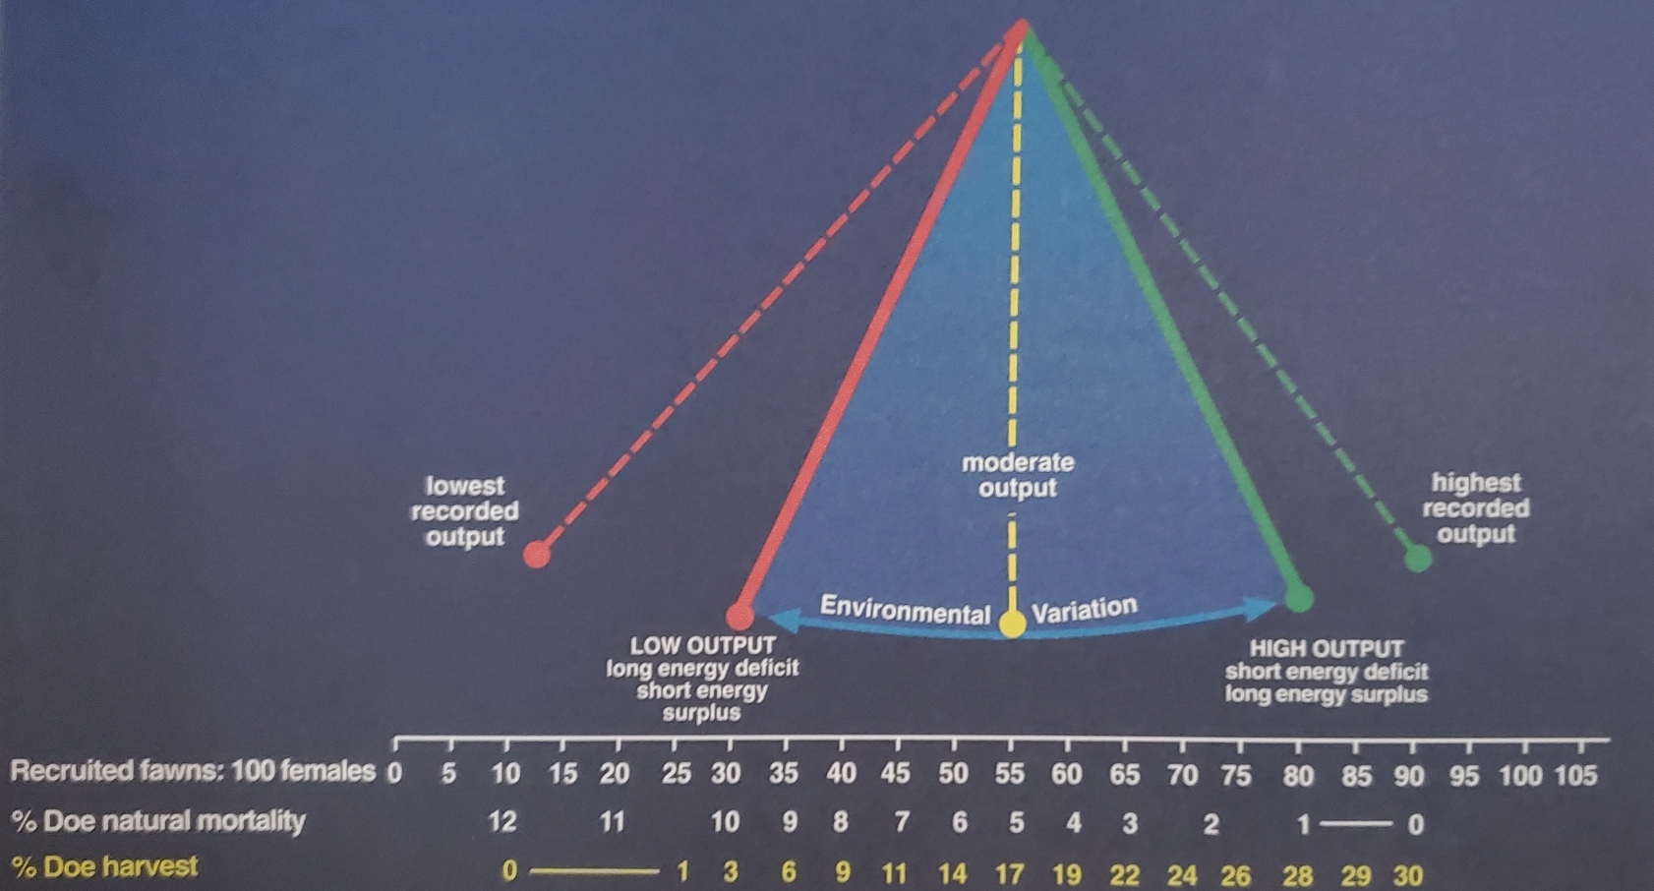
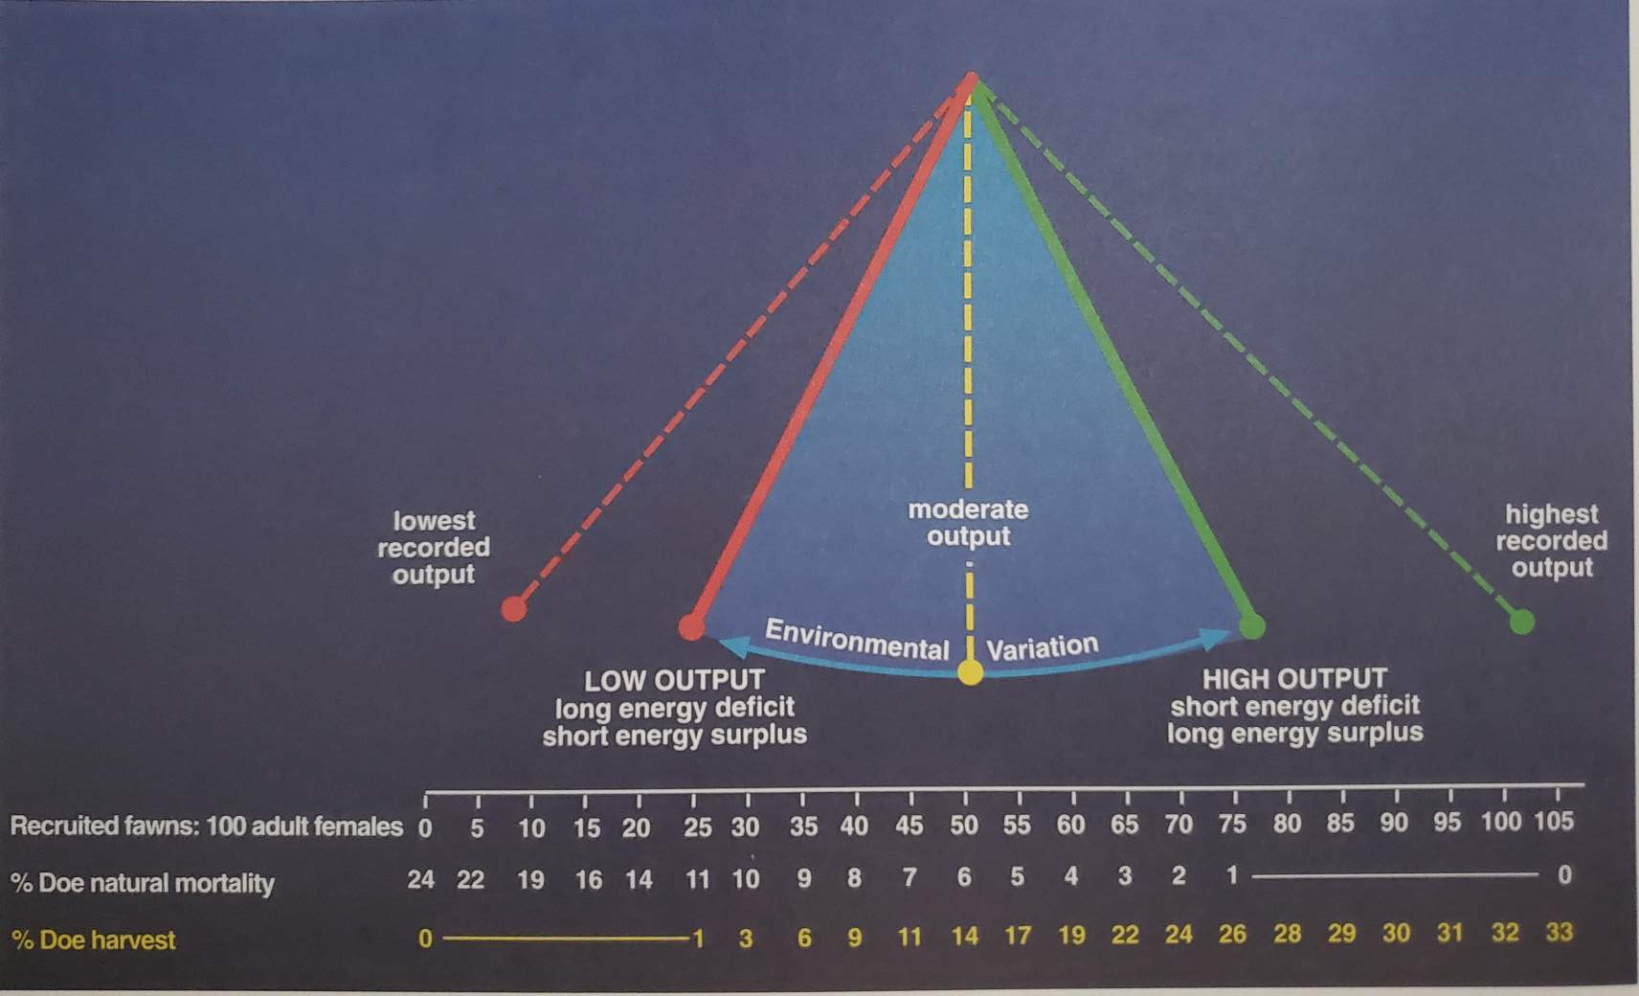
Variability in Population Characteristics Across Environments
Mountain Foothill Environment
Prairie Badlands Environment
Timbered Breaks Environment
(Mackie et al. 1998)

Slide 13
Objective: Maintain the total number of mule deer observed on trend areas within 20% above to 30% below long-term average.
Objective: Maintain the population within 25% of the long-term average.
Objective: Maintain the total number of mule deer observed on trend areas within 30% of the long-term average.

Slide 14
Components of Adaptive Harvest Management
Population Objectives
Monitoring Program
Hunting Regulation Alternatives
Must be measurable via a strong monitoring program
When significant change in population status is detected, alternative hunting regulation may be triggered

Slide 15
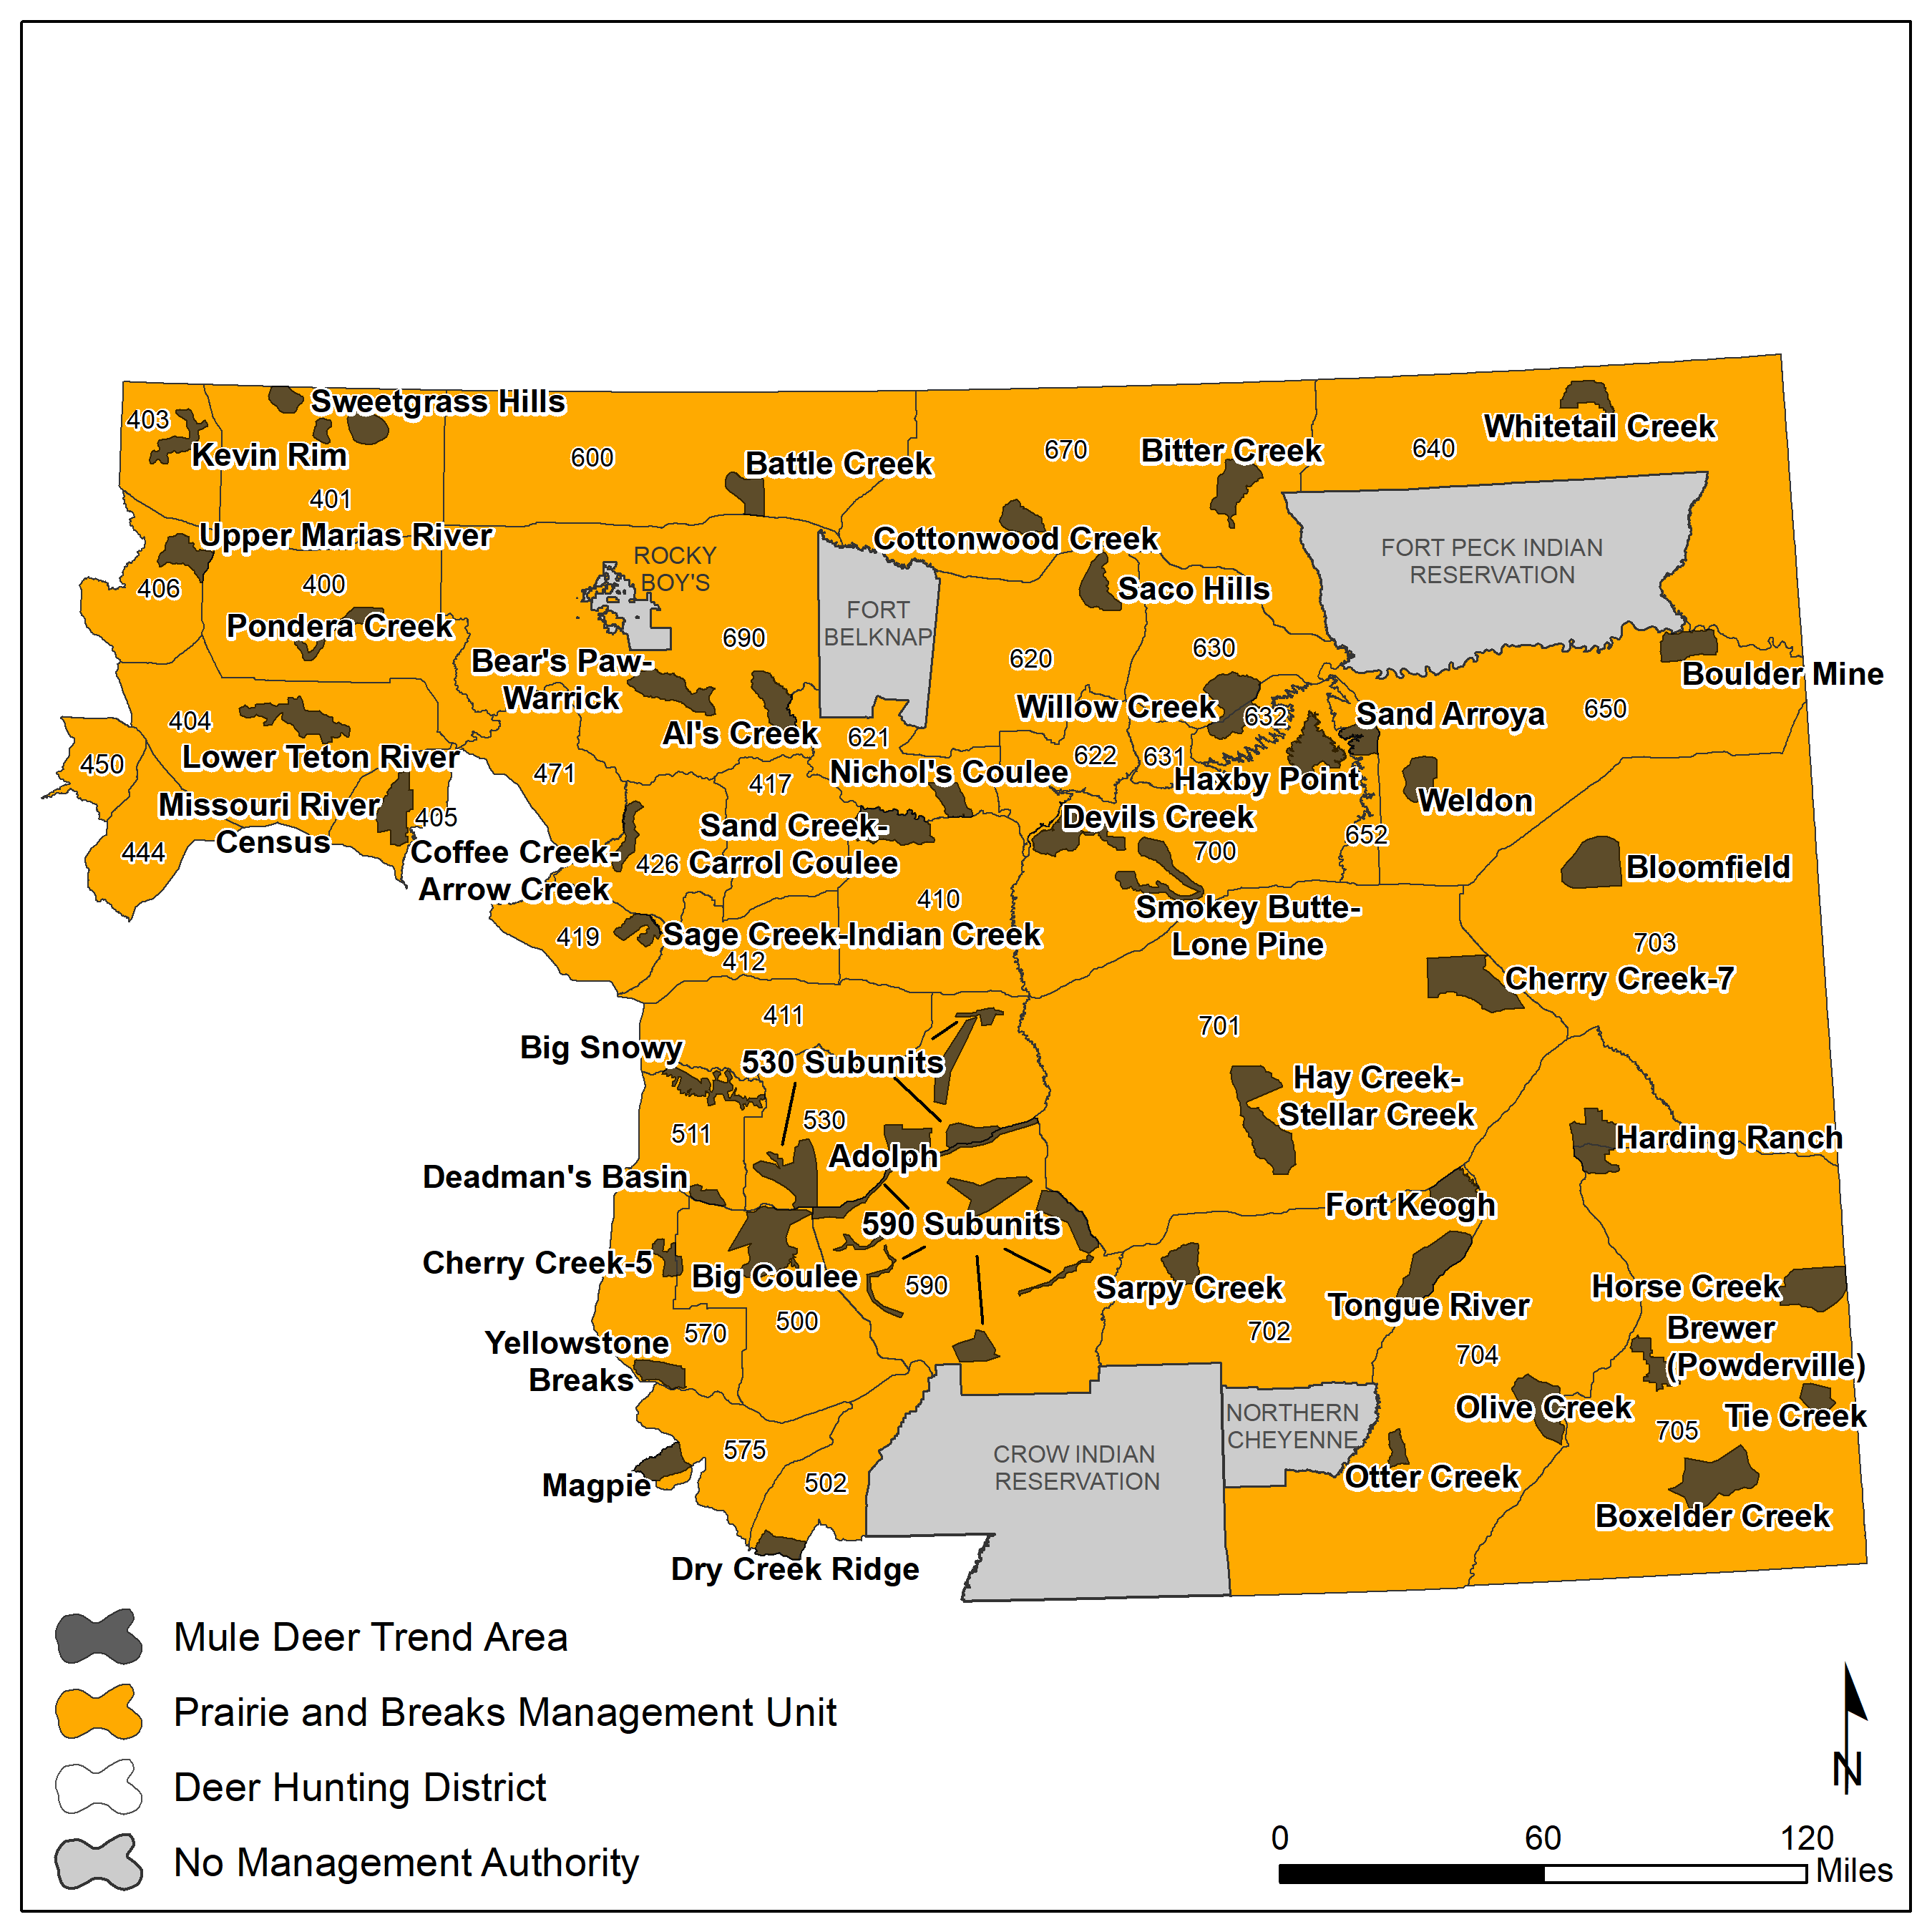
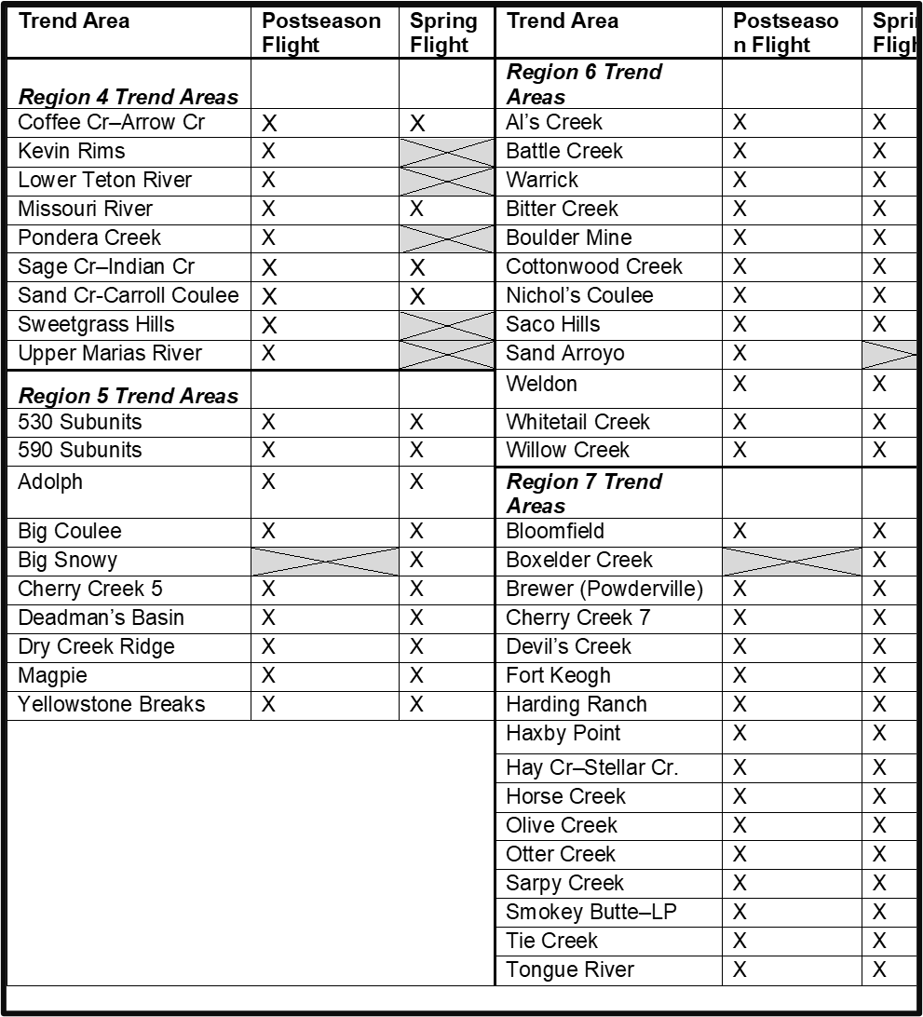
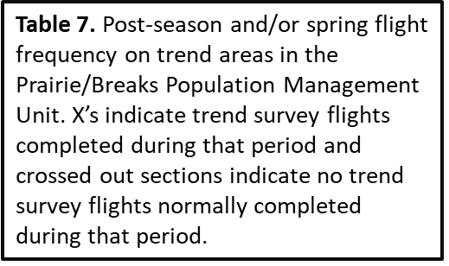
Trend Area Surveys
Post Hunting Season
Buck:Doe:Fawn Ratio
Total Count
Spring
Fawn:Adult Ratio
Total Count
= Recruitment &
Population Trend
Notes:
HDs that are not surveyed may be grouped with the nearest HD, occupying a similar representative environment that has a trend area

Slide 16
Areas Where Surveys are Unfeasible… Buck Harvest Rates
Deer demographic trends on some trend areas are less reliable indices of population size
Aerial surveys are unfeasible due to habitat type (e.g., dense forests)
Total counts on trend areas vary widely because of factors unrelated to population size
example: migratory mule deer that may or may not be on the trend area at the time of survey
Buck harvest (on general deer license) can be a reliable indicator of overall population trend (correlated to recruitment)
Buck harvest may be used in conjunction with trend survey data to recommend hunting regulations

Slide 17
Components of Adaptive Harvest Management
Population Objectives
Monitoring Program
Hunting Regulation Alternatives
Must be measurable via a strong monitoring program
When significant change in population status is detected, alternative hunting regulation may be triggered

Slide 18
Hunting Season Regulation Packages
Each regulation includes a description of:
General rifle season/Archery only season descriptions and antlerless B license availability
A specific hunting season type may be considered liberal (↑ antlerless harvest), restrictive (↓ antlerless harvest) or standard. Attributed to different:
Mule deer population characteristics and performance
Environments
Security provided by the terrain and vegetation
Land designations (public/private land, adjacent preserves, wilderness, etc.)
Access
Most HDs have regulations designed to provide maximum hunting opportunity and harvest of mule deer (e.g., five-week general rifle season) consistent with the long-term welfare of the mule deer resource
**The Commission has full authority under MCA 87-1-301 to determine final hunting regulations established each year

Slide 19
Components of Adaptive Harvest Management
Population Objectives
Monitoring Program
Hunting Regulation Alternatives
Must be measurable via a strong monitoring program
When significant change in population status is detected, alternative hunting regulation may be triggered

Slide 20
AHM Diagram
- %
Long-Term Average
+ %
Population Objective Range
Notes:
Both trigger 1 AND trigger 2 must be met to move between packages. There are two alternative methods for measuring total number of deer; trend survey total counts and buck harvest on general license

Slide 21
AHM Diagram
- %
Long-Term Average
+ %
Population Objective Range
Standard Regulation Package
Notes:
Both trigger 1 AND trigger 2 must be met to move between packages. There are two alternative methods for measuring total number of deer; trend survey total counts and buck harvest on general license

Slide 22
AHM Diagram
- %
- %
Long-Term Average
+ %
Below Population Objective Range
Population Objective Range
Standard Regulation Package
Notes:
Both trigger 1 AND trigger 2 must be met to move between packages. There are two alternative methods for measuring total number of deer; trend survey total counts and buck harvest on general license

Slide 23
AHM Diagram
- %
- %
Long-Term Average
+ %
Below Population Objective Range
Population Objective Range
Restrictive Regulation Package
Standard Regulation Package
Notes:
Both trigger 1 AND trigger 2 must be met to move between packages. There are two alternative methods for measuring total number of deer; trend survey total counts and buck harvest on general license

Slide 24
AHM Diagram
- %
- %
Long-Term Average
+ %
+ %
Below Population Objective Range
Above Population Objective Range
Population Objective Range
Restrictive Regulation Package
Liberal Regulation Package
Standard Regulation Package
Notes:
Both trigger 1 AND trigger 2 must be met to move between packages. There are two alternative methods for measuring total number of deer; trend survey total counts and buck harvest on general license

Slide 25
AHM Diagram
- %
- %
Long-Term Average
+ %
+ %
Below Population Objective Range
Above Population Objective Range
Population Objective Range
Triggers
Triggers
Restrictive Regulation Package
Recruitment
Liberal Regulation Package
Recruitment
Standard Regulation Package
&
&
Total # Deer
Total # Deer
Notes:
Both trigger 1 AND trigger 2 must be met to move between packages. There are two alternative methods for measuring total number of deer; trend survey total counts and buck harvest on general license

Slide 26
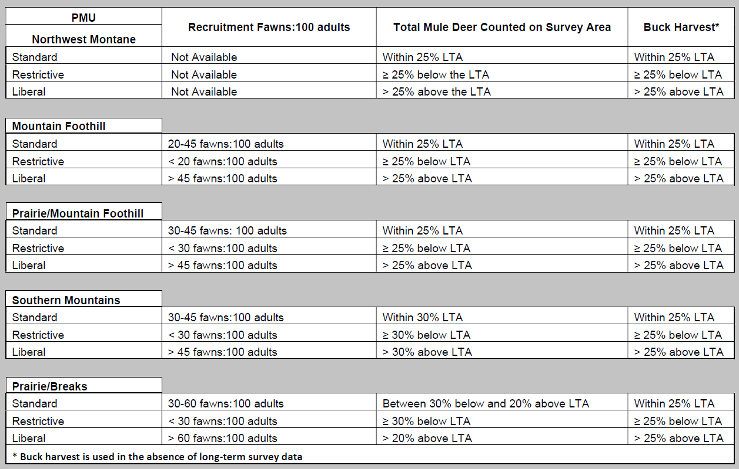

Slide 27
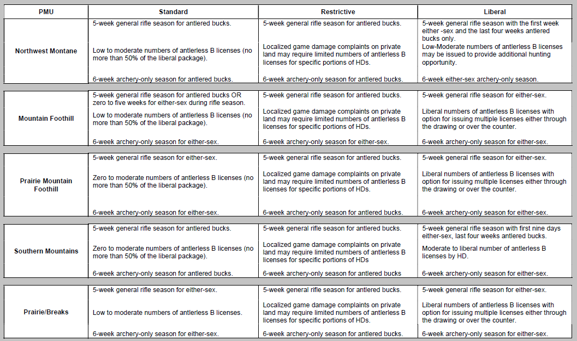

Slide 28
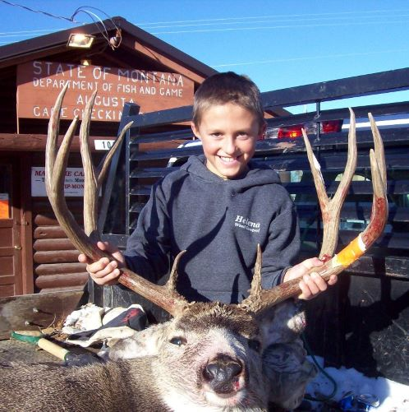
Buck Management: Special Management Districts (SMDs)
GOAL: Provide hunting opportunity for older aged bucks in a limited number of districts offering reasonable public access
Notes:
FWP is concerned that increasing the number of HDs with unlimited or limited permits may cause increased pressure in HDs with any antlered buck regulations thus decreasing buck:doe ratios in those HDs

Slide 29
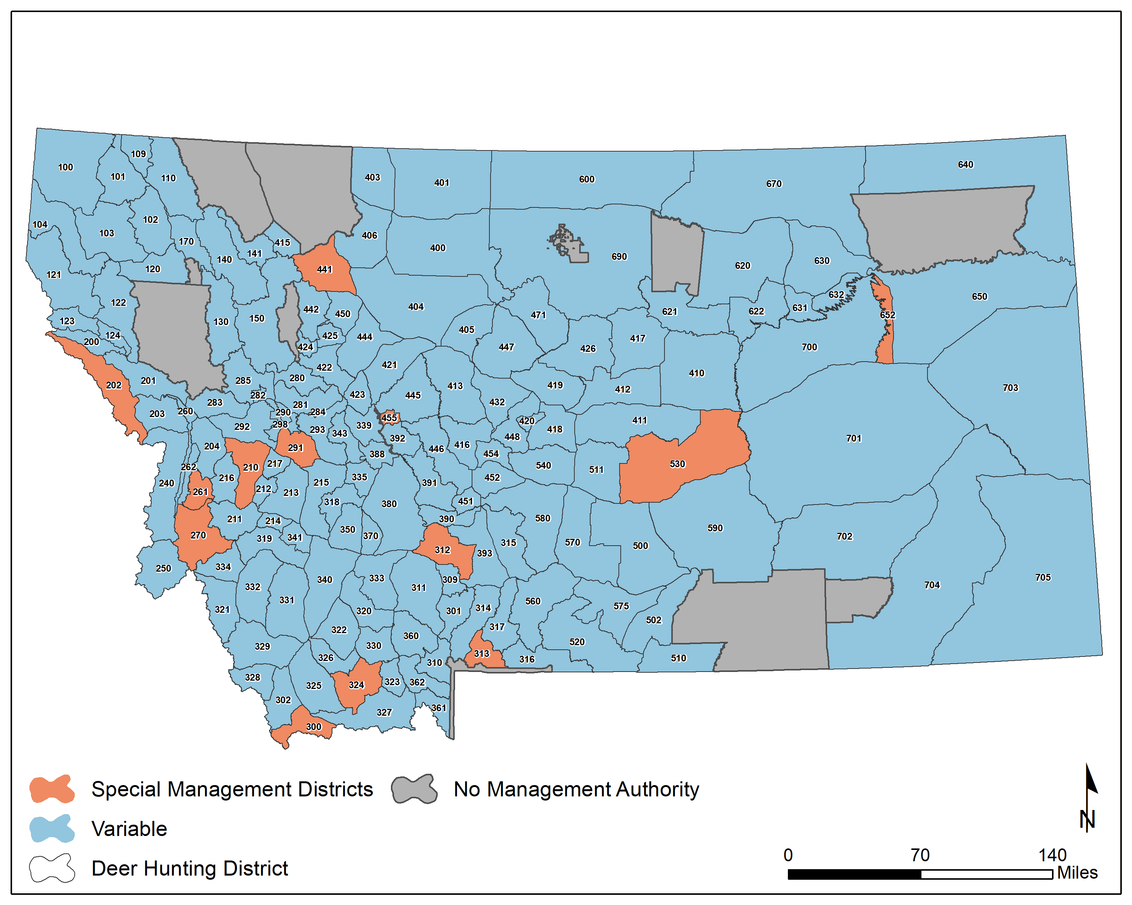
13 SMDs with regulations designed to diversify and increase buck age structure by restricting buck harvest
12 have a limited buck permit regulation
1 has a short 3-week season
All have been SMDs for over 20 years

Slide 30
Hunter Preference for Older Age Buck Hunting Opportunity
Four statewide deer hunter preference surveys completed over the last 30+ years (MT FWP 1988, 1995, 2011, 2023).
A few general similarities between survey results:
Majority satisfaction in general statewide deer management
Majority of respondents support less restrictive hunting seasons (e.g., general buck hunting season opportunity vs. limited buck hunting)
Enjoyment of nature and the outdoors, obtaining venison for meat, doing something with the family, and other reasons consistently outranked ‘trophy’ hunting as reasons for deer hunting
Important to note that these surveys are used more as a tool to gauge the range and level of hunter (hunting) preference types over time and not a ‘vote’ for one issue or opportunity over another.
Citations:
Montana Fish, Wildlife & Parks 1988 Lewis et al. Montana Fish, Wildlife & Parks 2011
Montana Fish, Wildlife & Parks 1995 Lewis et al. Montana Fish, Wildlife & Parks 2023

Slide 31
Special Management District Selection Criteria (Abbreviated)
SMDs should be in a portion of the state where hunting opportunity for bucks and buck age diversity is low while not significantly impacting overall opportunity for the greater area.
The total number of SMD’s should be limited because of impacts from restrictions on hunting opportunity and the statewide impact of the resulting redistribution of hunters.
Hunter interest in managing for older bucks in the area should be significant to support the restriction.
SMD locations should be accessible to reasonable public hunting opportunity.
The area should not have a naturally high buck:doe ratio because of limited access.
SMDs (existing or proposed new) must consider the impact of a hunting season structure related to CWD management.

Slide 32
Buck Management: Special Management Districts (SMDs)
GOAL: Provide hunting opportunity for older aged bucks in a limited number of districts offering reasonable public access
*Special management districts are not the same as HDs where the buck regulation has changed to limited or unlimited buck permits due to other deer management/demographic and/or human social interests (improve buck:doe ratios, controlling hunter numbers, CWD, etc.).
Notes:
FWP is concerned that increasing the number of HDs with unlimited or limited permits may cause increased pressure in HDs with any antlered buck regulations thus decreasing buck:doe ratios in those HDs

Slide 33
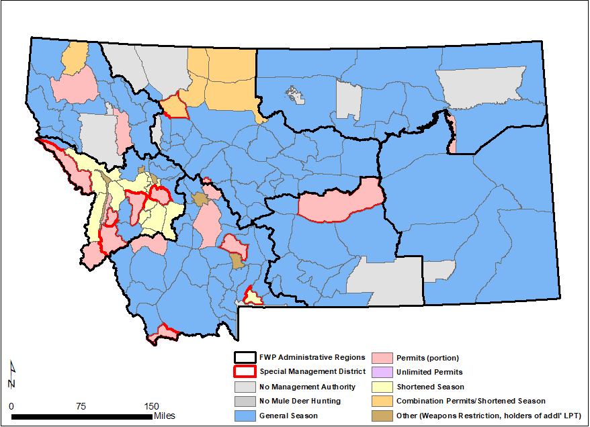
2022 Mule Deer Seasons
71% general season, 29% with hunting season restrictions, 8% Special Management Districts (SMDs)
Season Type | Number of HDs
General Season | 97
Limited Permits | 17 (9 SMDs)
Unlimited Permits | 0
Shortened Season | 10 (1 SMD)
Combo (shortened season & permits) | 7 (1 SMD)
Weapons Restriction | 4
Total | 136 (11 SMDs)
Notes:
In 2022, MT under went a “regulations simplification” process in which several hunting districts were combined, license/permit types were removed, and an overall effort to add consistency across the state occurred. This resulted in a reduction of 26 hunting districts to 136, but the ratio of districts maximizing “opportunity” to districts with some sort of restriction remained the same, with the same percentage of those being considered SMDs.
During the 2022 season, MT offered 98 general season HDs, 17 limited permit HDs, 11 districts with a shortened season, 6 with a combination shortened season/permit, and 4 weapons-restricted areas. We did away with limited permits and most of those districts became limited (with higher quotas).

Slide 34
Chronic Wasting Disease & Mule Deer Management
Chronic Wasting Disease (CWD) is a fatal neurologic disease of elk, deer, moose, and caribou for which there is no known cure
October 2017- CWD was first detected in free-ranging deer in Montana
In Montana, (2017‒2022) adult male mule deer had 3.7 times the risk of infection as adult females² (other research consistent or similar to this risk factor¹)
Targeting males may thus be an efficient way to reduce overall transmission and prevelance³
Citations
¹ Miller and Conner 2005, Heisey et al. 2010, DeVivo 2015, Samuel and Storm 2016
² Montana Fish, Wildlife & Parks 2022
³ Jennelle et al. 2014, Potapov et al. 2016, WAFWA 2017

Slide 35
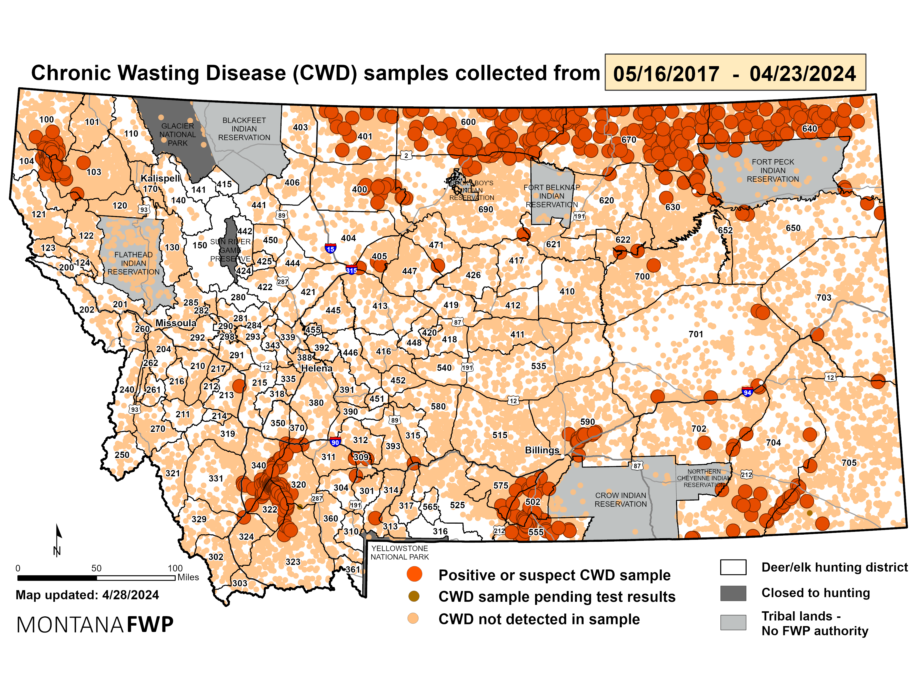
Chronic Wasting Disease & Mule Deer Management
Chronic Wasting Disease (CWD) is a fatal neurologic disease of elk, deer, moose, and caribou for which there is no known cure
October 2017- CWD was first detected in free-ranging deer in Montana
In Montana, (2017‒2022) adult male mule deer had 3.7 times the risk of infection as adult females² (other research consistent or similar to this risk factor¹)
Targeting males may thus be an efficient way to reduce overall transmission and prevelance³
Citations
¹ Miller and Conner 2005, Heisey et al. 2010, DeVivo 2015, Samuel and Storm 2016
² Montana Fish, Wildlife & Parks 2022
³ Jennelle et al. 2014, Potapov et al. 2016, WAFWA 2017

Slide 36
CWD Management Tools and Evidence for Their Efficacy
Once CWD is present in a wild population, it is extremely difficult, if not impossible, to eliminate
There are currently no effective treatments or vaccines for CWD
Preventative tools include:
Restricting the transport of carcasses from CWD-infected areas or states
Banning the transport or translocation of wild cervids
Requiring the responsible disposal (e.g. incineration or disposal in certified landfills) of carcasses from infected regions
Restrict the baiting and feeding of wild cervids
Regulate the use of cervid lures
Management Tools:
Increasing harvest of antlered deer to include post rut hunting options
Hot spot culling/targeted removal in focused areas around CWD detections
Reducing cervid aggregations
Decreasing overall deer densities
Other alternatives showing potential for decreasing CWD prevalence and/or spread
Officially recommended as CWD management tools by WAFWA (2017)

Slide 37
Management of CWD in the Context of AHM
The Montana Chronic Wasting Disease Management Plan will serve as the guiding principles and strategies in management of CWD
Regardless of prevalence, any detection of CWD needs to be addressed through active management (e.g., increased antlered buck harvest, hot spot culling, reduce aggregations, etc. – WAFWA recommended CWD management tools)
CWD management generally exceeds AHM management and the goal of CWD management is reduce the potential for negative population level effects, i.e. reduce potential for increased distribution of the disease and increased prevalence.
Mule deer population size and demographic triggers within PMU’s will continue to guide mule deer management (e.g., hunting regulation packages and/or SMDs) in CWD positive areas, however:
Managing for CWD, short- and long-term, may differ or even conflict with AHM prescriptions
Liberalizing permit levels and/or complete removal of an areas special buck management status will be considered

Slide 38
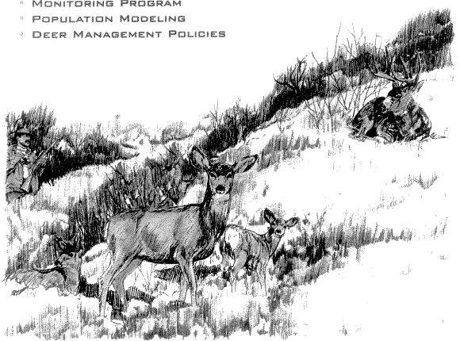
Summary
Mule Deer Adaptive Harvest Management:
Population Objectives
Hunting Regulation Strategies
Special Management Districts
Monitoring Program
Chronic Wasting Disease Management
Questions?
Brent Lonner
MT FWP Area Wildlife Biologist – Fairfield
BLonner@mt.gov
406-467-2488 (O) / 406-590-1637 (C)

Slide 39


